Slide 1
Hawai`i Physician Workforce Assessment 2021
Kelley Withy
withy@Hawaii.edu

Slide 2
Hawaii Physician Workforce 2021
There are 11,325 licensed physicians in Hawaii (1,051 DO, 10,274 MD).
Current supply of practicing physicians is 3,519 for 2,982 Full Time Equivalents. Increase of 115 from 2021.
Significantly more LOCUMS, telehealth and movement.
At least 59 retired, 7 passed away, 84 moved away, 212 decreased work time, 90 increased time, 39 reopened practice, over 200 new docs
Notes:
216 new

Slide 3
Physician Workforce Trends

Slide 4
Workforce Demographics
Average age 53.3 (compared to 53.2 US average)
21% of our docs are already 65!
Women make up 40% of the workforce (up from 38% last year)
48% Asian, 36% White, 1.4% AA, 6%NH, 2.5% PI, 2.3% Hispanic alone
Notes:
Age for 95%
Ethnicity for 65%

Slide 5
Greatest Subspecialty Shortages
Percent Shortage | Specialty
74% | Child Pulmonology
69% | Child Endocrinology
69% | Child Gastroenterology
65% | Adult Pulmonology
62% | Adult Psychiatry
61% | Colorectal Surgery
61% | Child Psychiatry
53% | Allergy & Immunology
50% | Adult Endocrinology

Slide 6
Shortages by County
 | Honolulu County | Maui County | Hawai’i County | Kauai County | Statewide
Shortage | 564 | 174 | 217 | 61 | 1016
Percent | 21% | 41% | 43% | 33% | 22%
Notes:
Honolulu County
Maui
County
Hawai’i
County
Kauai County
Statewide
Shortage
344
158
187
43
732
Percent
15%
40%
40%
26%
22%
Honolulu County
Maui
County
Hawai’i
County
Kauai County
Statewide
Shortage
115
32
16
1
163
Percent
15%
27%
11%
1%
15%

Slide 7
Primary Care Shortage by County
 | Honolulu County | Maui County | Hawai’i County | Kauai County | Statewide
Shortage | 114 | 46 | 37 | 11 | 208
Percent | 15% | 37% | 25% | 10% | 19%
Notes:
Honolulu County
Maui
County
Hawai’i
County
Kauai County
Statewide
Shortage
115
32
16
1
163
Percent
15%
27%
11%
1%
15%

Slide 8
Let’s make the changes that we want to see in Hawaiʻi!!
withy@Hawaii.edu

Slide 9
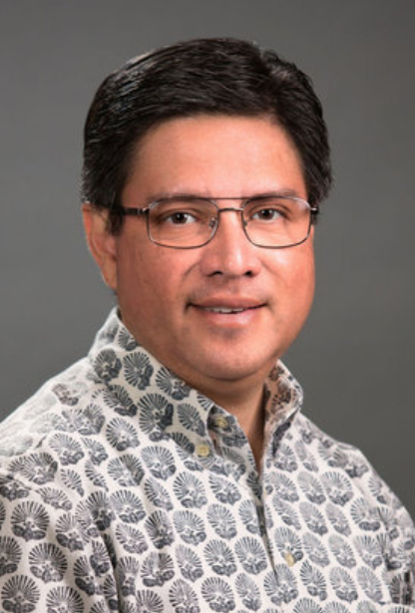

Slide 10
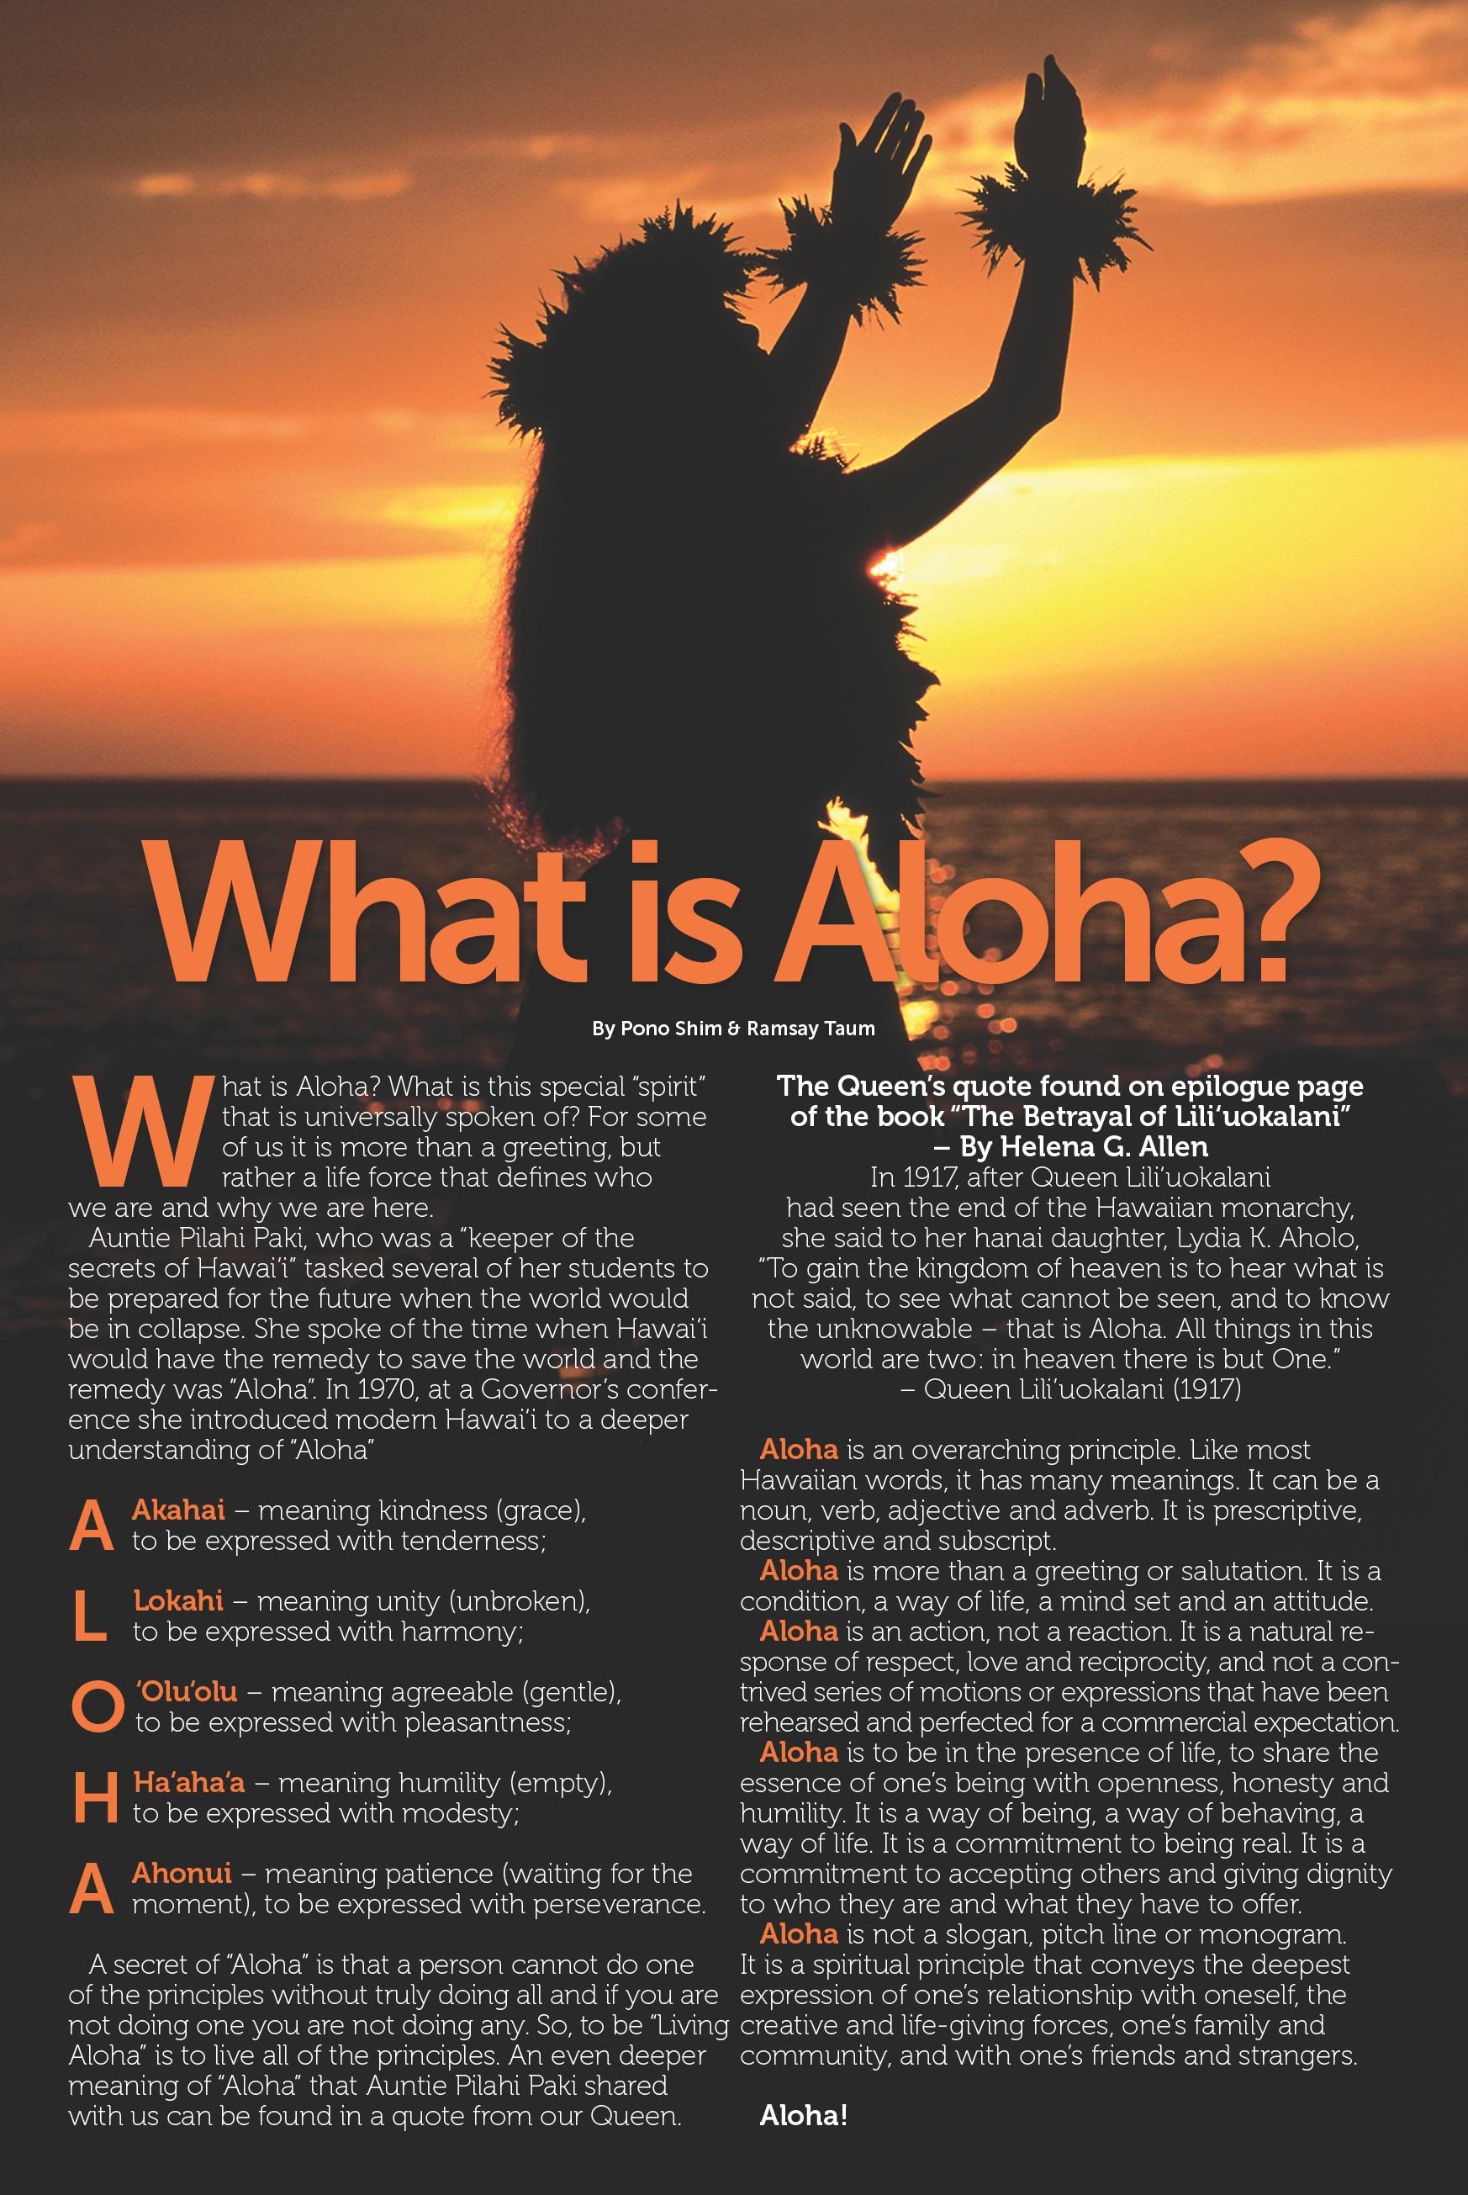

Slide 12
I am going to show minutes 4-7 of this video: https://www.youtube.com/watch?v=YG7AaKSFwDc

