Slide 1
Making Shared Decision-Making Work
Sept. 24 2022

Slide 2
Carl Barton
Principal and Founder of Derigo Health
Executive Healthcare Consultant
Moderator for this panel discussion

Slide 3
The reciprocal benefits moving the patient back to the center has on patient outcomes and provider satisfaction
Introduction
Objectives
Panelists and Collaborators
Care Team and Care Model
Case Studies
Panel Discussion
Analysis

Slide 4
Objectives
Identify steps to enhance your team-based approach to preventive and chronic care
Describe the components of self-measured blood pressure program
Evaluate the resource-effectiveness of including a clinical pharmacist and health coach coordinator in your physician-led care team
Understand how patients:
Increased awareness and health literacy
Became empowered to prioritize their health
Engaged in shared decision-making
Benefited from self-measuring and care team
Reflect on feedback shared by patients

Slide 5
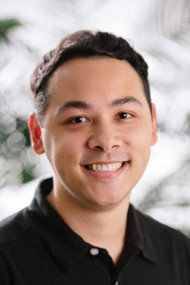
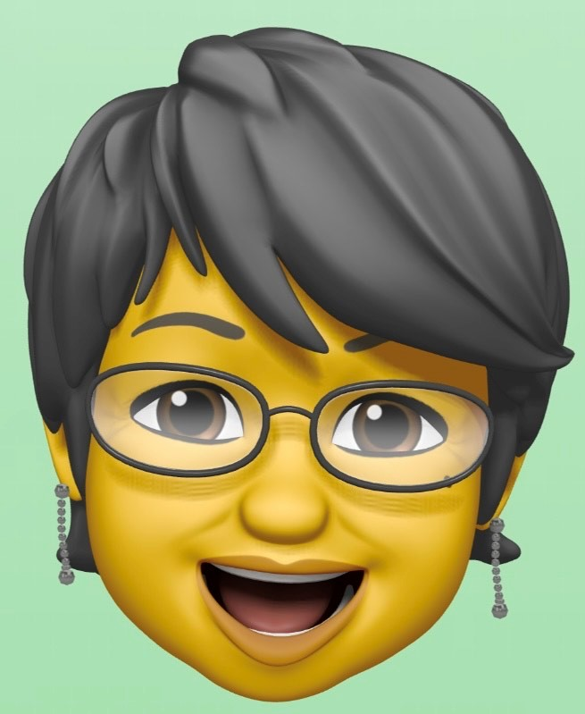
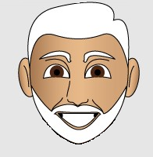
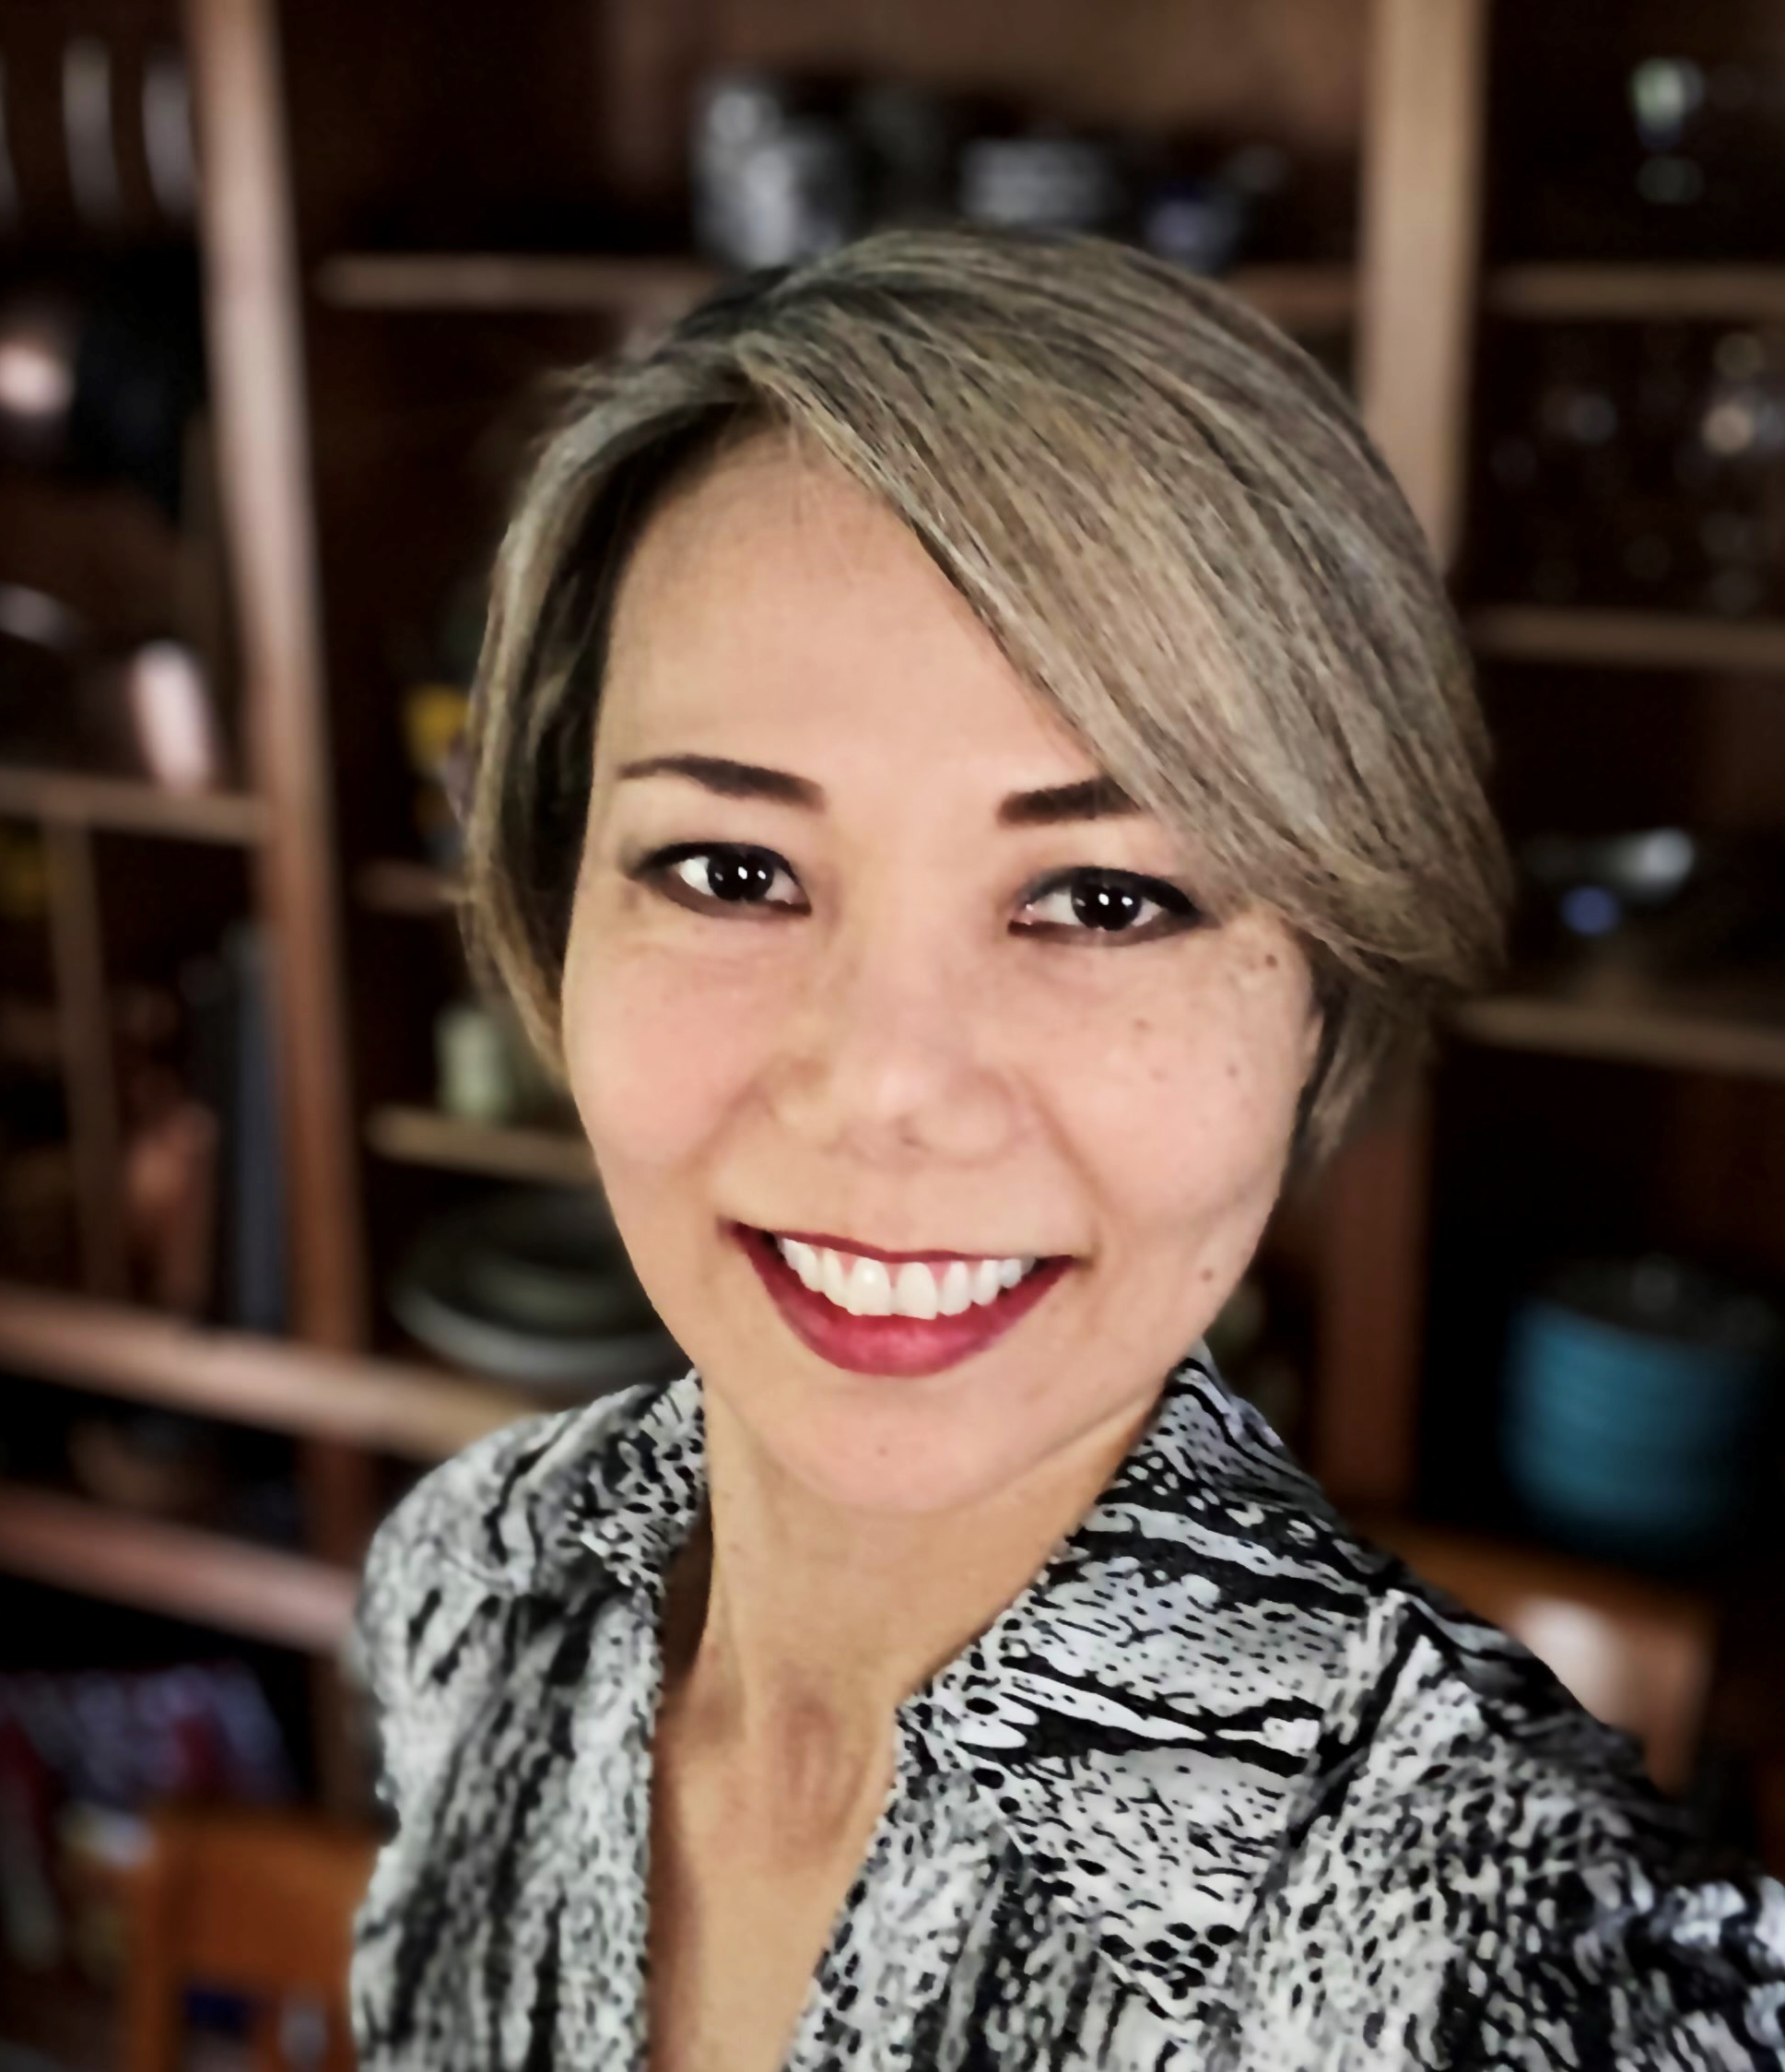
Jarred Prudencio, Pharm.D.,
BCACP, BC-ADM
Chief of Experiential Education
Pharmacy Practice
Experiential
Chief of Experiential Education, Associate Professor
Blair Grant, RN, MSN,
FNP-BC, APRN-Rx
Clinical Transformation Consultant
JoAnn Marabella
Healthcare Transformation Consultant
ACE Certified Health Coach
Behavior Change Specialist
Senior Fitness Specialist
Gina
John

Slide 6
State of Hawaiʻi
Department of Health
Chronic Disease Prevention
&
Health Promotion Division (CDPHPD)

Slide 7
Care Team
Primary Care Physician • Health Coach Coordinator (HCC) • Clinical Pharmacist(s)
Care Model
Physician-led • HCC directed
External team • integrated care • telephonic care • patient centered • EHR access
Chronic disease management
Care team autonomy
Collaborative Practice Agreement with Clinical Pharmacist
Remotely reported Self-Measured blood pressure (SMBP)
Notes:
Deleted slide 8 and contents below become talking points
Evidence-basis
Patient Population
Patient Feedback Survey
Analysis
Presentation & appendix has subset of analysis
Upcoming whitepaper includes additional analysis

Slide 8
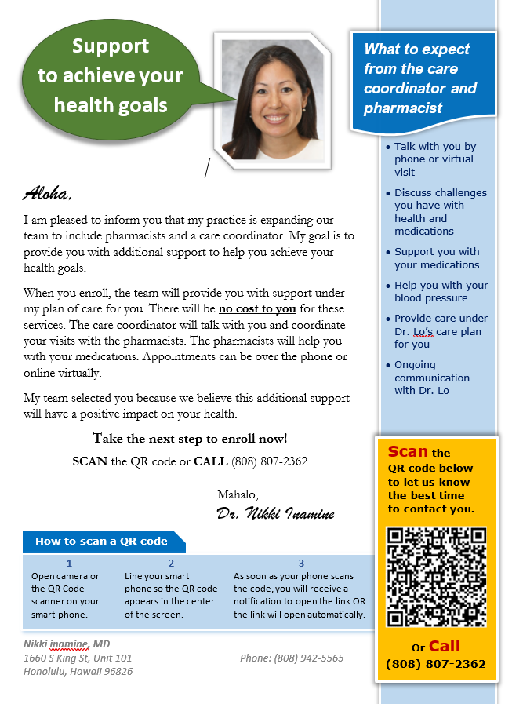
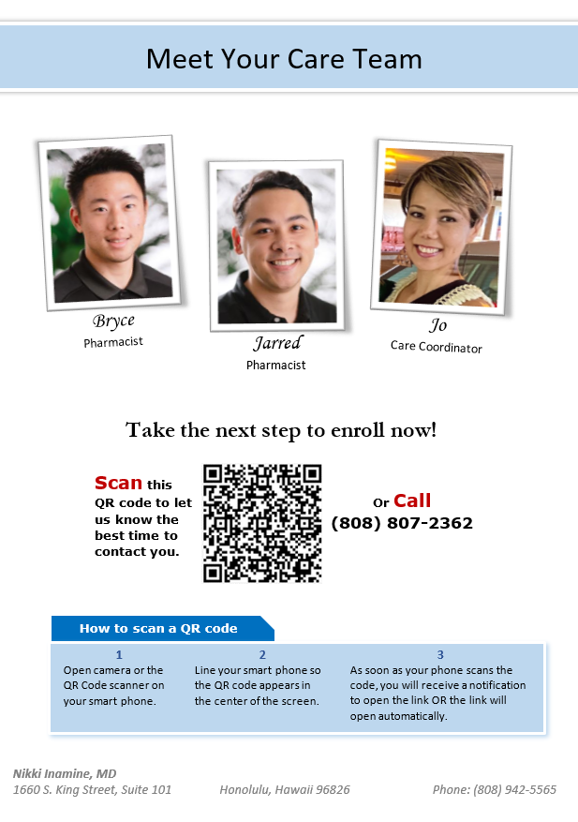
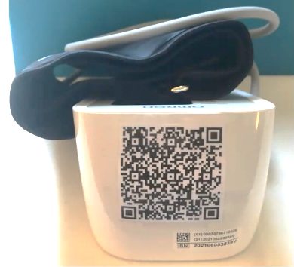
Patient Outreach & Enrollment
Nikki Inamine, MD
1660 S King St, Unit 101
Honolulu, Hawaii 96826
John Doe
2333 Kapiolani Blvd.
Honolulu, Hawaii 96826
Notes:
List and physician control
Accurate Blood Pressure Reading:
Training and education materials
2 readings one minute apart
Report time of day
Transmitted to Health Coach Coordinator
Omron 3 Series BP 7100 (https://www.validatebp.org/)
Patient Dashboards
Graphical displays
2 weeks of daily averages with time of day and med adherence
21 days of 7-day averages
Office BPs – baseline and most recent
Patient Panel Dashboard
PHYSICIAN
Leads the Care Team
Selects/refers patients
Letter comes from the physician
Pre-authorizes and/or approves medication changes
JO ENROLLS
Endowment effect
Best practice-based methodology
Scripts
Established workflows
Training

Slide 9
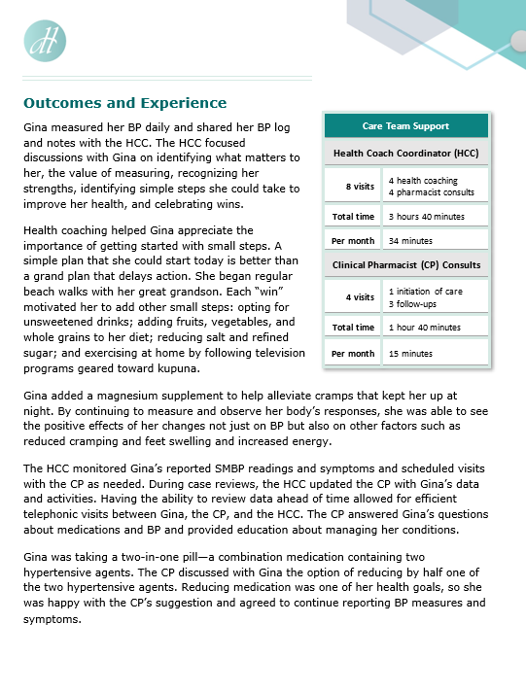
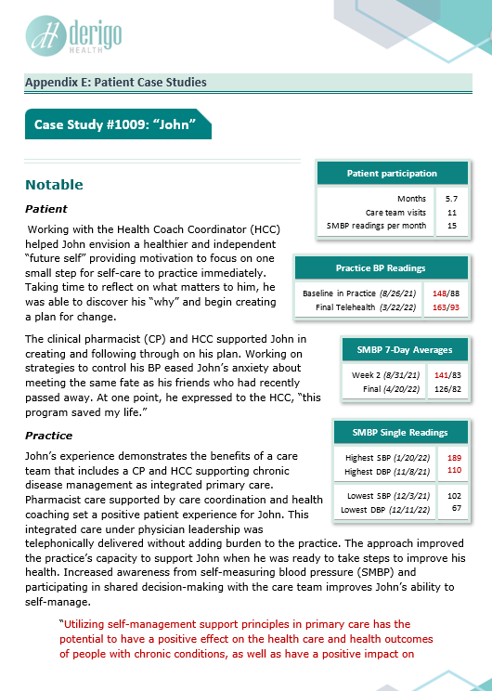
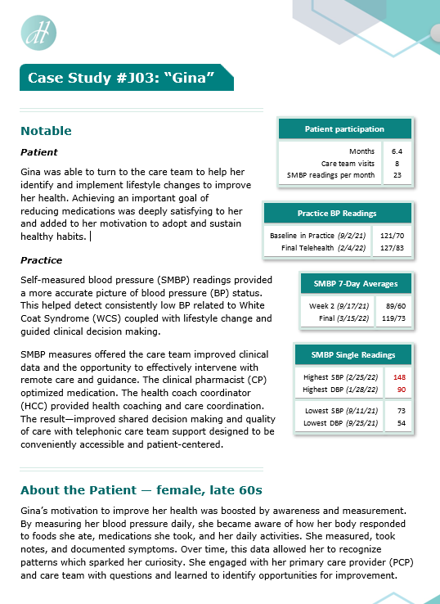
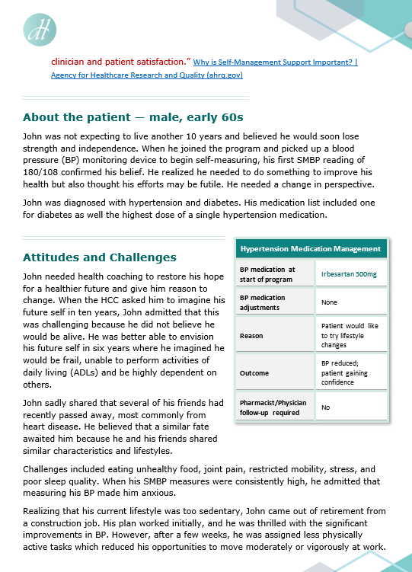
Case Studies
John and Gina
NOTE: additional available
and included in upcoming whitepaper
e-mail
carl.barton@derigohealth.com
to receive case studies and whitepaper
Notes:
**TRANSITION SLIDE***
Working at the top of their licensee- how was this team with the HHC allowing them to be able to do this?
When a CP + provider work together it allows each clinician to work at the top of their license, CP are not providers and providers are not CP they each have their expertise which when combined can make will create a best outcome for a patient that is on any type of medication.
Most patients have never spoken to a clinical pharmacist before- what has been Jared experience with working with a patient, how does he make them feel comfortable, how does he introduce himself.
How does he best collaborate with a provider while integrating in the patient experience to create a shared decision making model.

Slide 10
Panel Discussion

Slide 11
Jo’s Health Coaching with Gina & John
listening
with curiosity and empathy
identifying
what matters, challenges & strengths
facilitating
creation of SMART goals
Addressing Challenges & Celebrating Wins!
together
Notes:
HHC how has Jo's training as a HC positioned her to be the best fit for this role?
Behavior change – Motivational interviewing, strength based coaching, active listening, SMART goal with follow up and accountability/support
Providers have the skill set to do this type of work but often can not due to the constraints of time, behavior change is more effective when we can understand a patient better- one of the reasons of burn out is just lack of time to make effective change
HCC provides necessary information to the provider to the provider about the patient which then enables shared decision making without the provider having to spend a significant amount of time gather all this information
Where there any barriers to being able to have the patient open up and share to Jo?
Remote vs. Inperson
Accountability and make pt feel like they are being heard (often not enough time in an office visit for the provider to ask open ended questions, and for the patient to fully express themselves)
**Questions that Jo will organically ask Gina and John

Slide 12
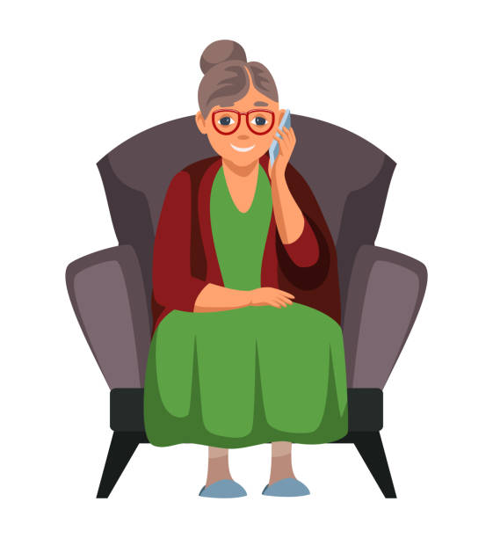
Patient Feedback • accountability
This program helps to hold you accountable for your health/life.
Knowing that I would be discussing the BP readings held me accountable. Otherwise, I probably would not have taken the readings as often as I did.
Notes:
Affect real change, sustainable change
Improved health of the patient population
Accountable meaning feeling like they matter and are apart of the decision instead of feeling like they are going to be "scolded"
Patients will even cancel appts because they know they haven't been doing well or following what the care plan was told to them and are afraid of what the provider might say or think of them

Slide 13
Shared Decision Making John & Gina’s journey and outcomes
curiosity
adopt healthy habits
engagement
accountability
health literacy
permission to prioritize needs & health
Notes:
What current practices due to enact behavior change vs what a small care team can do to enable behavior change
Patient is put back into the center of care, provided with the resources needed to be able to be apart of the shared decision making team- the patient is an equal team member.
When a provider can come into an office visit with a patient that is committed to their healthcare (they want to and are prioritizing themselves), a patient who is willing a curious about improving their health, it makes it a more pleasurable experience instead of a lecturing at the patient the provider is able to have an engaging conversation where a shared decision can be made as a team (HHC + Provider + PT + CP) to affect real changes
Takes the burden off of the provider- eliminates decision making fatigue
More engaged patients who care about their health come to see a provider because they "want to" compared to they "have to" dialogue shift
John/Gina- did they feel as thought they were apart of the team that was making decisions about their care plan/health plan?

Slide 14
Patient Months of Participation with SMBP and physician-led care team
Project Details
39 patients
2 practices
4 PCPs
2 EHRs
Elation
Queens Epic
25th Percentile
Median
75th Percentile

Slide 15
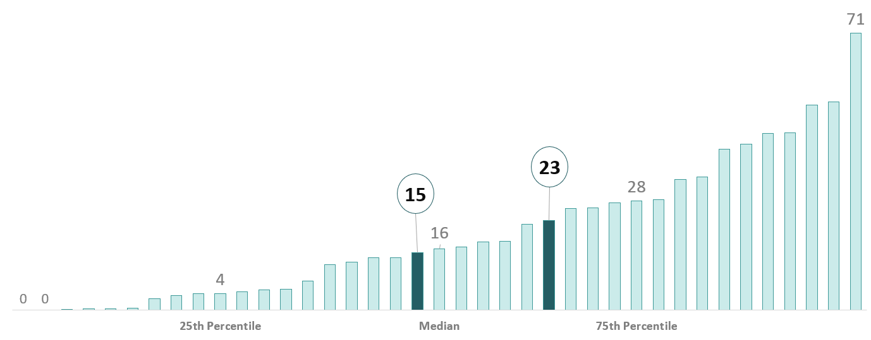
SMBP Readings per Month submitted remotely by patients
Self-Measured Blood Pressure
Engaged patients in self-care and drove accountability
Monitored by Health Coach Coordinator
Supported Health Coaching
Supported clinical decision making by Clinical Pharmacist
25th Percentile
Median
75th Percentile

Slide 16
Visits per Month with Jo
health coaching & care coordination
Health Coach Coordinator
Joined all Clinical Pharmacist (CP) Consults with patient which are reflected in these visits
Scheduled all visits with patients
Gathered information for CP
Had case reviews with CP before consults
25th Percentile
Median
75th Percentile

Slide 17
Visits per Month with Jarred
Clinical Pharmacist MTM and CMM
Clinical Pharmacist
Provided direct care
Medication Therapy Management (MTM)
Comprehensive Medication Management (CMM)
All visits included Health Coach Coordinator
25th Percentile
Median
75th Percentile

Slide 18
Clinical
Pharmacist
Medication Therapy Management
Comprehensive Medication Management
Notes:
**TRANSITION SLIDE***
Working at the top of their licensee- how was this team with the HHC allowing them to be able to do this?
When a CP + provider work together it allows each clinician to work at the top of their license, CP are not providers and providers are not CP they each have their expertise which when combined can make will create a best outcome for a patient that is on any type of medication.
Most patients have never spoken to a clinical pharmacist before- what has been Jared experience with working with a patient, how does he make them feel comfortable, how does he introduce himself.
How does he best collaborate with a provider while integrating in the patient experience to create a shared decision making model.

Slide 19
Dr. Inamine’s Feedback
Pharmacist MTM/CMM • Collaborative Practice Agreement (CPA)
The pharmacists were able to work with autonomy under the scope of practice defined in a Collaborative Practice Agreement (CPA), sending prescriptions to the pharmacy directly from the EHR and documenting in an EHR note that was routed to me.
Notes:
- shared decision making
Timely medication changes = improved patient compliance with medications
CP- speaks on how the CPA allows for a smoother flow of patient care
CP- speaks to importance of HER documentation

Slide 20
Patient Feedback • medication change
This experience was very useful for me, and I was able to decrease the amount of medication I was on before I started this program. I am more aware of what I can do for myself as far as taking control of my health.
Notes:
CP takes what the HC has done and put a clinical perspective on it, time focused on medication needs
What are the CP goals that they have when working with a patient.
What is the biggest gap that they see when working with patients and how does the CP role help to close that gap?
Timeliness of making medication changes compared to current model? Able to free up the provider from having to have an appt with the patient to just make a medication change
CP able to support with the medication decision and more frequent calls to the office about medication side effects, understanding how to submit for prior authorization, etc all areas that can take up a lot of the providers time is now more supported by the CP

Slide 21
Dr. Inamine’s Feedback
pharmacist recommendations • expanding CPA scope
When the medication changes were outside of the scope of the CPA, pharmacists made recommendations for medication changes in the EHR note. It was easy for me to see and act upon the recommendations.
I see the benefits of increasing the scope of the CPA, so the pharmacists have more autonomy to manage chronic disease under my leadership.
Notes:
- shared decision making
Timely medication changes = improved patient compliance with medications
CP- speaks on how the CPA allows for a smoother flow of patient care
CP- speaks to importance of HER documentation

Slide 22
Visits per Month with Jarred
Clinical Pharmacist MTM and CMM
Clinical Pharmacist
Provided direct care
Medication Therapy Management (MTM)
Comprehensive Medication Management (CMM)
All visits included Health Coach Coordinator
25th Percentile
Median
75th Percentile

Slide 23
Hearing from Gina & John
your physician • your care team • shared decision making
Notes:
Carl ask: "If your doctor was sitting right here what would you tell them about this care team and approach under their leadership."
Scalable way to communicate to the patient panel that they are IMPORTANT, and there is a team that will be working with them. Minimal effort/time required of the provider
Adds creditability to a "cold call" and increases the enrollment rate when there are multiple modes of communication
Letter allows for the "appearance" of an integrated connected team (even though this is fully remote effort)- which is helpful in rural areas.
COVID has "normalized" telephonic/telemedicine care as the new standard of receiving health care, most patients are much more comfortable with receiving this type of care compared to pre-pandemic.
What was Jo's eperience with calling the patients and receptiveness/ response of pt when letter was sent compared to when letter was not sent (was a letter not sent with another office?)
John/Gina- how did they feel when they received the letter? Did it help/ encourage them to want to enroll?

Slide 24
Patient Feedback • adopt healthy habits
This experience taught me to be more aware of myself and my health, looking at my diet and increasing my exercise. Tried new methods in my diet and exercise to assist in improving my health and how to stay motivated!
Notes:
Can John relate this to his experience
Why does he feel that he was not able to do this prior?
Did john feel as though his provider was informed of his health wins?
Ability to put the patient back to the center of care, empowering them through a team approach.
Ability to effect real change- compared to previous experience?

Slide 25
Questions
for the panel

Slide 26
Dr. Inamine’s Feedback
physician-led care team • integrated care • EHR documentation
The clinical documentation in my practice’s EHR gave me confidence that the care team was delivering patient care consistent with my standard of care and adhering to my care plan for each patient.
The care coordinator and pharmacists had access to my practice’s Epic Electronic Health Record (EHR) which was essential.
Notes:
Provider satisfication, decrease burnout
- shared decision making
Timely medication changes = improved patient compliance with medications
CP- speaks on how the CPA allows for a smoother flow of patient care
CP/HCC- speaks to importance of EHR documentation

Slide 27
Questions about Learning Lessons considerations for adopting in a medical practice
SMBP medical policy
Technology
Health Coach Coordinator value
Patient demand and feedback
Optimal implementation and generalizability
Resource effectiveness
Clinical pharmacist MTM/CMM & value add
Availability and access
Scalability and sustainability
Shared decision making
Provider burden and burnout
Notes:
Technology - EHRs not built for this care team model (neither are other HIT vendors)

Slide 28
Mahalo
Case Studies,
Additional Analysis, and Whitepaper
carl.barton@derigohealth.com
joann.marabella@derigohealth.com
blair.grant@derigohealth.com
Notes:
**TRANSITION SLIDE***
Working at the top of their licensee- how was this team with the HHC allowing them to be able to do this?
When a CP + provider work together it allows each clinician to work at the top of their license, CP are not providers and providers are not CP they each have their expertise which when combined can make will create a best outcome for a patient that is on any type of medication.
Most patients have never spoken to a clinical pharmacist before- what has been Jared experience with working with a patient, how does he make them feel comfortable, how does he introduce himself.
How does he best collaborate with a provider while integrating in the patient experience to create a shared decision making model.

Slide 29
Appendix

Slide 30
Population 47 enrolled • • • 39 participated
Age | Female |  | Male |  | Total
35 to 44 | 4 | (18%) | 3 | (17%) | 7 | (18%)
45 to 54 | 2 | (9%) | 4 | (22%) | 6 | (15%)
55 to 64 | 5 | (23%) | 6 | (39%) | 11 | (30%)
65 to 74 | 5 | (23%) | 4 | (22%) | 9 | (22%)
75 to 84 | 6 | (27%) | 0 |  | 6 | (15%)
Total | 22 | (55%) | 18 | (45%) | 39

Slide 31
BP Control CMS 165 (<140/90)
 | Baseline | Final
Uncontrolled | 14 | 2
Controlled | 23 | 37
No BP | 2 | 0
Total: | 39 | 39
12
23
2
Notes:
Probably will just delete this….
14 uncontrolled @ baseline
12 of 14 achieved control @ final BP
12 with elevated SBP @ baseline
Mean @ baseline = 149.6
Mean @ final = 134.5
Δ = -15.1
7 with elevated DBP @ baseline
Mean @ baseline = 95.4
Mean @ final = 85.1
Δ = -10.3

Slide 32
Excerpt • Gina’s Case Study reduction of hypertension medication
The HCC monitored Gina’s reported SMBP readings and symptoms and scheduled visits with the CP as needed. During case reviews, the HCC updated the CP with Gina’s data and activities. Having the ability to review data ahead of time allowed for efficient telephonic visits between Gina, the CP, and the HCC. The CP answered Gina’s questions about medications and BP and provided education about managing her conditions.
Gina was taking a two-in-one pill—a combination medication containing two hypertensive agents. The CP discussed with Gina the option of reducing by half one of the two hypertensive agents. Reducing medication was one of her health goals, so she was happy with the CP’s suggestion and agreed to continue reporting BP measures and symptoms.
The CP was working under a collaborative practice agreement with Gina’s PCP delivering integrated care and medication therapy management (MTM). The following represents the CP’s care and MTM on the consult:
• E-prescribed the dosage reduction via the electronic health record (EHR)
• Medication order was sent to Gina’s preferred pharmacy
• Visit was documented in the EHR in an encounter note routed to the PCP
The HCC led the follow up with Gina:
• Monitored her SMBP readings and symptoms
• Scheduled a telephonic health coaching visit
• Reviewed Gina’s case with the CP during case reviews
The CP had no concerns with the outcomes of the medication reduction. Based on Gina’s progress and goals, the HCC scheduled a telephonic follow-up visit with the CP.
BP – Blood Pressure
CP – Clinical Pharmacist
HCC – Health Coach Coordinator
PCP – Primary Care Physician
SMBP – Self-Measured Blood Pressure
Notes:
* wrap John into this conversation
* John no medication changes – how was your experience with the CP, did you feel there was a benefit? Was there education? the way you take your medications?

Slide 33
Excerpt • John’s Case Study gaining confidence to self-manage
With the support and guidance of the care team, he developed an action plan to improve his health starting with small steps that could be developed into healthy habits. Beginning with small changes or “baby steps” enabled him to experience small wins that raised his confidence. He practiced deep breathing to reduce stress and reported “feeling the change” when he remembered to pause and breathe deeply and slowly. John requested daily text reminders until his self-efficacy improved. Health coaching was impactful to support his transition to healthy behaviors.
In consults with the CP, John learned about the damage persistent hypertension can wreak on internal organs; the impact of stress and excessive sodium on BP; and the benefits of meditation, a healthy diet, and planned increases in physical activity. The CP had a strong connection with John and recommended an exercise regimen he would enjoy. Strong rapport with the CP also helped him reconsider medication if lifestyle changes were insufficient to improve his hypertension.
SMBP trend highlights:
• For the initial 20 weeks reporting SMBP, John’s 7-day averages were often uncontrolled (>=140/90) for multiple consecutive days. Occasionally the readings were concerningly high for multiple consecutive days.
• Beginning week 21, his SMBP 7-day averages began to show a clear downward trend for 4 weeks until week 25 when his SMBP 7-day average was 126/82.
• Since this improvement in John’s BP, there have been some isolated SMBP readings that were high. However, overall SMBP trends, 7-day averages, and readings have continued to show great improvement.
John expressed appreciation and gratitude for the care team and thanked them for their patience. He felt this experience was a “wake-up” call to take better care of himself and believed that changes in lifestyle and perspective would add years to his life.
BP – Blood Pressure
CP – Clinical Pharmacist
SMBP – Self-Measured Blood Pressure
Notes:
* wrap John into this conversation
* John no medication changes – how was your experience with the CP, did you feel there was a benefit? Was there education? the way you take your medications?

Slide 34
Patient Feedback Survey
Likert scale
18 questions
3 domains
Care team
Ability to self manage
Value of SMBP
Open ended feedback
Provide any additional feedback on your experience

Slide 35
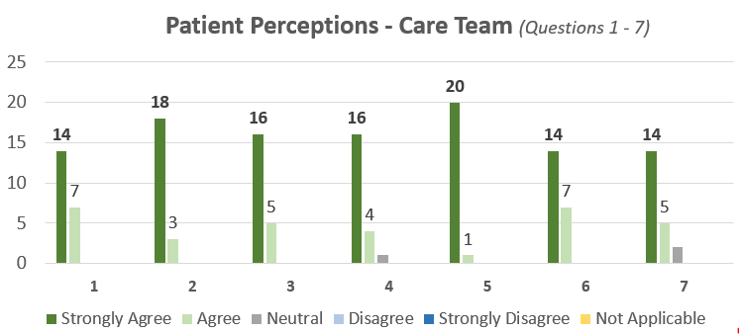
1. | I would recommend my physician’s care team to a friend or family member who has high blood pressure
2. | I was treated with respect, and I felt my opinions mattered
3. | The visits were convenient and fit my schedule
4. | The pharmacist visits were valuable to me
5. | The care coordinator visits were valuable to me
6. | The care team helped me work toward achieving one or more of my health goals
7. | I feel that the care coordinator and pharmacist communicated with my physician about the care I was receiving.

Slide 36
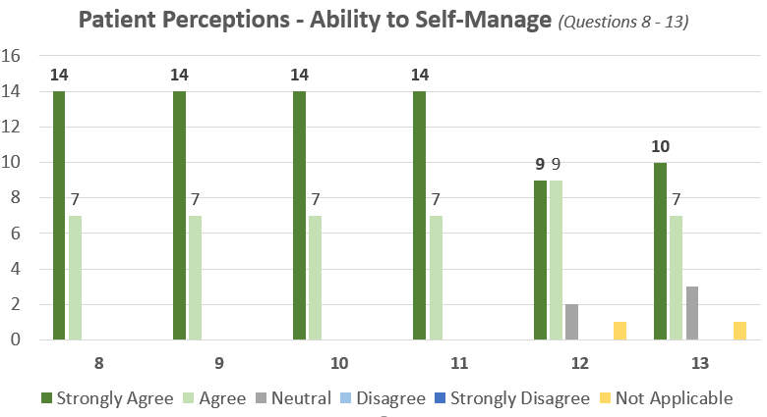
8. | I have a better understanding of my health
9. | I feel I have gained knowledge and skills to improve my health
10. | I feel motivated or empowered to improve my health
11. | I have a better understanding of my role in improving or maintaining my health
12. | I have a better understanding of my medications
13. | I take my medications more consistently

Slide 37
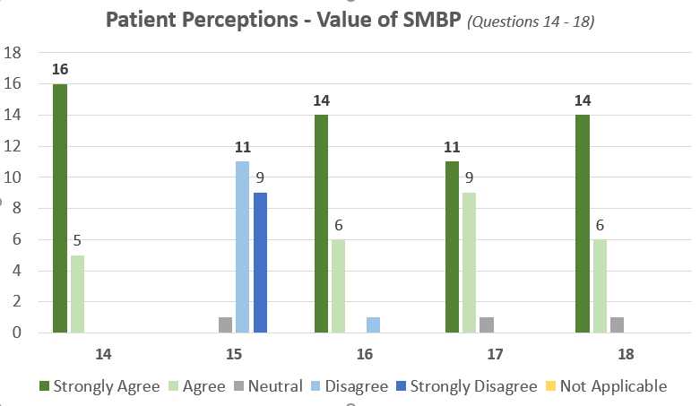
14. | I was provided with everything I needed to measure and report my own blood pressure easily and accurately
15. | Measuring my own blood pressure was upsetting or frustrating to me
16. | Measuring my own blood pressure helped me be more aware of my health
17. | Measuring my own blood pressure motivated me to adopt or continue healthy behaviors
18. | I feel the care team used blood pressure readings I reported to make more informed decisions about my care

Slide 38
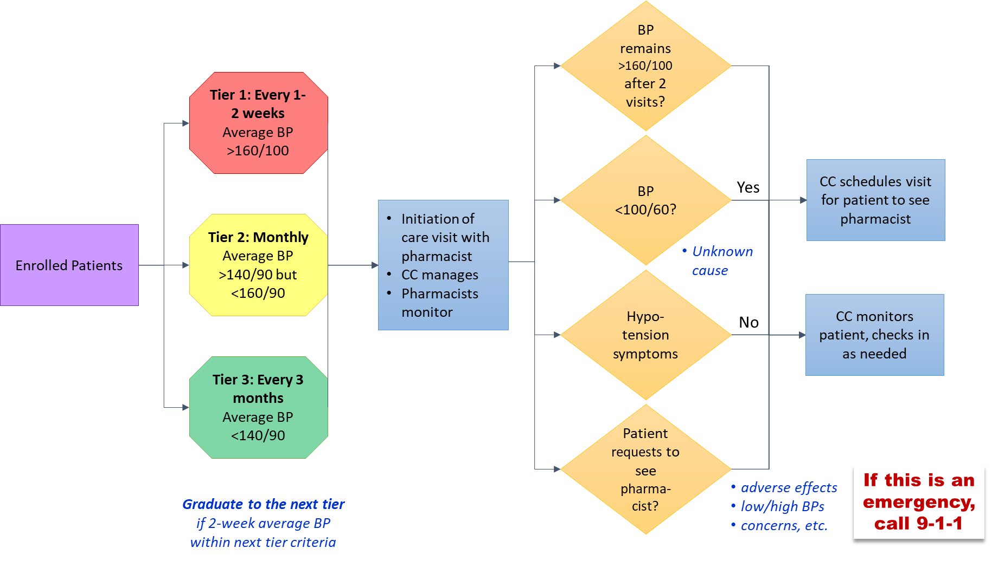
Tier Criteria

Slide 39
Evidence-basis
5-page summary of literature review with 69 citations
Included in upcoming whitepaper
Select samples as reference for this presentation

Slide 40
Evidence-Basis samples of citations
62. Nunan D, Thompson M, Heneghan CJ, Perera R, McManus RJ, Ward A. Accuracy of self-monitored blood pressure for diagnosing hypertension in primary care. Journal of hypertension. 2015;33(4):755-762.
58. de la Sierra A, Vinyoles E, Banegas JR, et al. Prevalence and clinical characteristics of white-coat hypertension based on different definition criteria in untreated and treated patients. Journal of hypertension. 2017;35(12):2388-2394.
59. Cohen JB, Cohen DL. Integrating out-of-office blood pressure in the diagnosis and management of hypertension. Current cardiology reports. 2016;18(11):1-8.
64. Nasothimiou EG, Tzamouranis D, Rarra V, Roussias LG, Stergiou GS. Diagnostic accuracy of home vs. ambulatory blood pressure monitoring in untreated and treated hypertension. Hypertension Research. 2012;35(7):750-755.
44. Polgreen LA, Han J, Carter BL, et al. Cost-effectiveness of a physician–pharmacist collaboration intervention to improve blood pressure control. Hypertension. 2015;66(6):1145-1151.

Slide 41
Evidence-Basis • whitepaper samples
Over the past decade, self-monitored blood pressure (SMBP) has become a common practice among patients with hypertension.⁶² SMBP has been shown to be effective for diagnosing hypertension in the primary care setting⁶²
62. Nunan D, Thompson M, Heneghan CJ, Perera R, McManus RJ, Ward A. Accuracy of self-monitored blood pressure for diagnosing hypertension in primary care. Journal of hypertension. 2015;33(4):755-762.

Slide 42
Evidence-Basis • whitepaper samples
Further, “White Coat Syndrome” (WCS), referring to a stress-related increase in blood pressure when a measurement is taken in the clinical setting, is a relatively common phenomenon in both hypertensive (approximately 35.2% - 45.8%) and normotensive patients (approximately 26.1% – 27.2%.⁵⁸
If WCS goes unrecognized, it may contribute to unnecessary initiation or intensification of antihypertensive treatment.⁵⁹
SMBP has high diagnostic agreement with ambulatory monitoring and is reliable alternative for detecting “White Coat Syndrome” and masked hypertension.⁶⁴
58. de la Sierra A, Vinyoles E, Banegas JR, et al. Prevalence and clinical characteristics of white-coat hypertension based on different definition criteria in untreated and treated patients. Journal of hypertension. 2017;35(12):2388-2394.
59. Cohen JB, Cohen DL. Integrating out-of-office blood pressure in the diagnosis and management of hypertension. Current cardiology reports. 2016;18(11):1-8.
64. Nasothimiou EG, Tzamouranis D, Rarra V, Roussias LG, Stergiou GS. Diagnostic accuracy of home vs. ambulatory blood pressure monitoring in untreated and treated hypertension. Hypertension Research. 2012;35(7):750-755.

Slide 43
Evidence-Basis • whitepaper samples
Findings from the Collaboration Among Pharmacist and Physicians to Improve Outcomes Now (CAPTION) trial demonstrated that a pharmacist–physician collaborative intervention specifically designed to use existing clinical pharmacists located in primary care offices resulted in clinically significant reductions in systolic blood pressure (-6.1 mmHg).⁴⁴
Analysis established financial cost to lower SBP/DBP by 1mmHg and improve hypertension control performance by 1% in the intervention group.⁴⁴
44. Polgreen LA, Han J, Carter BL, et al. Cost-effectiveness of a physician–pharmacist collaboration intervention to improve blood pressure control. Hypertension. 2015;66(6):1145-1151.

