Slide 1
Hawaii CARES Call Center Statewide Crisis Services WORKFORCE SUMMIT SEPTEMBER 24, 2022
Notes:
JP

Slide 2
DOH
Community Mental Health
Substance Abuse Agencies Statewide
Community Collaboration
Innovative
Linkage
Evidence Based
Best Practice
Cultural Competency
Striving for Excellence
Referrals
Crisis Intervention
Suicide Intervention
Safety Planning
Therapeutic Support
Locally Based
Committed
Statewide Services
Dedicated
Ohana
Partnerships

Slide 3
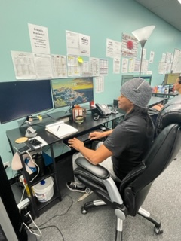
What is Hawaii CARES?
Hawaii CARE’s is a Partnership between Hawaii State Department of Heath (DOH) and the community based mental health and substance abuse service providers statewide
Our Behavioral Health Crisis and Suicide Call Center provides services 24 hours per day / 7 days per week. We provide services to adults and children statewide.
Our Crisis Counselors specialize in providing supportive counseling, screening for urgent or emergent mental health or substance use needs and recommendations for behavioral health assessments and services and crisis intervention.

Slide 4
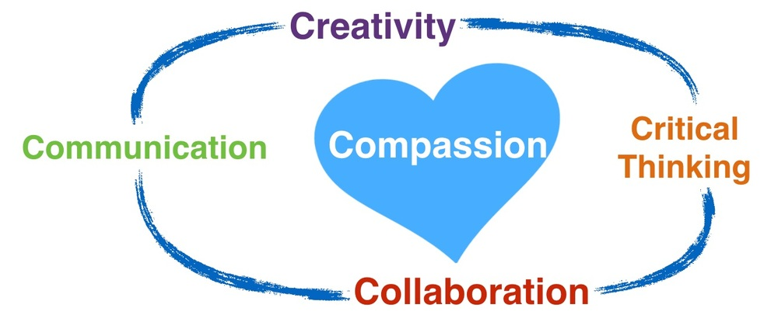
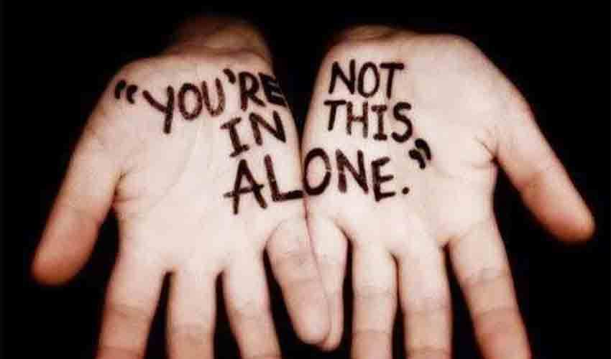
What is Hawaii CARES Continued
We provide free, non-judgmental services, with compassion and delivered with the spirit of aloha.
Our team consists of Crisis Counselors that reside within the state of Hawaii with diverse cultural backgrounds.
Our staff provides resources, referrals and linkages within our state and tries to maintain updated resources.
Our team is skilled in crisis intervention and best practices and provided with on going weekly trainings.

Slide 5
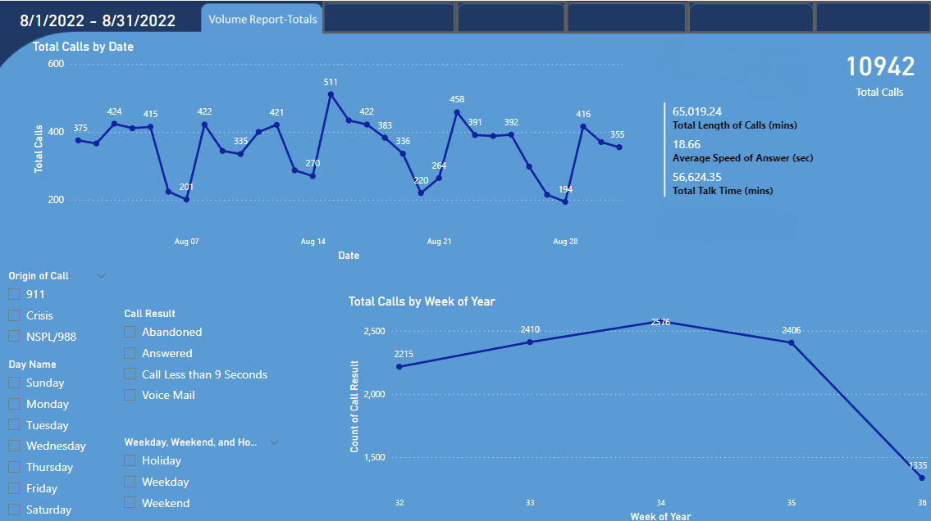

Slide 6
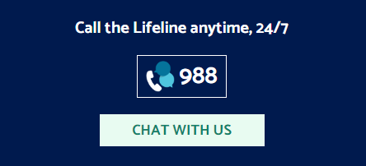
Contact Hawaii CARES
Hawaii CARES Call Center
Call 24/7: 808-832- 3100 or toll-free 800-753-6879
Substance Use Disorder
New and Returning S.U.D. clients shall be routed via warm transfer from
Care Hawaii to
AUW 211 S.U.D. CARES Call Center (7 days/week, 7am-10pm).

Slide 7
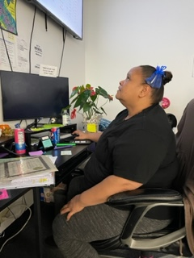
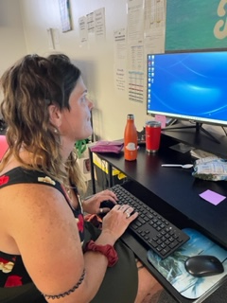
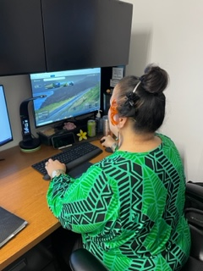
Services with Aloha

Slide 8
988 Suicide and Crisis Lifeline
Launched 988 in the State of Hawaii on July 16, 2022
The three-digit dialing code connecting people to the existing National Suicide Prevention Lifeline
National Suicide Prevention Lifeline (NSPL) has been in operation since 2005
988 is confidential, free, and available 24/7/365
Connecting those experiencing a mental health, substance use, or suicidal crisis with trained crisis counselors.

Slide 9
988 Suicide and Crisis Lifeline Continued
988 is a simplified number that was created to make it easier for those experiencing a mental health crisis, suicide, and/or substance abuse to access help.
1-800-273-8255
People can use 988 if they are worried about a loved on who may need crisis support.
All callers will be routed to the nearest crisis center based on the area code of their phone number
24 hour follow up calls are provided

Slide 10
Text and Chat Services
Text and Chat launched September 1, 2022, in the State of Hawaii
NSPL Lifeline Crisis line Chat and website information 988lifeline.org
Servicing Adolescents, Teens, Young Adults and Hearing Impaired.
For more information
call/text/chat 988
or log onto
988lifeline.org

Slide 11
Hawaii C.A.R.E.S Call Center
Is the caller in a crisis or suicidal?
YES
If the caller is in imminent risk or is physically violent refer to 911
Provide telephonic Crisis intervention
If needed dispatch CMO worker for face-to-face intervention
If crisis criteria is met, then link to appropriate mental health services such as:
CSM
LCRS
Stabilization Bed
Others as needed
Create a safety plan and refer to the proper supports

Slide 12
Hawaii C.A.R.E.S Call Center
NO
Is the caller in a crisis or suicidal?
Determine what Services are needed
Other Services
Mental Health
Substance Use
Already connected to CARES for SUD?
Continue with care coordination and referral process between CARES
and treatment centers as necessary
Link to other services and provide information as needed:
Criminal Justice
Housing
Healthcare and Health Insurance
Others as needed
If connected to case management, refer to the assigned agency for needed services.
If not connected to case management, refer to CMHC for assessment
Refer to provider for assessment to determine level of care
If not enrolled, begin enrollment as necessary
Link to case management
If approved for case management
Follow up as needed
Staff will coordinate referral to program with appropriate level of care, and follow up on all referrals
Individual enters the appropriate level of treatment

Slide 13
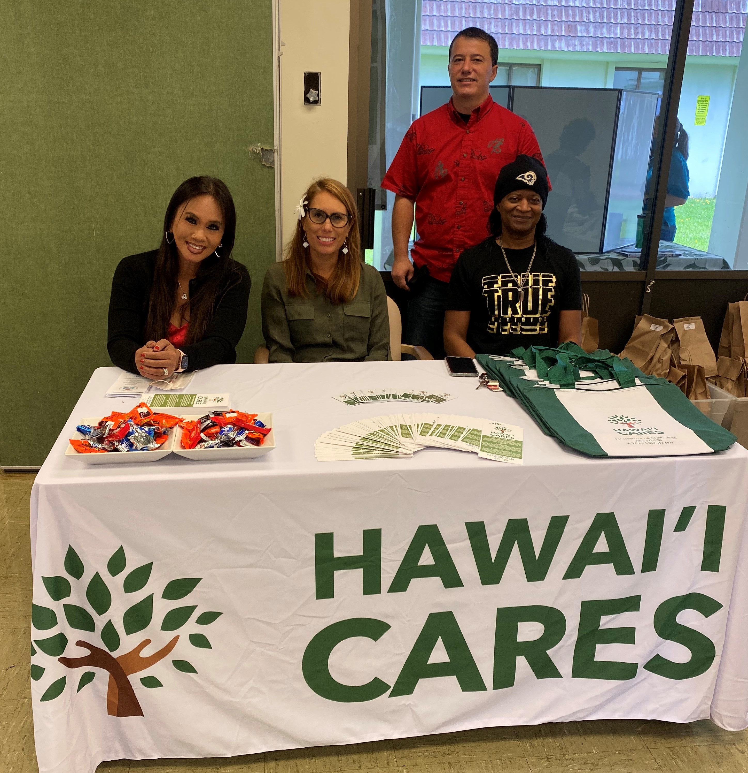
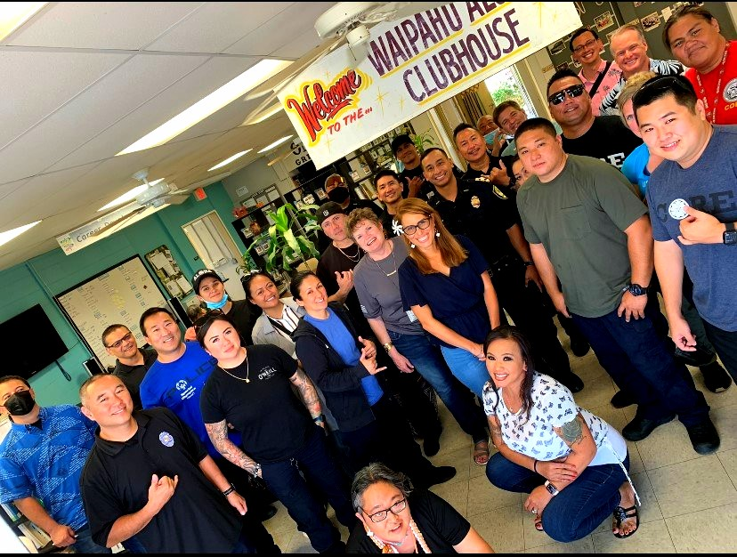
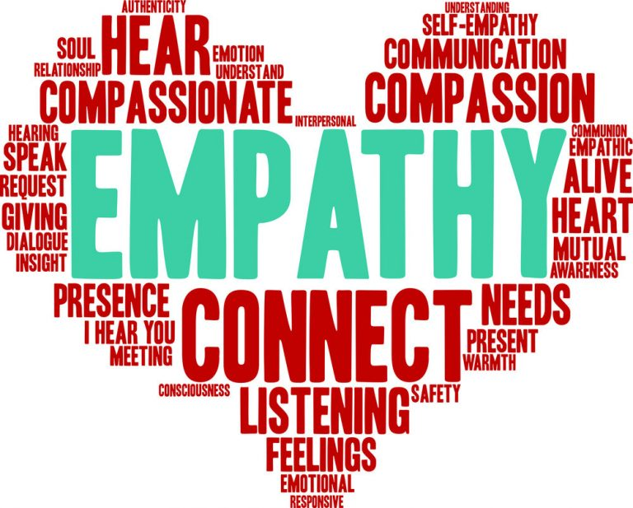
CARE Hawaii Community Outreaches

Slide 14
Crisis Mobile Outreach Services (CMO)
Risk Assessment, Clinical Assessment, Crisis Shelter Assessment, Crisis Stabilization
Crisis Intervention, Planning and short-term treatment which includes, but is not limited to, medication administration or arrangements, consultations and referrals
Linkage for follow-up; community resources for support
Crisis Mobile Outreach (CMO) is a community – based service for clients experiencing a crisis
Goal of constructively resolving aspects that may precipitate a crisis
CMO supports clients by providing accessible, responsive, coordinated and timely community assistance
Program aims to assist individuals who are a danger to themselves or others
CMO Services are face-to-face crisis stabilization, provided 24 hours a day, 7 days a week and responded to within 24 hours a day, 7 days a week, and responded to within 45 minutes or less

Slide 15
Crisis Support Management Services (CSM)
Time limited support services (30 Days temporary case management), to assist individuals in finding more intensive interventions for behavior that could further disrupt community integration and return the consumer to pre-crisis life.
For people in crisis, who are not linked or who do not have appropriate case management, to be linked with Mental Health Services for support and stabilization.
CSM Team includes stabilization of crisis situations, initiation of treatment interventions, resolution of problems and conflicts, coordination with other agencies, gaining access to community resources and necessary services.
CSM Services are 24 hours a day, 7 days a week.

Slide 16
Licensed Crisis Residential Services (LCRS) Hilo (Hawaii Island), Maui, and Oahu
Are provided to assist individuals with the potential for danger to self or others
Short-term, acute residential services to individuals experiencing crisis or a period of acute stress that significantly impairs the capacity to cope with normal life circumstances
Provides services that address the psychiatric, psychological and behavioral needs.
Here are some clinical justifications for admission: Medication Stabilization, Mood Stabilization, Relapse Prevention, Prevent Psychiatric Emergency and Harm Reduction.

Slide 17
Certified Peer Specialist Support Services (CPSS)
May be requested from the Hawaii CARES following the initial response by CMO or CSM when on-going support from a crisis Hawaii Certified Peer Specialists is clinically indicated to assist a Consumer to recover from a crisis.
Provide a unique perspective based on their shared experiences and utilize their skills to assist Consumers to better understand their illness, plan their recovery, and navigate their way through the service delivery system.
CPSS Services will continue for 30 days.

Slide 18
Stabilization Intensive Case Management Program (SICM) Oahu and Hawai’i Island
Mental Health Crisis and needs to be triaged and stabilized
Recent substance use and needs a place for stabilization as bridge to substance use d/o treatment and recovery services
Homeless with mental health concerns, needs connection to case management for connection to behavioral health and AMHD housing services
D/C from correctional facility, seeking wrap around behavioral health services
D/C from inpatient care and the client has behavioral health concerns (mental health condition and/or substance use disorder (SUD), seeking connection to mental health or SUD services

Slide 19
Lead Program Developer Dennis Williams

Slide 20
Mahalo

