Slide 1
House Poor No More: Disrupting the Difficulty of Finding a Home in Hawai’i for Health Professionals
Hawai’i Health Workforce Summit
September 24, 2022
Bianca K. Frogner, PhD
Professor, Department of Family Medicine
Director, Center for Health Workforce Studies
University of Washington
Twitter: @uwchws, @biancafrogner

Slide 2
10-20% healthcare workers do not live & work in same neighborhood
Specific neighborhood commute data for Hawaiian healthcare professionals is challenging
Source: https://familymedicine.uw.edu/chws/resources/leveraging-data/commuting-patterns/

Slide 3
Most US healthcare workers drive to work
Commute time ranges from 24.1 to 31.2 min
Source: https://familymedicine.uw.edu/chws/wp-content/uploads/sites/5/2020/05/Commute-Patterns-FR-2020.pdf

Slide 4
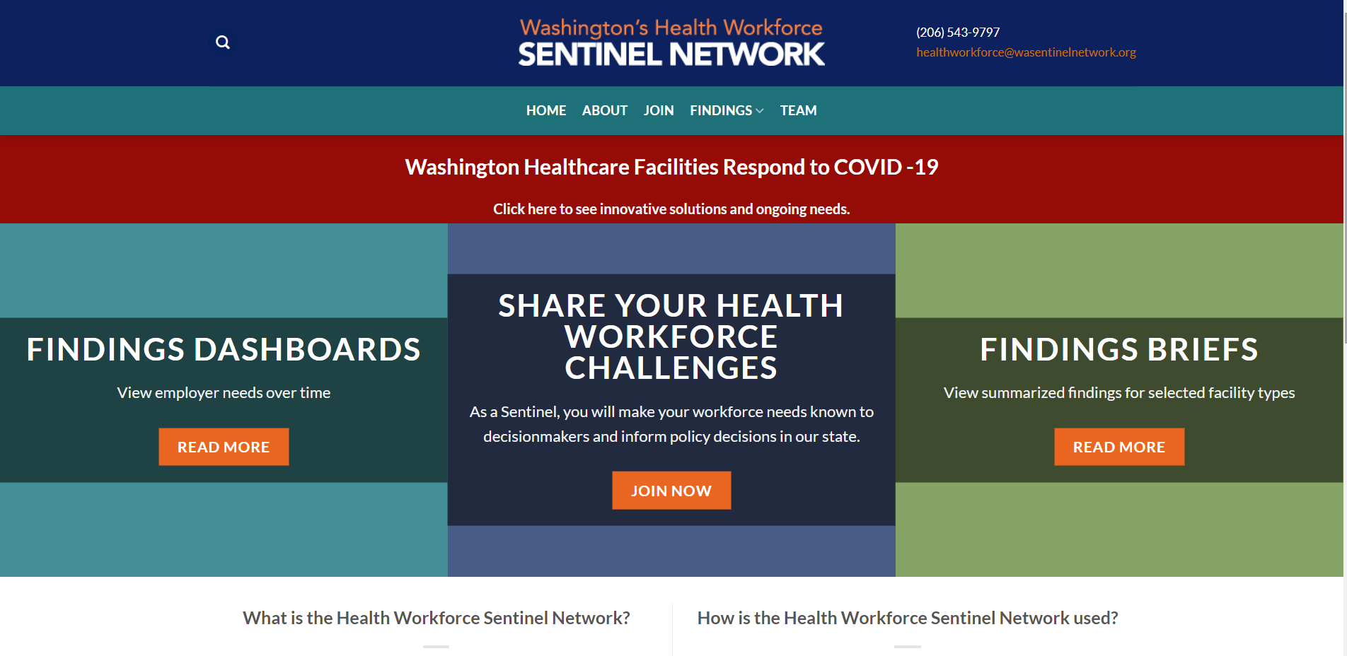
Housing is a limiting factor for rural & urban areas

Slide 5
Homeownership, Mortgage and Rent for US and Hawaiian Healthcare Workers, including Physicians
 | All Healthcare Workers |  | Physicians
 | All US | Hawai’i | All US | Hawai’i
Own Home | 69.1% | 71.7% | 77.5% | 83.0%
Mortgage Free | 27.5% | 25.8% | 27.9% | 25.5%
If Mortgage, Monthly Payment | $1,162 | $1,848 | $2,249 | $3,089
Rent Home | 30.9% | 28.3% | 22.5% | 17.0%
If Rent, Monthly Payment | $1,193 | $1,893 | $2,117 | $2,908
Source: Author calculation of 2022 American Community Survey extracted from https://usa.ipums.org/usa/

Slide 7
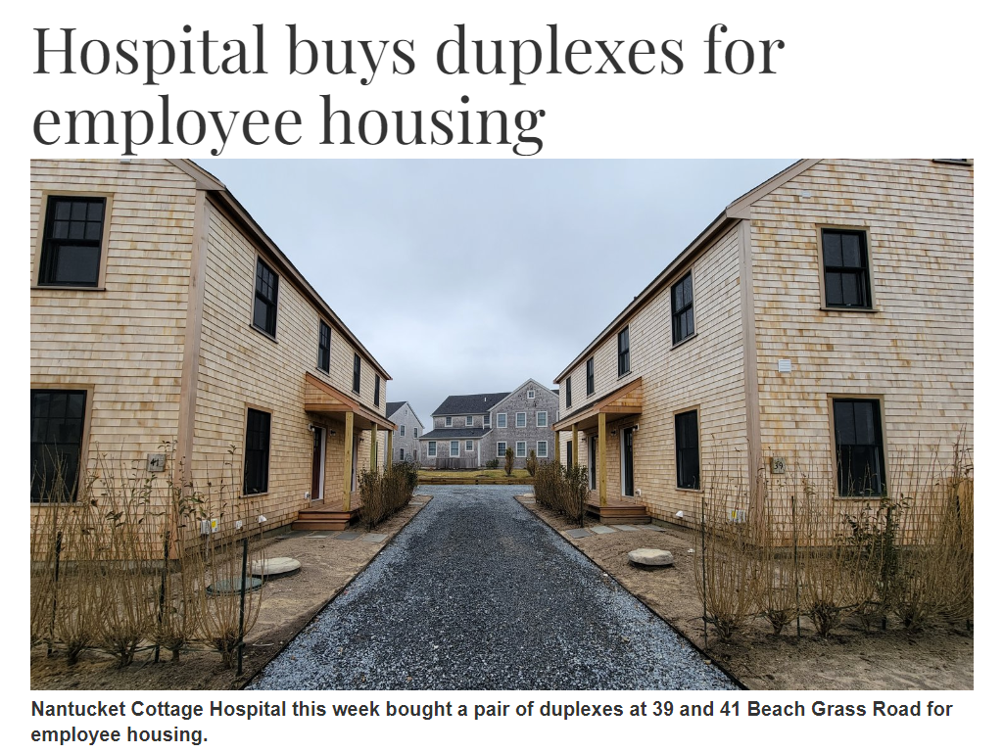
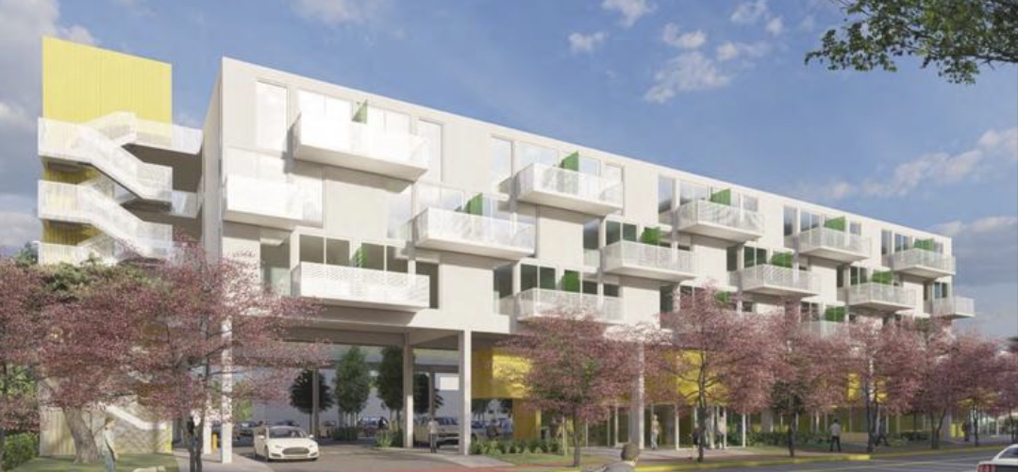
Notes:
Nantucket Cottage Hospital purchased two duplexes on Beach Grass Road Monday, spending $3.7 million to add housing for up to 12 employees just in time for the busy summer months.
The duplexes provide 12 beds for interim housing for full-time employees, as well as seasonal housing for traveling workers.
Overall, Nantucket Cottage Hospital now owns 33 housing units in the community, with nearly 80 beds for staff, according to the release.

Slide 8
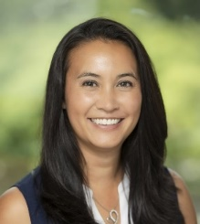
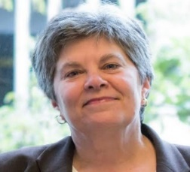
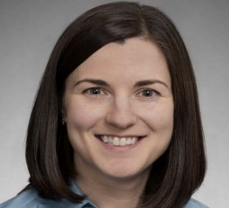
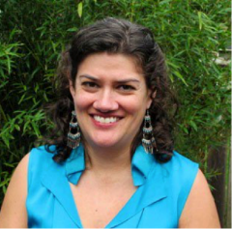
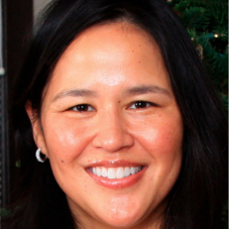
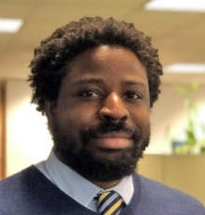
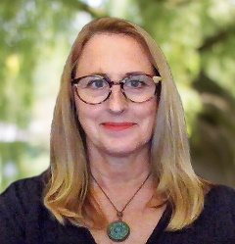
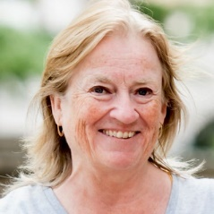
UW Center for Health Workforce Studies
Established in the Department of Family Medicine in School of Medicine in 1998
Conducts health workforce research to inform health workforce planners and policy makers
Supported by multiple grants/contracts including two center grants from the Health Resources and Services Administration with focus on:
Allied health workforce
Health equity & workforce diversity

Slide 9
Thank you!
Contact me with questions at:
bfrogner@uw.edu
Follow on Twitter @biancafrogner @uwchws

Slide 10
Possible Solutions for Housing Crunch in Hawai’i
Len M. Nichols, Ph.D
Non-Resident Fellow, Urban Institute
Professor Emeritus, George Mason University

Slide 11
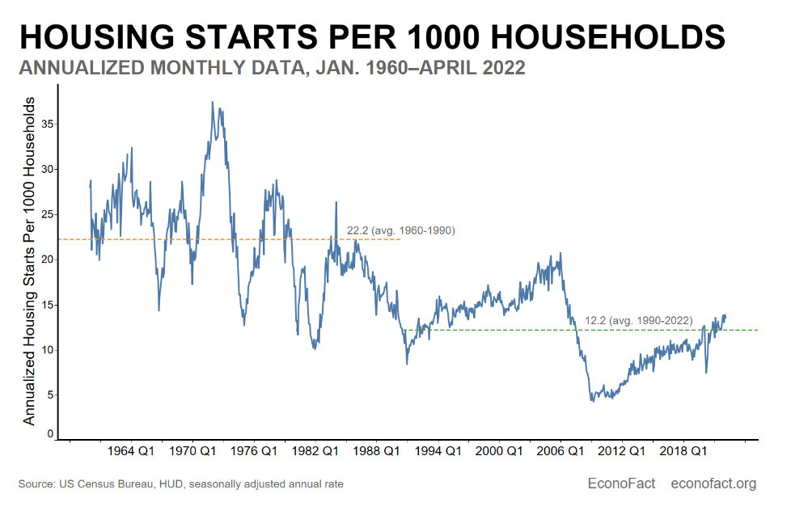
It’s not just a health workforce problem

Slide 12
https://www.businessinsider.com/solve-the-labor-shortage-housing-crisis-hiring-recovery-home-prices-2021-10
https://www.drovers.com/news/industry/labor-shortage-or-housing-shortage-companies-aim-fix-one-other
Notes:
Employer provided housing:
Resorts in high income/cost areas
Universities
Cities for teachers, health care workers

Slide 13
Some Ideas for Hawai’i
Employ housing assistance coordinators to match applicants with specific programs already available (HUD, state, cities, etc)
Explore multi-family construction and sliding scale rent/own options
Explore shared equity solutions
Reduce down payments and/or monthly payments, share in equity upon sale
Universities on coasts in the 1980s and 1990s
Landed.com set up program for teachers (waitlisted now)
Cities have created these for teachers and other lower-income workers (relative to housing costs)
Community Land Trusts, wherein cities sell at discount, require re-sale at discount also, but appreciation allowed

Slide 14
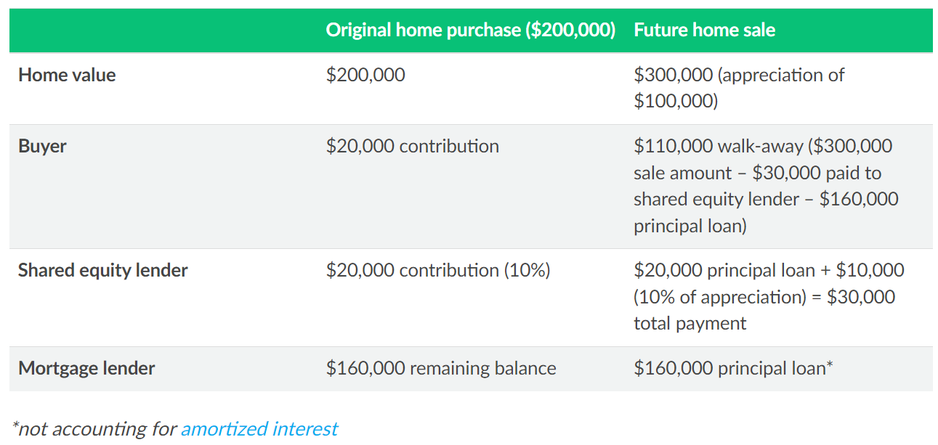
Example of Shared Equity Mortgage from Lending Tree
https://www.lendingtree.com/home/mortgage/buying-a-home-with-a-shared-equity-mortgage/

