Slide 1
Hawaii CARES Call Center Care Hawaii & Aloha United Way 211 Hawaii Health Workforce Summit 09.24.2022

Slide 2
Hawaii CARES (Aloha United Way 211) Substance Use Disorder Coordinated Access Resource Entry System (S.U.D. CARES) Referral & Treatment Call
Notes:
Quick Introduction (Name, Position, What you do at AUW 211)
Elliott Josh Josh give JP Intro SLIDE

Slide 3
About Aloha United Way
AUW has been serving Hawaii for over 100 years.
AUW brings resources, organizations, and people together to advance the health, education, and financial stability of every person in our community.
AUW 211 is the hub of statewide health and social resources in Hawaii to ensure people in need are connected to agencies & services that can help them.
Notes:
JOSH - For over a century, Aloha United Way has been dedicated to serving the people of Hawaii to work on the issues that face everyday people.. from working families struggling to afford basic household expenses…. to creating partnerships with county and state public agencies that improve the social.. Health.. & human services for our kupuna and low-income families,… and working with small and large non-profit organizations in oahu and neighbor islands on health & housing, economic security, and larger systemic issues facing Hawaii.
For those of you who might not know what 211 is… anyone can dial 2-1-1- for free, confidential, and statewide Information & Referral services …that connects the people of Hawaii to over 4,000 government, non-profit, and social service agencies and programs (ranging from Housing & Shelter services, Healthcare, COVID-19, Utility Assistance, Food Support, Employment… income services, Disaster Relief, and much more!

Slide 4
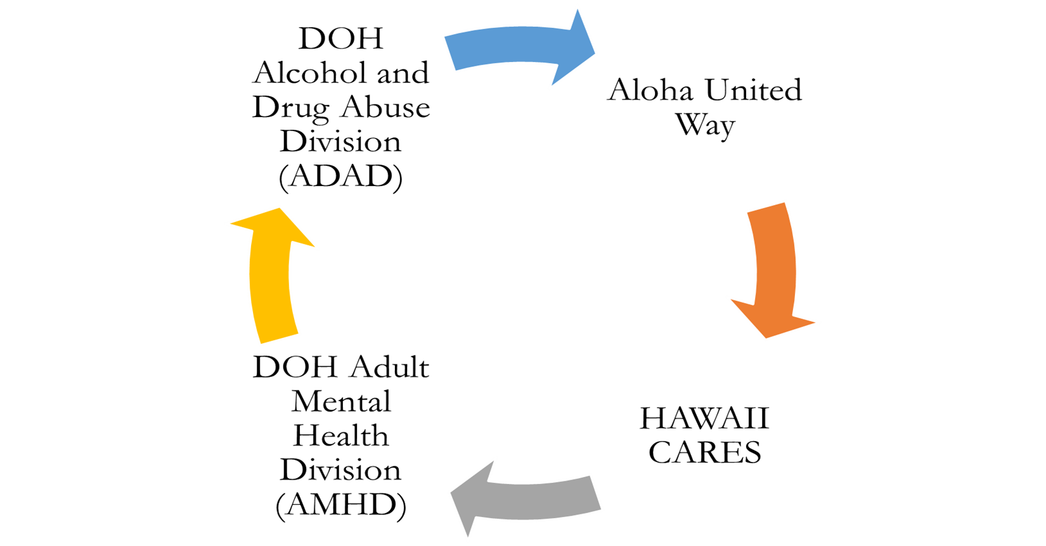
The Hawai'i CARES Ecosystem
Notes:
JOSH –THE AUW 211 partnership with the DOH presents a new, exciting opportunity to impact the field of behavioral health in Hawaii by joining the Hawaii CARES ecosystem. Since the start of COVID-19, AUW 211 worked closely with hospital systems, county and state leadership, various state agencies, and community groups to protect our kupuna and most vulnerable households in the fight against COVID-19.
In 2022, AUW 211 restructured, we expanded operations, and increased staff to develop the SUD CARES Referral & Treatment call center. Since this past April, AUW has worked very closely with the Dept Of Health, Alcohol & Drug Abuse Division, Adult Mental Health Division, and Care Hawaii to work on integrating our systems to best serve the mental health, substance use, and behavioral health needs for our community. For the past 5 months, AUW has started taking SUD calls and created an entire new division of 211. This new partnership with Hawaii CARES helps allow DOH and AUW to better respond to the critical Substance Use needs of the people of Hawaii and our providers working in the field of Substance use and behavioral health….This graphic shows the collaborative approach to behavioral health in Hawaii and how engaged and intertwined each stakeholder is within the Hawaii CARES system. We believe one way we can better serve our clients in the field of behavioral health is by implementing a culture of continuous learning, improvement, and evaluation into all aspects of the Hawaii CARES program. We all work closely together so that the people of Hawaii can access the care they need.

Slide 5
Hawaii CARES Call Flow
Suicide & Crisis Call Center
Substance Use Disorder Referral & Treatment Call Center
Care Hawaii 9-8-8 808.832.3100
Aloha United Way
2-1-1
808.ASK.2000
Crisis
Live calls 24/7
Mental Health
Live calls 7days/week (7am-10pm)
Substance Use
Notes:
JOSH
To build upon what was stated earlier by Care Hawaii, here is another example of the high level of collaboration between the Hawaii CARES programs. Care Hawaii manages the 988 line and the Suicide and Crisis Call Center as part of Hawaii CARES… The Suicide and Crisis Call Center is there for clients/consumers who are in need of critical care 24 hours a day, 7 days per week. Anyone can call the main Suicide & Crisis Line by calling 808-832-3100, or by dialing 988 for mental health and crisis needs, around the clock. AUW manages the SUD Referral & Treatment Call Center as part of Hawaii CARES…. Clients and Providers in need of SUD services, screening, and referrals, can either dial 211 if you have a local 808 area code, or can dial 808 ASK 2000 for numbers with out of state areas codes or can call the Suciide and Crisis Call Center. AUW is here for your SUD service needs everyday, from 7am-10pm. So as you might be able to tell from this graphic and others, A major part of Hawaii CARES is the collaboration and communication between all agencies and stakeholders. If someone dials the Suicide & Crisis Line or 988 and they are in need of Substance Use Disorder services, The Crisis Line will stay on the line with the client and begin a warm transfer to 211. Also, if someone calls 211, and is in immediate crisis or other mental health related needs, AUW will stay on the line with the client and warm transfer the caller to the Suicide & Crisis Center and stay with the client until the someone is on the other line to help.
We work closely together at Hawaii CARES to make sure that every client in need of substance use, mental health, or crisis services will get the care and support they need.
Transfer calls from AUW to CARE HI and Care HI to AUW
CQI –
808

Slide 6
SUD CARES: For Clients; Dial 2-1-1 (Option 7)
AUW 211 SUD CARE Coordinators will conduct the following for clients in need of SUD services:
Conduct S.U.D. Universal Standardized Intake & Screening (USIS)
Screen for Substance Use Disorder needs and treatment services
Screen for mental health support or crisis intervention (Warm transfer to Care Hawaii); or 9-1-1
Conduct Hawaii Medicaid eligibility check through DHS Medical Online (DMO) system
Enter client information into WITS (Web Infrastructure for Treatment Services) for referral to ADAD Provider.
Determine if caller needs additional 211 information & referral services (i.e., food, health, housing, SNAP benefits)
Notes:
JOSH Clients/patients in need of Substance Use Disorder services, can now easily dial 2-1-1 and or contact the Suicide &Crisis Line… Once a client dials 2-1-1 and selects option 7 for their substance use disorder needs or are transferred from Crisis, one of AUW 211 Care Coordinators will answer the call and conduct the following for all callers:
USIS – Ellio

Slide 7
SUD CARES: For Providers; Dial 2-1-1 (Option 8)
AUW 211 SUD CARE Coordinators will collect the following information from SUD Providers:
First & Last Name
Contact information (Phone and/or Email)
Organization
Reason for Contact
For Referrals: 1) Email: 211sud@auw.org 2) Email: Supervisor(s), Alec Cornejo acornejo@auw.org or Kelsi Tamanaha ktamanaha@auw.org
For Benefit Exceptions: 1) Email: 211sud@auw.org 2) Email: Clinical Manager, Elliott Plourde eplourde@auw.org
Notes:
JOSH For Substance Use Disorder/SUD providers who need to get ahold of someone in leadership, supervisor/manager, AUW makes it simple and easy for our SUD providers to get an update on your client or your need. One way Providers can obtain their client’s updates, information or requests would be to dial 2-1-1 and select “option 8”, designated for SUD Providers. One of our AUW 211 SUD CARES Coordinators will collect your information and pass on your request to someone who can best assist you.
As Providers, we know you are busy and have a lot on your plate, so another way to contact a supervisor or manager, will be to email us. Our general email box is 211SUD@auw.org, which is HIPPA secured and enabled for encryption for your protection. Another way is to directly email one of our supervisors (ALEC/KELSI) using the email address above. Elliott will speak on What Benefit Exception requests are in just a minute, but Elliott is our Clinical Manager and can be reached using the email address above.

Slide 8
SUD CARES: Benefits For Providers Dial 2-1-1 (Option 8)
CARES COC provides a Universal entry system
Quicker access to assessments (scheduling & follow up)
All SUD services in a central location; paperwork is generated and completed; client only completes one screening
Coordinate referrals to appropriate treatment provider, once clinical assessment is completed, and LOC is determined
Efficient Care Coordination between client, treatment providers, and other community-based referrals
Probation
Public Defenders
Hospitals
Notes:
Elliott Benefits offered by a Continuum of Care that provides universal entry to a comprehensive system of specialized services to meet the behavioral health needs of individuals.
A universal entry to a comprehensive system is beneficial as it: Increases access to SUD treatment and recovery services and serves as another option for point of entry and referral for potential individuals to be connected with agencies they may not be already familiar with.
Allows providers to refer to other agencies seamlessly, and helps to ensure stronger coordination of services that are custom-fit to the individuals needing services
Provides excellent response time, quick referrals, and could become a knowledge resource for individuals, families, and providers
It helps to alleviate stress on individuals looking for services by providing assistance for appropriate care.

Slide 9
S.U.D. CARES Service Delivery
Authorize client S.U.D. Statewide Services for:
Early Intervention
Outreach
Outpatient/Day Treatment
Intensive Outpatient
Continuing Care
Residential
Clean & Sober Homes
Opioid Services & more.
*ADAD payor of last resort*
Notes:
Elliott
These are the Substance Use services that are needed when helping this population and are billable through client's insurance. ADAD will reimburse for these services if needed but they are the Payor Of Last Resort.

Slide 10
S.U.D. CARES Service Delivery
Referrals In: Review incoming ADAD Provider S.U.D. referrals:
ASAM
DENS-ASI
Treatment Plan/Health & Wellness Plan
CAGE-AID
Pre-Treatment Services (i.e., Motivational enhancements, screening, assessments (ASAM, DENS-ASI)
Notes:
Elliott – ADD NOTES
Explain what is the Bundle (Cage-Aid, DENS-ASI, ASAM, Tx. Plan)
Pretreatment services motivational enhancement (engagement) screening, assessment (ASI and ASAM) and determination
Other services include clean and sober living, Transportation costs, Translation and Interpreter services...
ASAM (American Society of Addiction Medicine) provides Treatment criteria for Addictive, Substance-Related and Co-Occurring Conditions

Slide 11
S.U.D. CARES Service Delivery
Referrals Out: Care Coordination for referrals to appropriate ADAD contracted treatment providers & other providers based on client needs
Benefit Exceptions: Review requests for extension of services based on client needs
-
Notes:
Elliott – Referrals out – follow up calls for treatment.
Ensure referral has been accepted and client has engaged in recommended services.
Keep client engaged and motivated while waiting for services to begin
Benefit Exception Request (BE request) – A Benefit Exception request is a request for clinically indicated SUD services beyond the allowable service max units. When insurance stops paying, requesting ADAD funding

Slide 12
AUW 211 SUD CARES: Call Volume (April 2022– August 2022)
Average Speed of Answer:
0.49 seconds
Average Handle Time:
13 minutes
* SUD calls started April 18
Notes:
Josh –
SUD CARES has seen a steady increase in the amount of incoming calls from clients and providers in need of SUD services. We anticipate with more promotion and continued meet and greets with various SUD providers, our incoming call volume will steadily increase in the coming weeks and months. To highlight some of what Elliott mentioned about our SUD service delivery, the data clearly shows that another critical aspect of the SUD program is maintaining a level of contact and coordination with our clients and providers. This is one way to ensure that clients are getting the services they need for recovery. Another metric we closely monitor to ensure for high quality SUD customer service is the amount of time it takes to answer a call. For the first 5 months of the SUD program, we have maintained a call answer rate of less than 1 sec. This means if a client or provider is in need of SUD services, our 211 SUD CARES Coordinators are there to answer the call and begin care coordination. Lastly, on average, our Care Coordinators are on the lines with clients for about 13 minutes. During the call, our coordinators will ask clients questions about their SUD history and current use and use principals in motivational interviewing to properly screen clients for SUD services

Slide 13
SUD CARES Testimonial 1
A kupuna client with pre-existing health conditions called AUW 211 SUD CARES for residential treatment for Meth. Client told the AUW Care Coordinator, "I don't want to die like this, can you help me like you helped my ex-wife?" Client proceeded to say that his ex-wife called AUW211 SUD CARES and was able to access care and get back on her feet. Client said, “Awww man you guys really helped her, she looks great, she looks healthy, and she has more weight on her now, she looks ALIVE!".
The client saw clear results from his ex-wife’s experience, which motivated the client to seek access to care for his own SUD issues. The AUW Care Coordinator was able to get the client referred to treatment.
Notes:
Josh

Slide 14
SUD CARES Testimonial 2
AUW 211 SUD CARES received a call from a young male who lives on a neighboring island seeking SUD services. The client was referred for a more thorough assessment at a Residential Program on Oahu. Unfortunately, the client relapsed and missed his flight to Oahu. The client called back AUW 211 SUD CARES and said, “Man, I messed up. Tell the first AUW Coordinator not to be mad at me”. The AUW Coordinator that answered assured the client that our staff would not get upset and empathized with client. The client stated he “was not even considering treatment” until he spoke with the first AUW Care Coordinator.
Client repeatedly thanked AUW staff and AUW Care Coordinator #2 picked up where AUW Care Coordinator #1 left off. Client was referred into a Licensed Crisis Residential Shelter (LCRS) to begin treatment and recovery.
Notes:
Elliott...Read

Slide 15
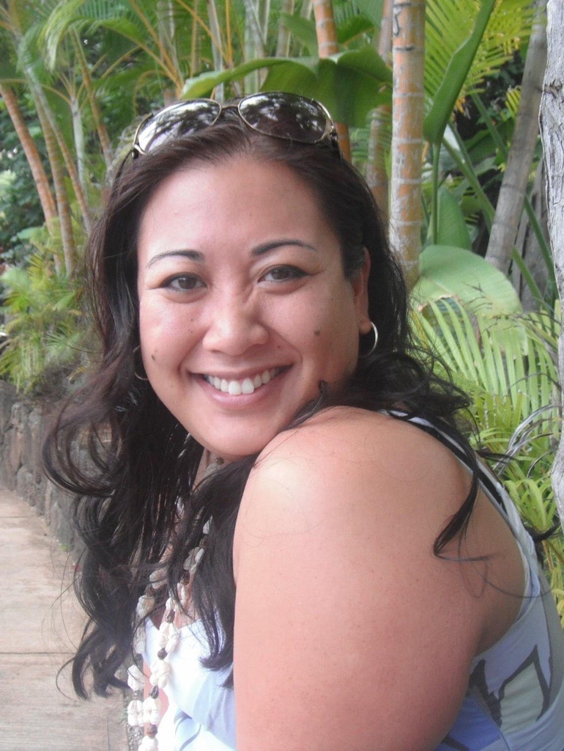
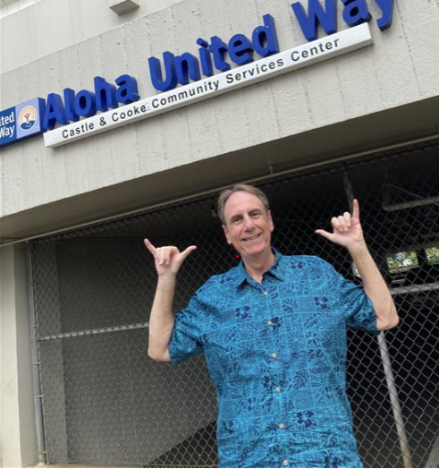
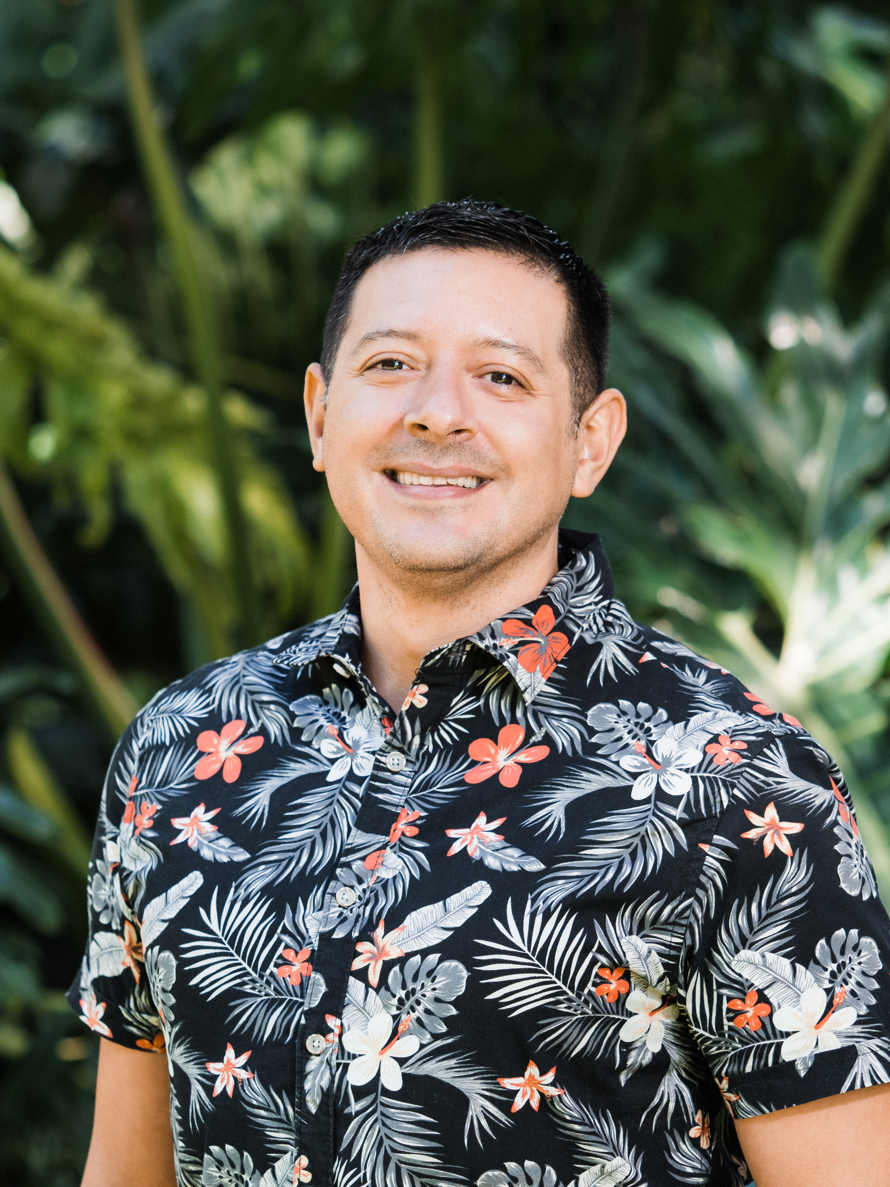
Hawaii CARES - Aloha United Way 211 S.U.D. CARES Management
Jennifer Pecher, Senior Director 211 & Community Response Programs
Jpecher@auw.org
(808) 543-2260
General Questions for 211 S.U.D. CARES Leadership: Email: 211sud@auw.org
Joshua Osegueda, MSW
Program & Evaluation Manager AUW 211 S.U.D. CARES
josegueda@auw.org
(808) 543-2237
Elliott Plourde, MSW
Clinical Manager AUW 211 S.U.D. CARES
eplourde@auw.org
Notes:
Elliott and Josh

