Slide 1
VitalTalk
Upskilling Our Workforce
Rae Seitz, MD, Hui Pohala
Michelle Cantillo, RN, Hawaii Pacific Health
Crystal Costa, JABSOM
Representatives from the Hawai’i VitalTalk Consortium

Slide 2
Disclosures
Disclosure: “Neither we, nor our immediate family members, have a financial relationship with a commercial organization that may have a direct or indirect interest in the content of this lecture.”
Notes:
RS

Slide 3
Objectives
Provide overview of VitalTalk
Examine how VitalTalk enhances shared decision-making & person-centered care
Understand how the VitalTalk project was built
List 3 outcomes of the VitalTalk Project to date
Notes:
RS

Slide 4
We Had An Idea!
Train a cadre of faculty to advance communication skills of clinicians
Locally based
Practicing MDs and APRNs
Coherent and proven methods to ensure consistency and quality
Notes:
RS

Slide 5
Shared Decision-Making Is Our Holy Grail
Our vision is that every seriously ill patient
will be surrounded by clinicians who can speak about
what matters most and match care to values
VitalTalk Vision Statement
Notes:
RS

Slide 6
What Did We Know & What Did We Discover
Effective, empathic and honest conversations are the cornerstones of patient-centered care
The issue is not whether we all agree that good communication is important
Good communication skills can be taught and learned
VitalTalk has developed a theory and method to systematically and consistently advance communication skills of healthcare providers
Notes:
RS

Slide 7
Hawaii VitalTalk Consortium
Notes:
RS – How it came to Hawaii
Convened meeting of potential supporters
Palliative Care Leaders & Educational Institutions
UHA, DOH, HAH, HPH
Funding appeared - DOH
Built structure - Hawaii VitalTalk Consortium!

Slide 8
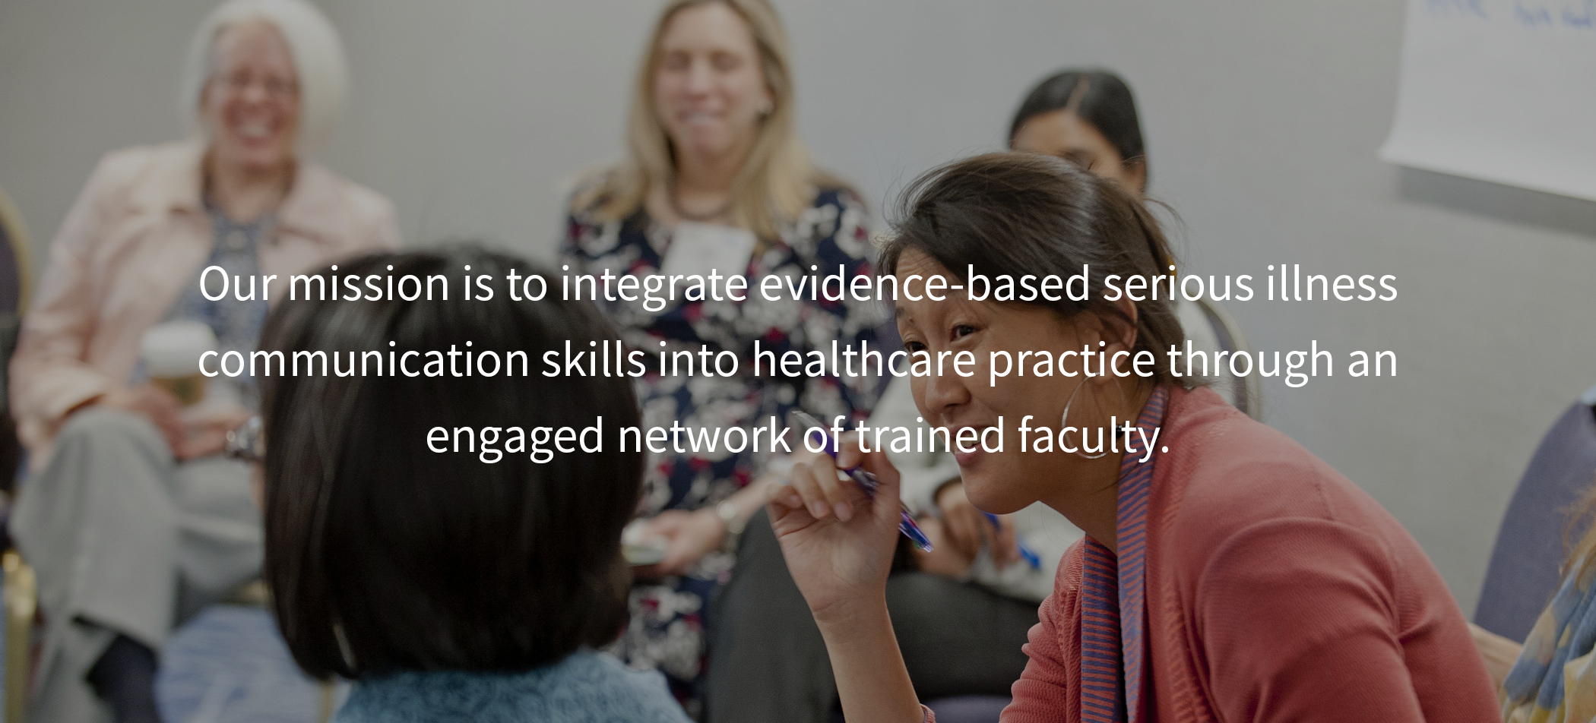
What is VitalTalk?
Communication skills training
Evidence-based
Deliver serious news
Discuss goals of care
Notes:
RS - So why VitalTalk? We thought it might be more effective if we showed you rather than told you…show video

Slide 9
Notes:
Just in case - https://www.youtube.com/watch?v=6N5gKGtIq4Y

Slide 10
Key Points About the VitalTalk Method & Curriculum
Importance of emotion
Simple tools to respond empathetically to emotion
Provide language
Provide opportunity to practice (realistically)
Quick drills
Forgetting is learning
Notes:
RS

Slide 11
Making VitalTalk Specific to Hawai’i
Train local providers as VitalTalk faculty
Train a cadre of local actors who look and talk like our patients
Create cases which reflect local experiences
Adjust curriculum to enable VitalTalk methodology to be applied to allied health professionals
Notes:
RS

Slide 12
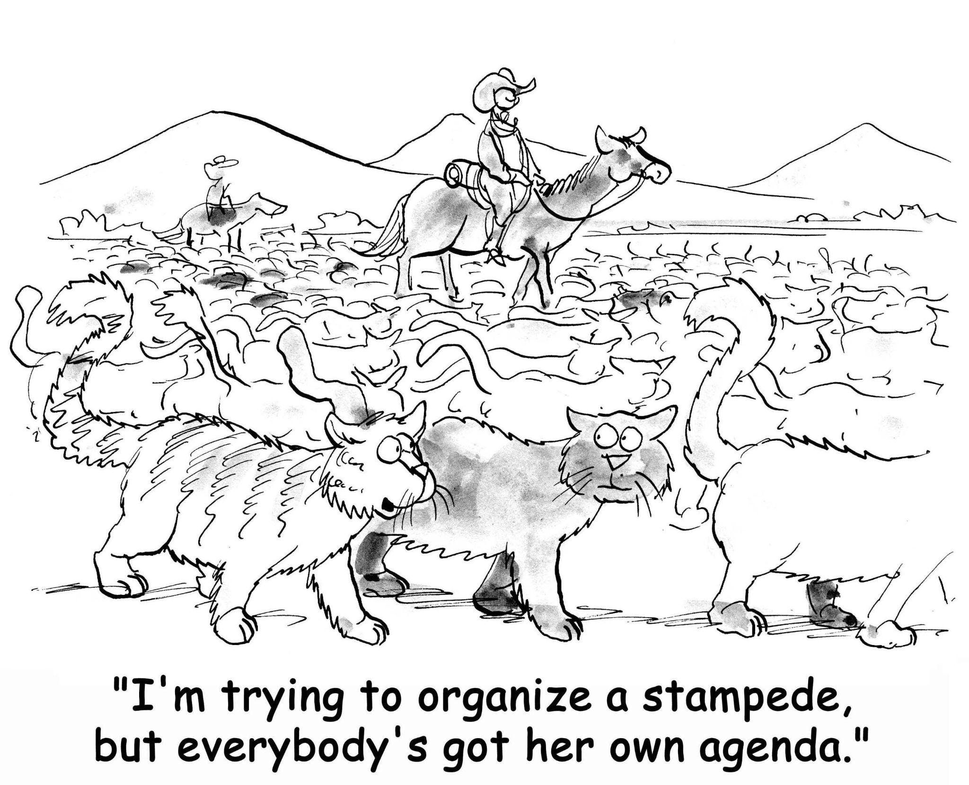
Notes:
RS transition to CC

Slide 13
About the Local Training in Hawaii
Held via Zoom
Typically have 6 trainees
Scheduling consists of 2 VT faculty facilitators, 2 actors, 1 Zoom tech support/coordinator
Invitation letters & talking maps shared with trainees
Evaluations conducted for ongoing improvement
Notes:
CC – Thank you Dr. Seitz. As mentioned, localizing the training was a priority for these sessions. We consider the target audience and work with the organizations and our facilitators to customize each session to optimize the training to reflect the needs of the trainees and theiir patient populations.
Sessions are held virtually for half a day and consists of pre/post surveys and is led by 2 co-facilitators with 2 local actors for the case scenarios.

Slide 14
Local VitalTalk Community Trainings in 2022
Hawaii Pacific Health – Neurology & Oncology (physicians, APRNs, social workers, nurse navigators)
Community Healthcare Workers – Maui College (students)
Geriatric Medicine Fellows – JABSOM
Internal Medicine Residents - JABSOM
Department of Geriatrics Attendings – Queen’s Medical Center
Notes:
CC – while VT was initially created for physician and nurse practitioners, they recognized the importance to build communication skills for interdisciplinary teams and started expanding training to include social workers. In Hawaii, we have extended the training to include community healthcare students, residents/fellows, community healthcare workers & nurse navigators. In the last year, we have completed 9 local sessions with a total of 54 trainees with these organizations. Now I will had it off to Michelle to discuss some of our survey data.

Slide 15
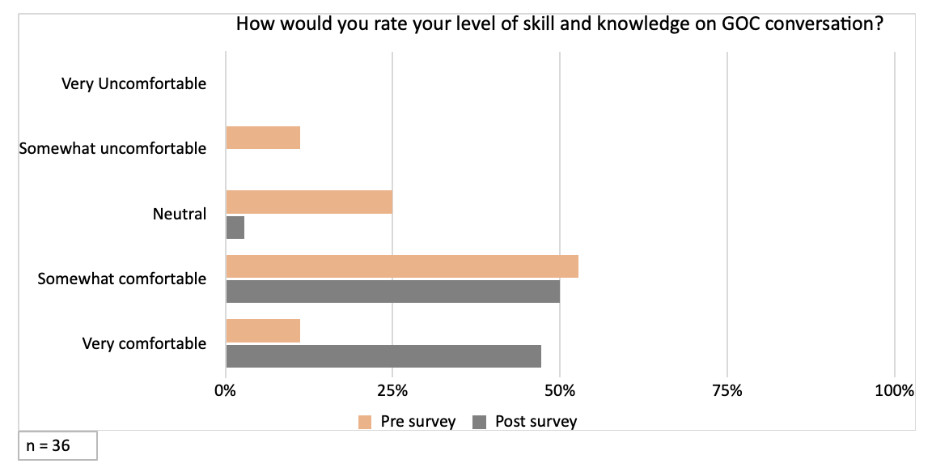
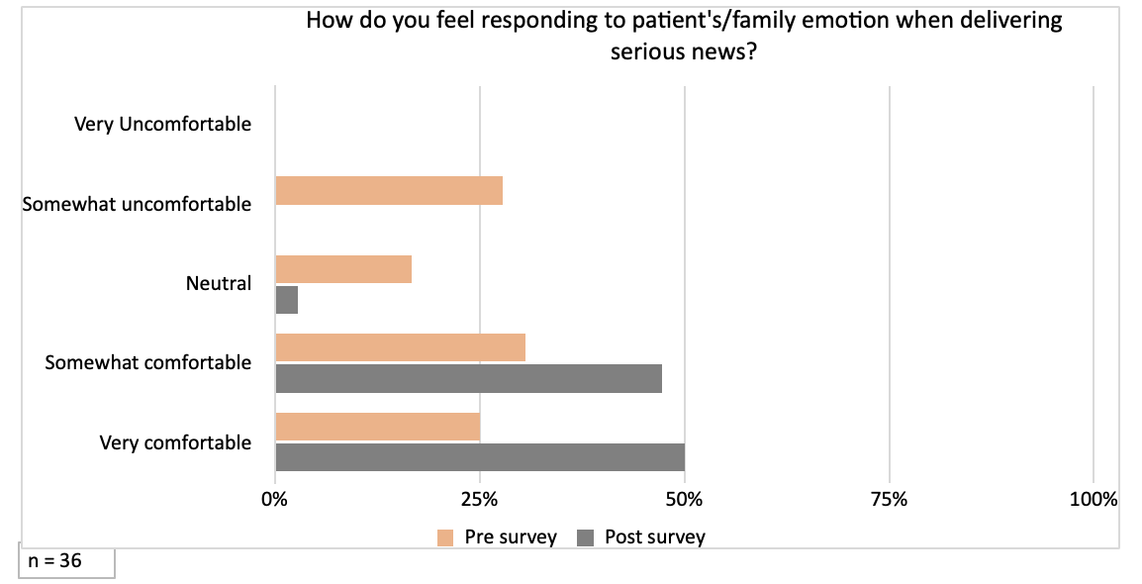
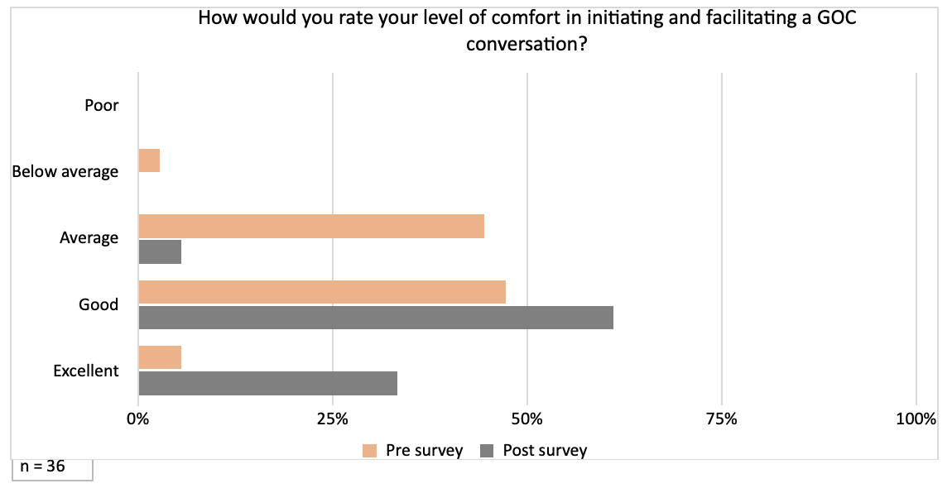
Outcomes of Hawai’i VitalTalk Trainings
Notes:
MC

Slide 16
What will you take forward for your next patient experience?
Practice more empathy and validate statements
Asking first before having the conversation, remembering to explore values/goals before discussion next steps in plan
Being more comfortable to address difficult conversations and emotions
Headline delivery and naming the emotion
Practice NURSE in advance
Transitions, naming emotions. This is excellent training
REMAP and NURSE as a way to frame conversations
Ask myself, “Is this a cognitive question or an emotional questions?” before deciding to respond
Notes:
MC

Slide 17
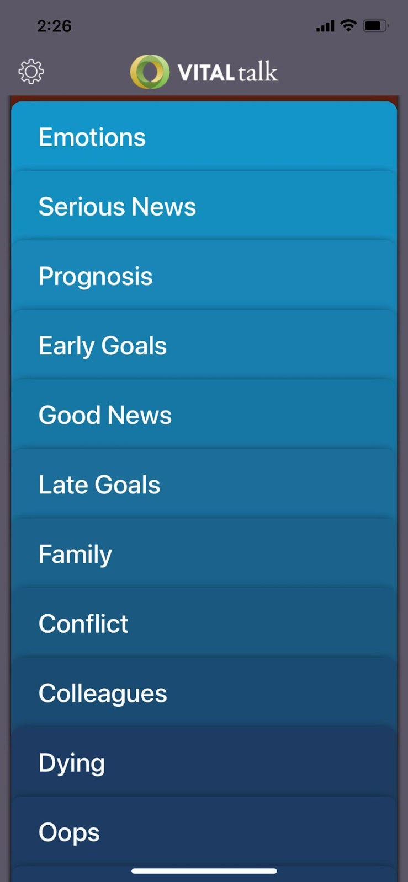
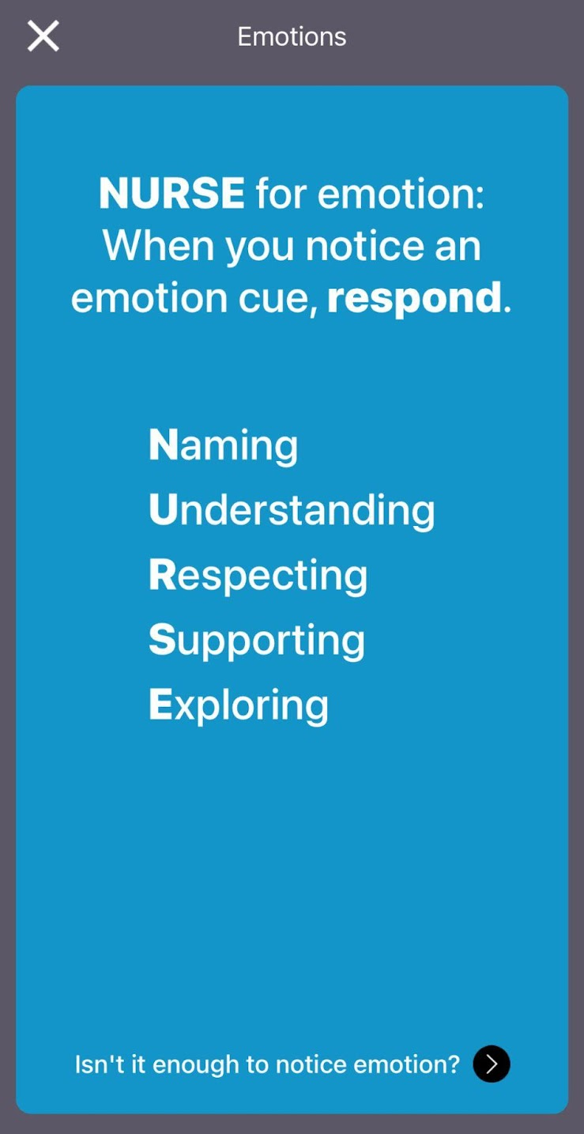
VitalTalk App
Download for Free!
Notes:
MC

Slide 18
IMUA!
VitalTalk Hawai’i Consortium
Join Us!
Ongoing training
Interdisciplinary approach
Continue to train actors
Applied for funding
Another 12-14 VitalTalk Faculty
Offer VitalTalk products to wide array of healthcare providers
Focus on providers who care for MedQUEST members with serious illness
Notes:
RS

Slide 19
Questions / Interest
Please contact via email, Dr. Rae Seitz - raeseitz@gmail.com
For more information, visit VitalTalk at - https://www.vitaltalk.org/
Notes:
RS

