Slide 1
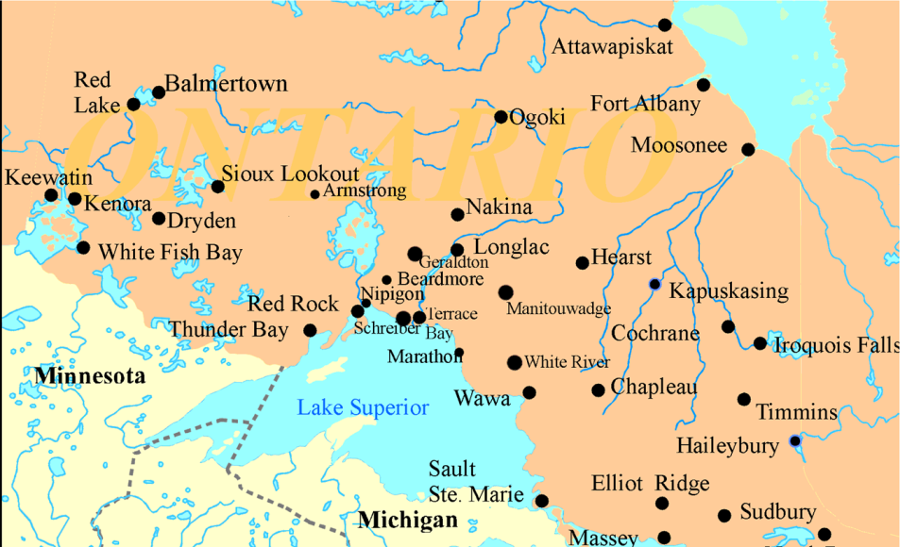
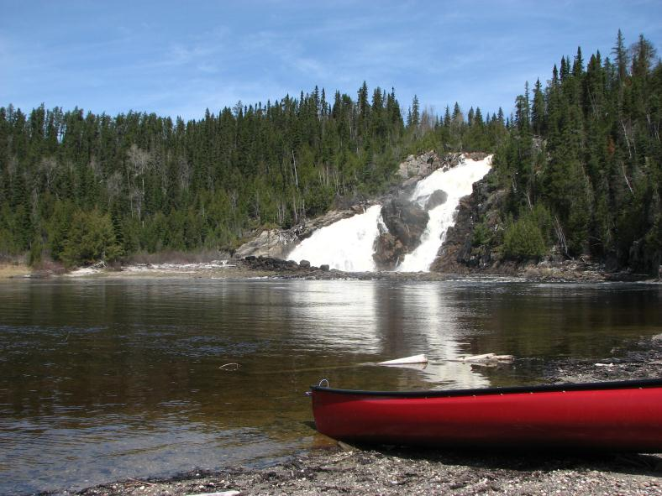
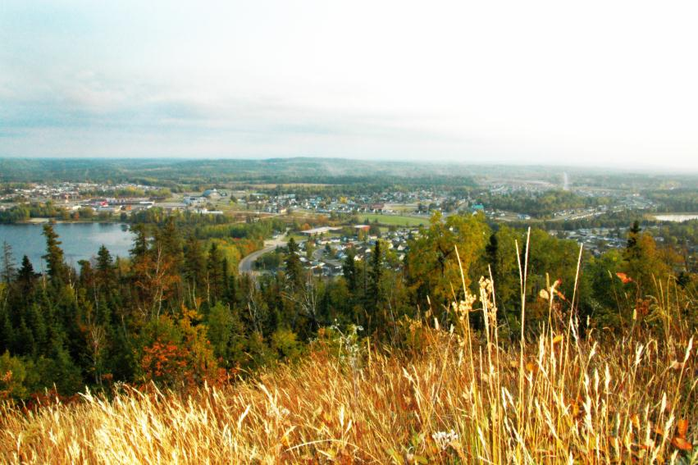
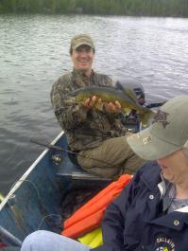
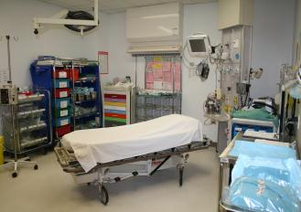
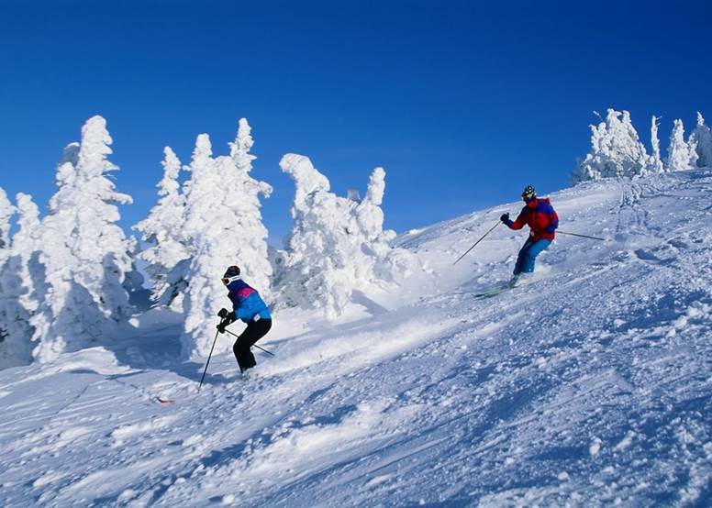
1,900
Pop
Santé Manitouwadge Health
Award Winning Integrated Health Care!!
Our energetic, wonderful interdisciplinary team has been championed by the MOH as a model for rural and northern health care in small communities.
Comprehensive Care
ED, Acute Care (9), Long Term Care (9), Rehab, Lab, DI….
FHT, Primary Care (3 physicians)
Innovative ideas for community involvement!
Metabolic program, Memory clinic, etc.
Dietitian
Nurse practitioner
Social Worker
Physiotherapy
Home Care, MOW, Transportation,
Public Health Promotions
Seeking 2 FT physicians
Locums
1 NP
1 Physiotherapist
Nurses
For more info:
807 826-3251 ext. 276
jbourgoin@mh.on.ca
www.mh.on.ca
EXCELLENT OPPORTUNITY TO PROVIDE COMPREHENSIVE CARE WHILE RECEIVING VERY LUCRATIVE COMPENSATION

