Slide 1
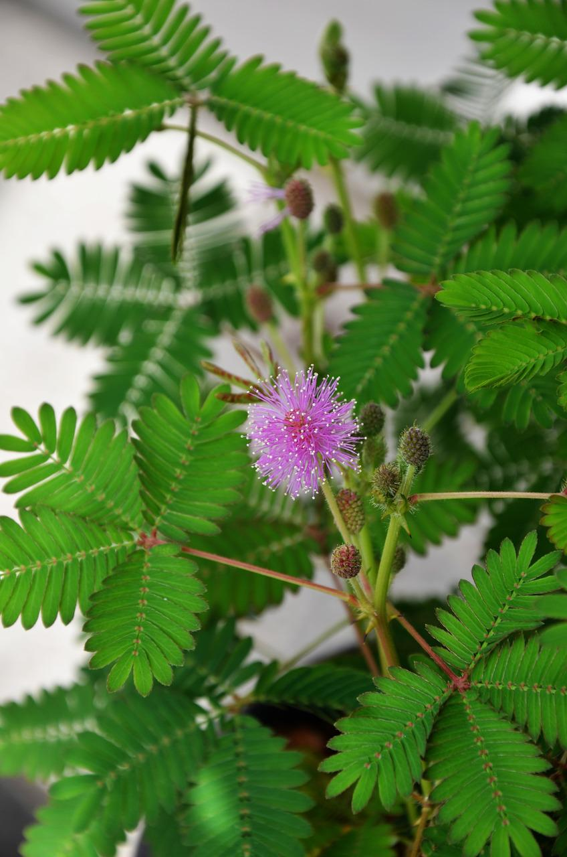
Provider “Resiliency”
Kapono Chong-Hanssen, MD
Medical Director of Ho`ōla Lāhui Hawai`i Kaua`i Community Health Center

Slide 2
Why Developing Individual “Resilience” Isn’t Enough to Heal Moral Injury
Moral Injury: similarity between health care workers and military veterans
“simultaneously knowing what your patients need and being unable to get it for them because of constraints outside of your control”
“perpetrating, failing to prevent, or bearing witness to an act that transgresses deeply held moral beliefs. In health care, those deeply held moral beliefs are the oaths that we took to put our patients first.”
https://www.ihi.org/communities/blogs/why-developing-individual-resilience-isnt-enough-to-heal-moral-injury

Slide 3
The Solution Shop and the Production Line — The Case for a Frameshift for Physician Practices
“Many clinicians feel an institutional push toward production line activities and an opposing personal-mission pull toward the solution shop to address patient symptoms, build trust, and minimize suffering. The tension between these two poles contributes to moral distress and burnout”
https://www.nejm.org/doi/full/10.1056/NEJMp2202511

Slide 4
Preventing Burnout: Talking to Colleagues Is Good Medicine
“What participants have told us is simply having that time to be with their colleagues, having that be protected and endorsed by the organization, is valuable in and of itself.” Colin P. West, MD, who initiated the COMPASS (Colleagues Meeting to Promote and Sustain Satisfaction) program at Mayo Clinic
https://www.consultant360.com/article/primary-care/preventing-burnout-talking-colleagues-good-medicine

Slide 5
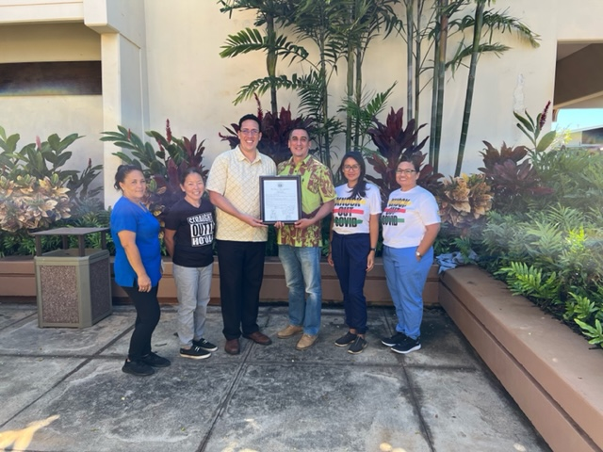
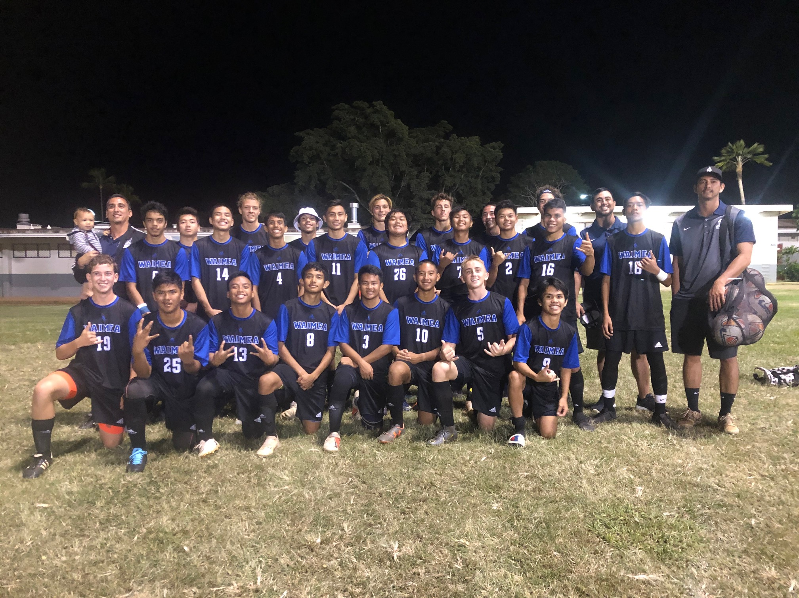
Factors at Ho`ōla Lāhui Hawai`i Kaua`i Community Health Center
More time with patients, 10-15 per day
More grateful patients
EHR Templates and staff support to ease the burden of the “production line”, Pharmacy, Prior authorizations
Policy strengthening to reduce chronic pain and other morally draining care burden
4 hours of administrative time per week
Minimal patient portal communication to providers
Increasing younger UH associated providers, education for UH-JABSOM students
Quarterly Peer Review Dinners paid for by administration
Work schedule flexibility as much as possible
WE ARE A TEAM!
Notes:
Fewer self google doctors

