Slide 1

Thinking about the Hawai’i Health Workforce as a Public Good
Len M. Nichols, Ph.D.
Non-Resident Fellow, Urban Institute, and Professor Emeritus, George Mason University
Hawai’i Health Workforce Summit
September 24, 2022

Slide 2
Overview
Some of what we know about shortages and consequences
What is a “Public Good?”
Think about the health workforce as part of Hawai’i’s social ecosystem, which has public good properties
Who benefits and who should pay for enhancement of that workforce?

Slide 3
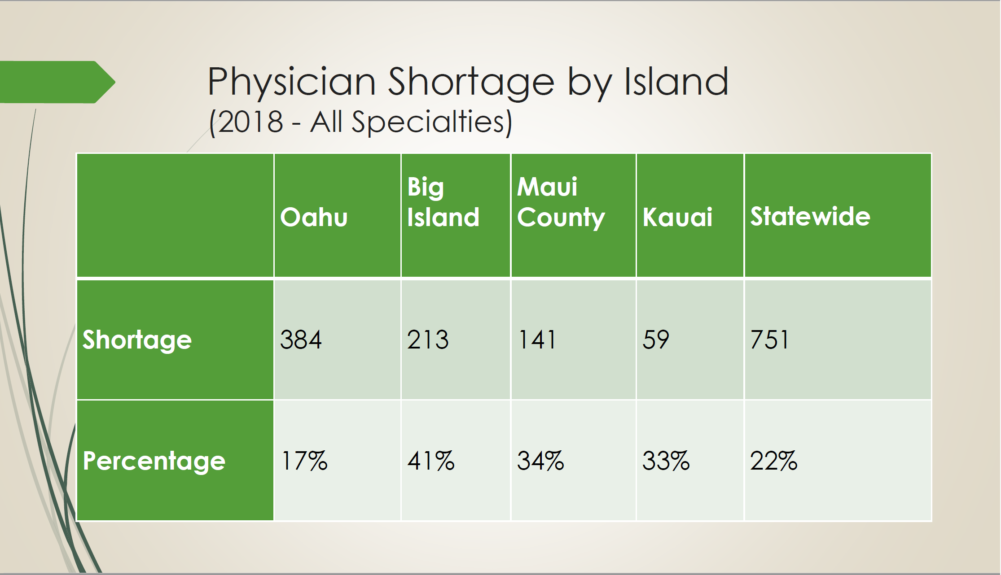
Source: Kelley Withy, Legislative Briefing, August 21, 2019

Slide 4
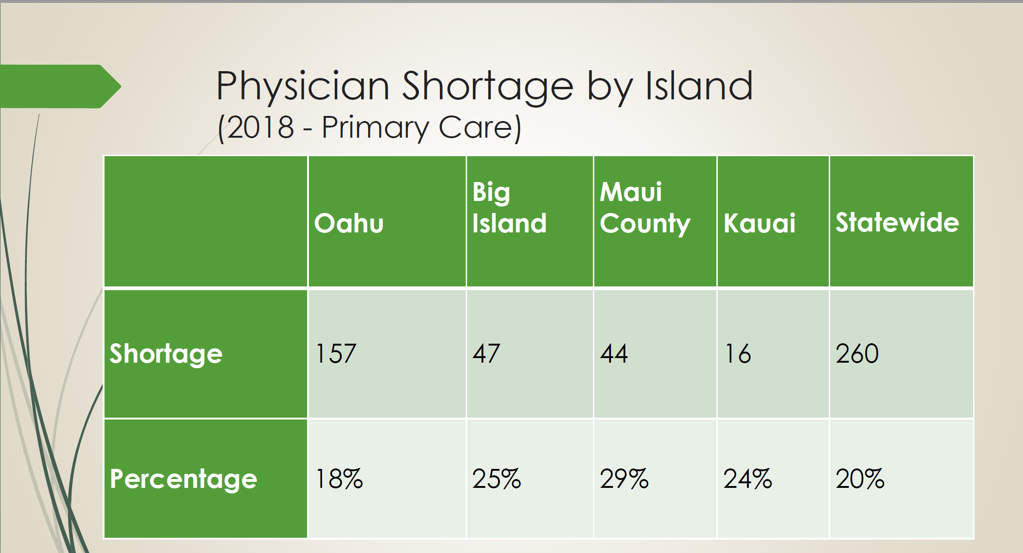
(15.5) (15) (14) (16) (15)
Source: Kelley Withy, Legislative Briefing, August 21, 2019; ( ) https://data.hrsa.gov/tools/shortage-area/hpsa-find

Slide 5
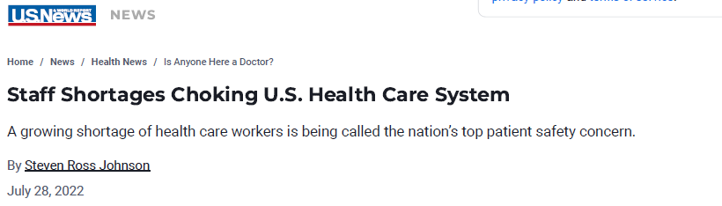
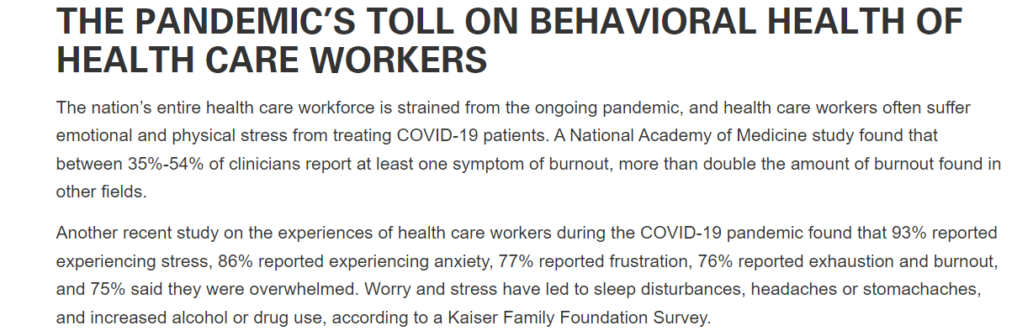
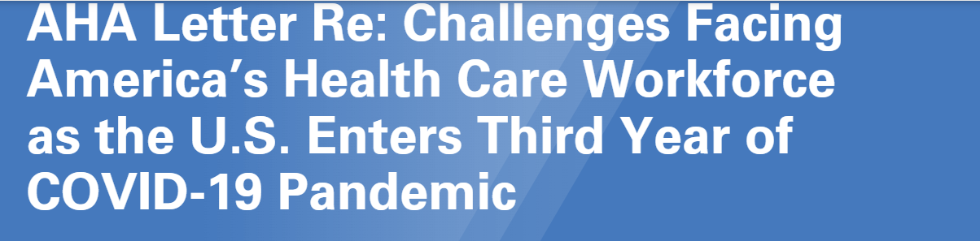
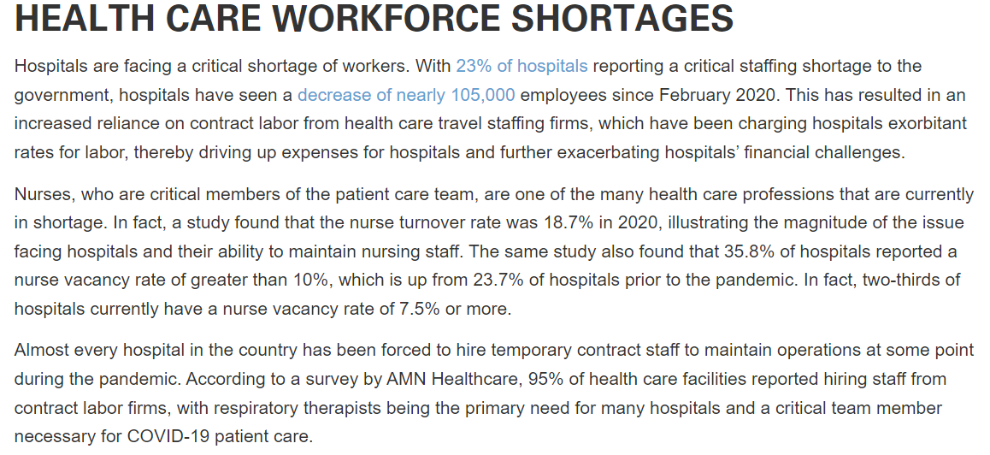

Slide 6


Slide 7
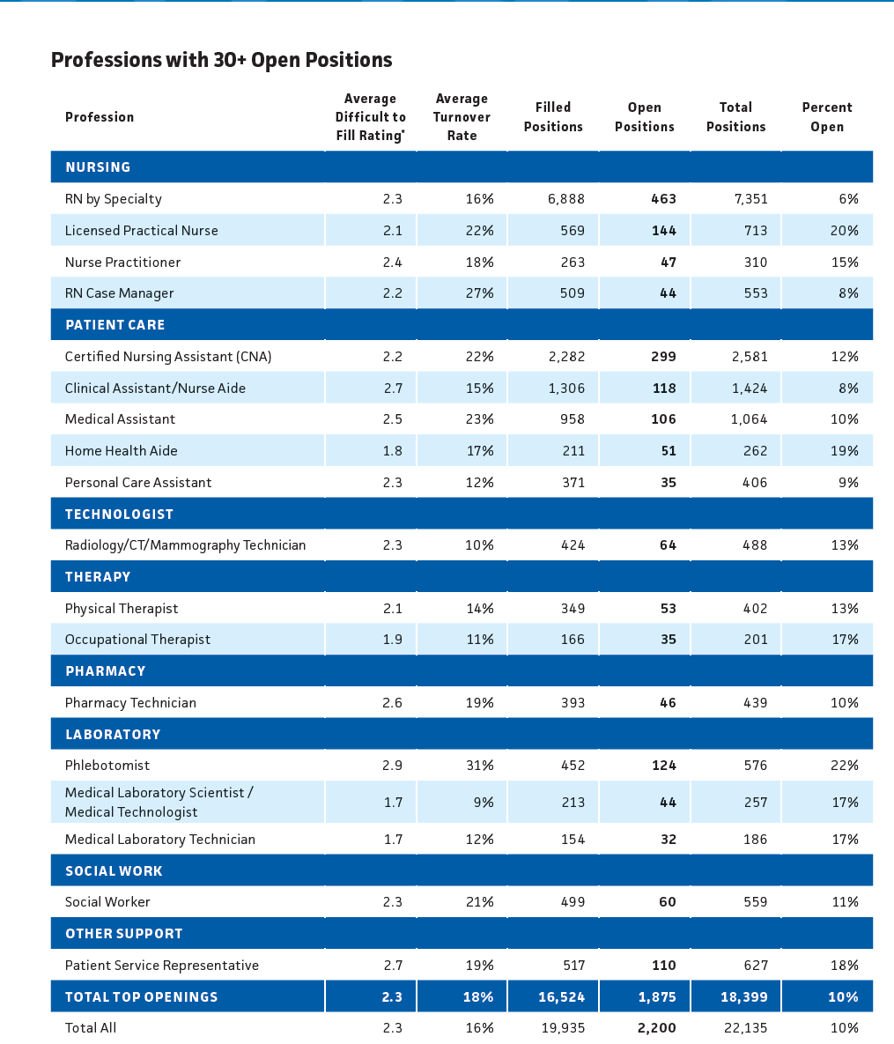
Median Wage (BLS data)
53.40
24,90
62.98
62.34
17.79
18.69
14.17
37.71
45.73
45.18
17.75
17.91*
29.26
37.15

Slide 8
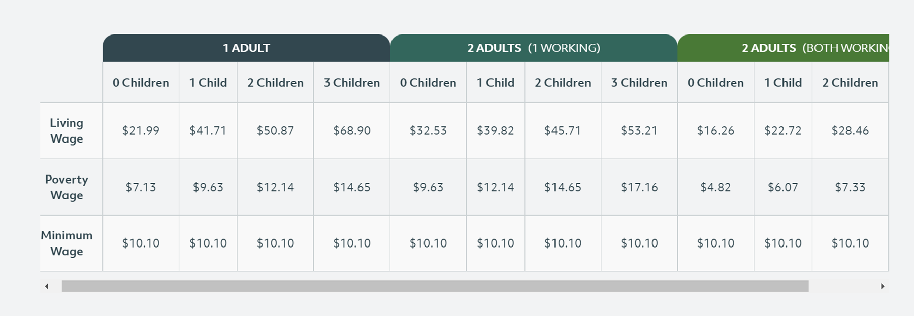
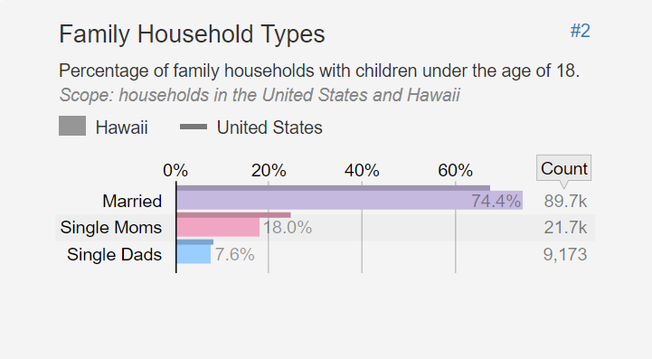
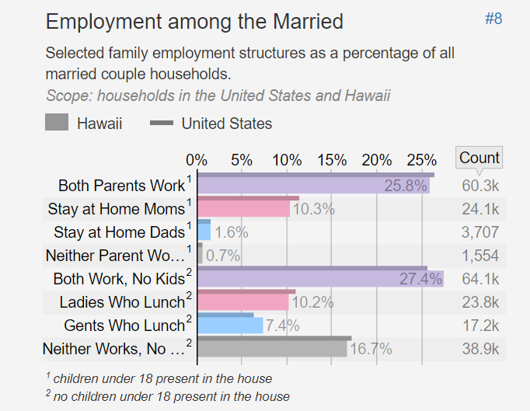
LIVING WAGE CALCULATIONS for HAWAI’I, 2021
https://livingwage.mit.edu/states/15
https://statisticalatlas.com/state/Hawaii/Employment-Status

Slide 9
Uniquely Hawaiian Contributors
Rural realities
  Provider shortages worse than in urban areas
  Incomes, health status lower, social service needs greater, services less prevalent
  Telehealth capacities limited
Cost of living
  Hawai’i ranks # 1 in COL in US: index = 193.3, NY =148, CA=142
  Hawai’i housing cost index = 315; NY housing = 230, CA = 202
  Hawai’i ranks 47th in home ownership, at 58% (WV #1, at 76%)
https://worldpopulationreview.com/state-rankings/cost-of-living-index-by-state

Slide 10
Costs of Health Workforce Shortages
Waits longer, health outcomes worse, and likely negative equity impacts
Health costs and prices higher as some wages bid up precipitously, operating margins squeezed
Burnout and mental health stress broader and deeper
Pandemic intensified all of these effects
Closures, shutdowns, cutbacks, etc. deter investment in rest of local economy

Slide 11
What IS a Public Good?
Multiple people/organizations can benefit simultaneously (non-rivalrous)
Expensive or impossible to prevent others from benefitting even if they don’t pay (non-excludable)
Enhances the value of many things, of living in a society with them

Slide 12
What IS a Public Good?
Examples:
  National Defense
  Lighthouses
  Streetlights
  Police and fire protection
  Flood protection
  Roads
  Dams
  Weather forecasts
  Parks
  Vaccinations

Slide 13
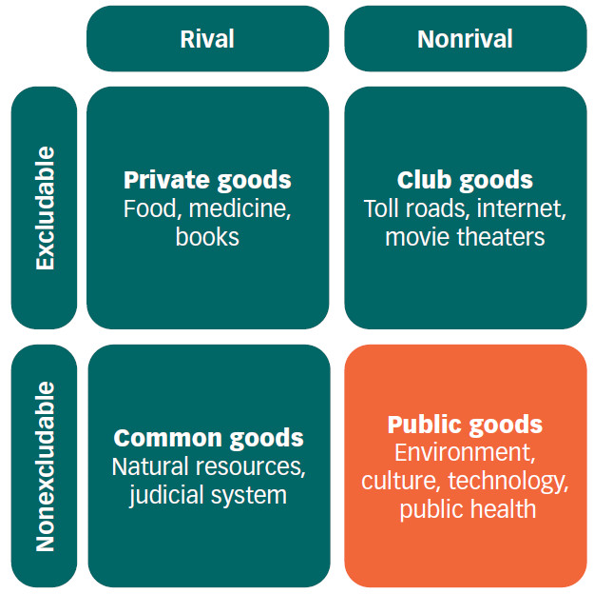


There are Degrees of Public Good-ness
Policy/Law

Slide 14
There are degrees of benefits as well
Flood protection
Vaccinations
Health care in general
  Private value high for treatment of non-contagious conditions
  Public value high for contagious prevention and treatment
  Public value high for screening of contagious conditions
Education
  Knowledge is a pure public good (sort of)
  Public v. Private value of education varies from k-5 through post-graduate

Slide 15





Differential Benefits…
People
Houses
Businesses
Government
Fire protection

Slide 16
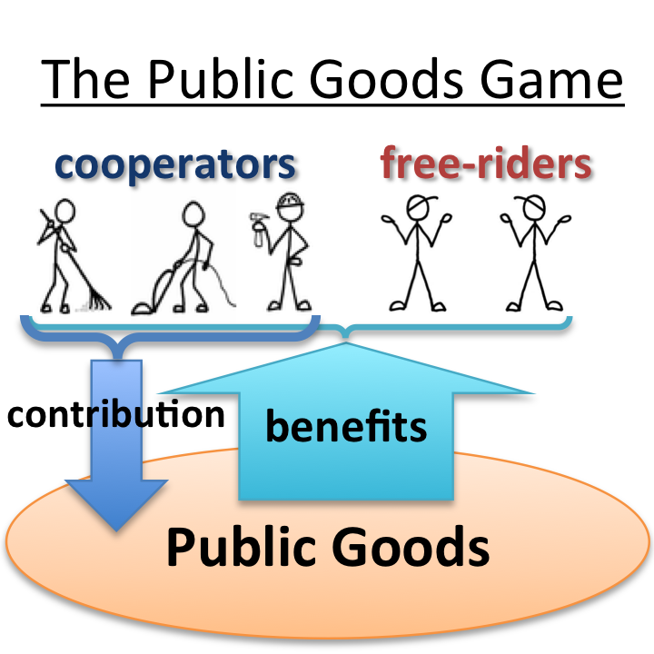
Why don’t we have “enough” public goods?
Exclusion is hard,
and free-riding is
self-interested

Slide 17
Who Benefits from a Healthy Health Workforce?
Population at large
Health organizations, including insurers, and health workers
Employers
Governments
Civil society/philanthropy

Slide 18
Some Good Hawaiian Facts, and One Implication
#1 among US states in Life Expectancy, 80.7 (down 1.6 since 2019)*
  But, you’ve got 10-12 year disparities in LE on every island
2nd lowest employer premiums, 11% below US avg (AR 14% lower than US avg)**
IMPLICATION: Hawai’i has been getting an unfunded “bargain” or “consumer surplus” from its health system for a long time
*https://www.cdc.gov/nchs/data/nvsr/nvsr71/nvsr71-02.pdf
**https://datatools.ahrq.gov/meps-ic#block-ahrqparagraphblock

Slide 19





“Free Riding” on Unfinanced Surplus Value Delivered by Straining Health Workforce
VALUE Delivered
People
Insurers
Employers
Government
Payments Made

Slide 20
Not So Good Hawaiian Facts
3rd highest tax burden, 14.1%, behind NY (15.9%) and CT (15.4)
  Hawaii has higher than average state sales and lower than average state income tax collections, lower than average local property as well
https://taxfoundation.org/tax-burden-by-state-2022/

Slide 21
Solutions to Free-Rider Problems
Government taxation and provision
Vickery-Clarke-Groves
Explicitly Collaborative Approaches
CAPGI (https://capgi.urban.org)
Common Spirit
Co-opetition

Slide 22

Collaborative
Approach to
Public
Good
Investments
https://www.healthaffairs.org/doi/full/10.1377/hlthaff.2018.0039
https://capgi.urban.org/

Slide 23
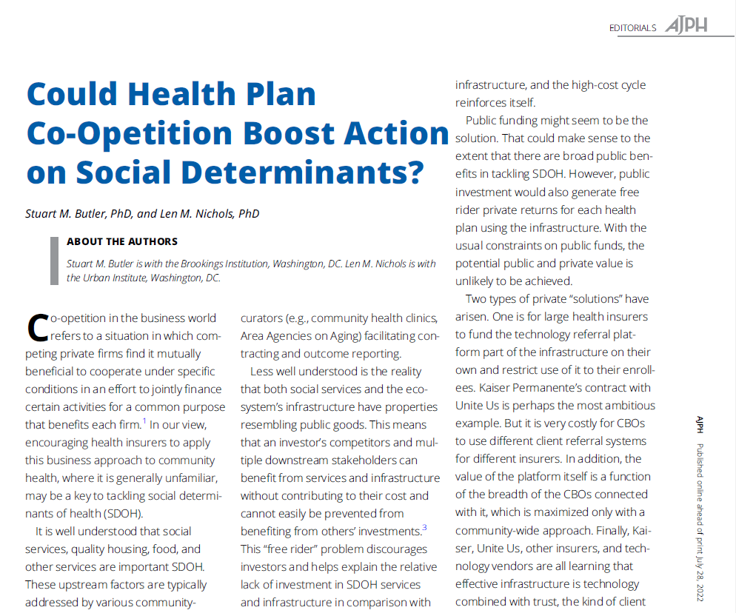
https://ajph.aphapublications.org/doi/full/10.2105/AJPH.2022.306941

Slide 24


Consequences of leaving health workforce shortages to health care system alone
Payment rates, prices, wages, premiums, etc, will have to rise, a lot
Free-riders may not pay directly, but will suffer growing opportunity costs of inadequate health workforce
In essence, the choices are:
  Continue Individualistic strategies and let workforce shortages fester and worsen, OR
  Collaborate to raise payments, wages, subsidies, and taxes to fill workforce gaps

Slide 25
Elements of Collaboration
Define and measure the costs which stakeholders bear now from health workforce shortages = lower bound estimate of value of adequate/high performing health workforce
  Value will vary by stakeholder
Estimate costs of remedying workforce shortages
  Payment rate, wage and/or subsidy increases and/or working condition changes that are necessary
    1% increase in one insurers’ MLR could provide $29k more for each PCP in Hawai’i
  Increase in teaching/training capacities, pipelines and highways
  Investment in new housing stock and financing arrangements required
Create Balanced Stakeholder Group to Govern Collaborative Process
  Determine priority workforce targets and actions
  Revisit opportunity cost/value of remedying shortages
  Assign “fair” prices to each stakeholder (deal with would-be free riders one way or another)
  Execute strategy, track outcomes, tweak programs, repeat…

Slide 26
What is the End Game of Health Workforce Collaboration?
Hawai’i could re-create a sustainable “Beloved Community”
Values and prices will be more closely aligned
System will be more sustainable
Sustainability requires recognition life is NOT a zero-sum game

Slide 27
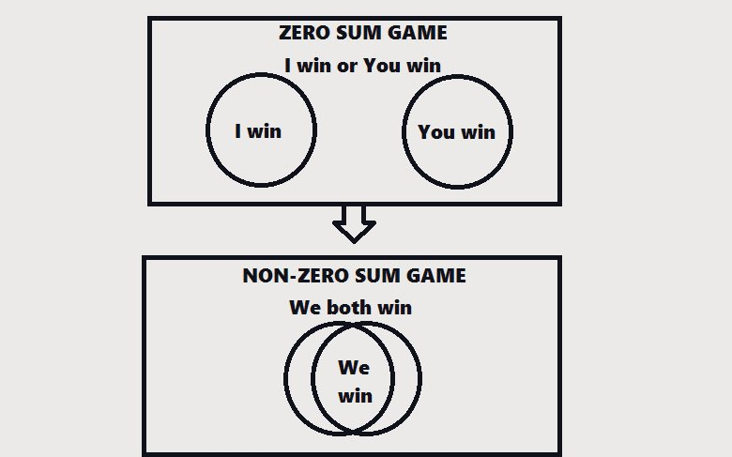
The world does not have be zero sum. Ike.
“Ultimatum Game”
The Fair Society
By Peter Corning
NONZERO
By Robert Wright
https://www.livinginhawaii.com/hawaii/hawaiian-philosophy-of-life-part-1-the-7-principles-of-huna/
Notes:
Ike: what we believe is real. Our ideas create reality. The world is exactly what you think it is.

Slide 28
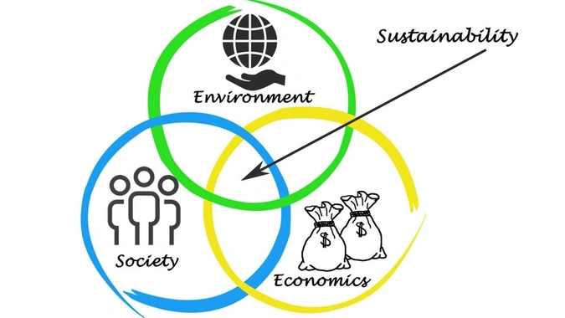
Health Workforce
Sustainability = Balance
Balance requires self-restraint, collaboration

