Slide 1
CNE Joint Activity
This activity has been planned and implemented in accordance with the accreditation requirements and policies of the American Nurses' Credentialing Center (ANCC) through the joint providership of Hawai'i State Center for Nursing and the Hawaii/Pacific Basin Area Health Education Center. Hawai'i State Center for Nursing is accredited as a provider of nursing continuing professional development by the ANCC's Commission on Accreditation.
The Hawai‘i State Center for Nursing designates this activity for a maximum of 7.5 contact hour.

Slide 2
CNE Disclosures
To receive continuing education credit, the participant must register and attend the activity, claim credit commensurate to their participation in the activity, and complete an evaluation form.
Full information regarding continuing nursing education is accessible on the FourWaves website under CNE tab.

Slide 3
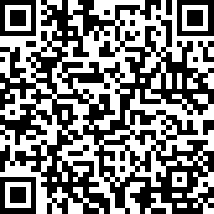
Nursing Continuing Education is only accessed by completing this survey
The Hawai‘i State Center for Nursing designates this activity for a maximum of 7.5 contact hour.
Access the link on the FourWaves website under: How Did We do? or
Follow the link or scan the QR code to access the evaluation:
https://www.surveymonkey.com/r/CE_57_092422
Please remember you must complete an evaluation to receive CNE credit. The evaluation will close on October 01, 2022, at 11:45 pm.
Once the evaluation closes, you will not be able to claim CNE credit for this activity. Please remember to print/save your certificate upon completion of the evaluation. It will not be available after you close the window. A secondary certificate can be produced for you at a cost.

