Slide 1
Cholestasis of Pregnancy: Diagnosis and Management
Dr. Laura Power
Department of OBGYN TBRHSC

Slide 2
Disclosure Slide
Relationships with commercial interests:
Grants/Research Support: TBRHSC Seed funcing
Speakers Bureau/Honoraria: Bayer, Pfizer, Hologic
Potential for conflict(s) of interest:
I am a member of the Conference SPC

Slide 3
Learning Objectives
At the end of this presentation, participants will be able to:
Understand the pathophysiology of intrahepatic cholestasis in pregnancy and how it can contribute to adverse fetal and maternal outcomes.
Create a treatment and delivery plan for patients suffering from cholestasis of pregnancy.
Intrahepatic Cholestasis of Pregnancy = ICP

Slide 4
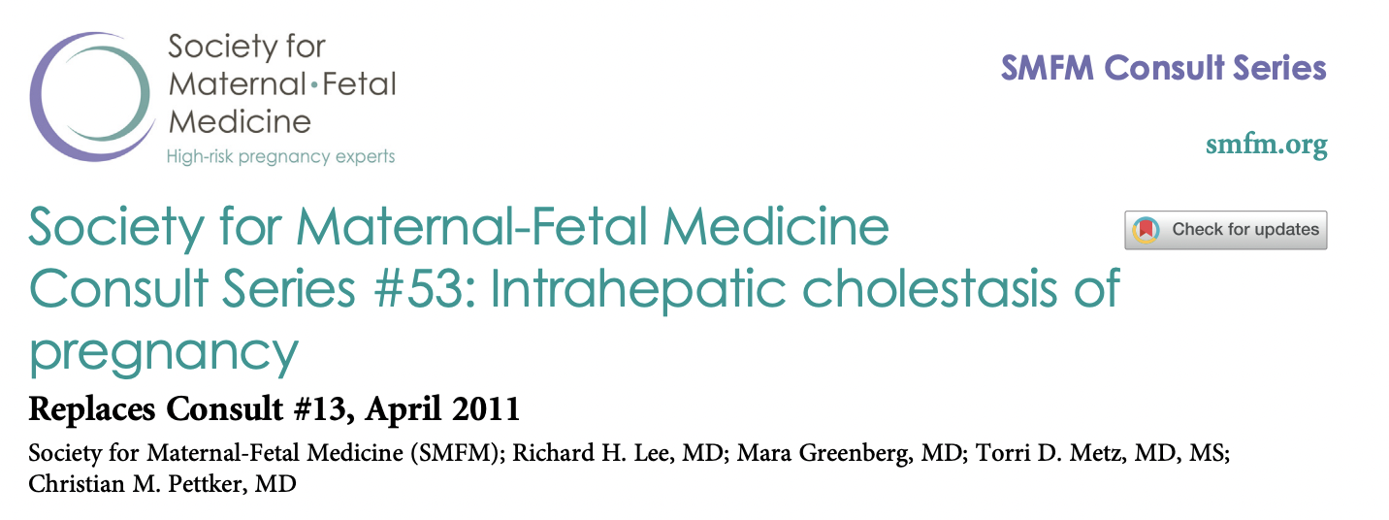
A Tale of Two Guidelines
Green Top (2022)
Society for Maternal Fetal Medicine (2021)

Slide 5
A Tale of Two Guidelines + The Real World

Slide 6
Winnipeg
Muddy Waters

Slide 7
What is ICP?
Increases in production of bile acid and decrease in clearance causes buildup of bile acids in systemic circulation
Bile acids cross the placenta and accumulate in amniotic fluid and fetal circulation
Notes:
Bile is composed of bile salts among other things. Bile salts are conjugated bile acids synthesized in the liver from cholesterol and their job is to help emulsify fat so that we can absorb and use it. Bile acids increase in states of high estrogen and progesterone like in pregnancy. Estrogen increases hepatic uptake of cholesterol and progesterone increases the hepatic secretion of bile especial the type of acids that prefer to create stones. Rate of synthesis of bile acids is usually regulared by negative feedback of bile salts returning to the liver via the enterhepatic circulation. The resulting increase in bile acids causes cholestasis not from stone formation and blockage but from the fact that production in increased and there isn’t a proportional increase in clearance and this negative feedback regulation is disrupted. . In fact clearance may be decreased because progesterone also decreases smooth muscle function (ie. One of the reasons why pregnant women get heartburn that sphincter isn’t working either).

Slide 8
Risk Factors
Genetic predisposition
0.1 – 1.5 % in Europe and NA vs 6 – 29% in SA and Scandinavia
Mendelian dominant inheritance pattern
Previous ICP – recurrence rate is around 60-90%
Hepatitis C
Seasonal variation
2x higher in October to December vs May and June
? Environmental
Pre-existing liver disease
Advance maternal age
Multiple gestation
Low Vitamin D levels

Slide 9
Maternal and Fetal Risks
Itching
Sleep deprivation
Preterm delivery (spontaneous and iatrogenic)
GDM
Preeclampsia
Meconium
Admission to NICU
Intrauterine demise
Notes:
Bile salts activate oxytocin receptors
Screen for GDM as per guidelines do not need to rescreen just for ICP

Slide 10
Closer look at IUFD
Bile salts cross the placenta
Mechanism of fetal death unknown
Vasoconstriction and fetal asphyxia?
Cardiotoxicity, arrhythmia and cardiac arrest?
No prodrome or warning signs

Slide 11
Diagnosis of Exclusion
Structured history and exam
Pruritis
NO RASH, NO STIGMATA OF LIVER DISEASE
May have
Fatigue from lack of sleep
Occasional nausea/emesis
Mild jaundice
Order
Bile acids (sent to St. Michael’s hospital takes 6 – 10 days)
Do not need to be fasting
ALT
Diagnosis = itching + elevated bile acids and negative everything else
Notes:
Typically itching starts in late T2 early T3 and may be accompanied by excoriations but not rash
Itching will typically be on palms and soles progressing to legs arms back breast and belly and worse at night
There will be no findings on physical exam
Repeat testing in a few weeks if itching persists but blood results were normal – ICP can be
If itching and bile acids resolve in pregnancy then the diagnosis is unlikely
PTT is not recommended by Green top guideline but they do say that steatorrhea can impair vitamin K absorption
ALT recommended by MFM guidelines

Slide 12
DDx Itch without Rash
Liver disease
(including ICP)
Chronic renal failure
Hypo- or hyperthyroidism
Acute fatty liver of pregnancy
Malabsorption
Parasites
HIV
Leukemia
Lymphoma
Polycythemia rubra vera
Paraneoplastic syndrome
Drugs
Multiple sclerosis
Psychiatric disease
Notes:
(hydrochlorothiazide, opioids, among others)

Slide 13
DDx Elevated Bile Acids
Primary biliary cholangitis
Obstructive bile duct lesion
Primary sclerosing cholangitis
Drugs (septra)
Liver tumour
Infection (hepatitis, EBV)
Autoimmune
Notes:
(hydrochlorothiazide, opioids, among others)

Slide 14
Possible Further Lab Testing
Liver panel
INR/PTT
Hepatitis serology
Blood sugar
Liver MRI
Liver ultrasound
Tox screen
CBC
Autoimmune markers
Notes:
Both guidelines agree that you should only Order if history or physical exam dictates this ie. Steatorrhea, pain, weight loss, significant nausea and vomiting, early presentation, excessive fatigue not explained by loss of sleep, elevated liver enzymes greater than 2x normal, easy bruising, rash, (green top guideline)
Green top says routine Hep C not recommended

Slide 15
Management
Referral to OBGYN, MFM, hepatology
Delivery is the cure
Goals are to minimize risk to fetus
Prematurity vs sudden fetal death

Slide 16
Monitoring
Maternal monitoring:
Monitor ALT, bile acids, PT
?frequency
Fetal monitoring:
All women should be doing kick counts
No evidence that NSTs or BPPs can predict still birth
But do them anyways . . . ??
Monitoring in labour
CEFM if bile acids > 100
If bile acids < 100 monitor as per obstetrical indications
Notes:
Green top doesn’t give a frequency because itching doesn’t correlated to bile acids. They also say that delivery is based on peak bile acids . . . So . . . ??they venture to say that weekly bile acids for mild as they approach 38 weeks, none for severe because it won’t change management plan,
Green top says that ICP not associated with IUGR
MFM study says no serial monitoring but repeat as necessary?

Slide 17
Symptom Management:
Topical emollients (menthol)
Antihistamines (itch and sedation)
Usodeoxycholic acid (UDCA)
10-15 mg/kg/day to 21 mg/kg/day
300 mg po bid
Will have effect in 1-2 weeks
Rifampin
Experimental
Vitamin K
Only if steatorrhea and abnormal coagulation studies
Notes:
MFM says it reduces risk of preterm birth
MFM says it reduces itch – Green top says it doesn’t
FMF says it reduces bile acids – Green top says it doesn’t

Slide 18
When to induce
Based on one study . .. ..
Risk of still birth is only based on peak bile acid levels
Not associated with itching or other liver parameters
Baseline risk of IUFD in UK was 0.29%, 0.1-0.3% in the US
Notes:
c/s only if indicated

Slide 19
When to induce: Green Top
Rate of IUFD was based on bile acids
Severe ICP: > 100 umol/L
Prevalence was 3.44 % or 18/524
Advised IOL at 35 to 36 weeks
Moderate ICP: 40 – 99 umol/L
Prevalence was 0.28% or 4/14
Advised IOL at 38 – 39 weeks (greentop)
Mild ICP: 19 – 29 umol/L
Prevalence was 0.13% or 3/2310
Women with ICP and other comorbidities
Unknown risk of still birth
Consider IOL at 36 – 39 weeks

Slide 20
When to induce: MFM
Rate of IUFD was based on bile acids
If > 100 umol/L induce at 36 weeks
If < 100 umol/L induce between 36 and 38+6
If high risk induce between 34 – 36 weeks
Previous still birth due to cholestasis
Excruciating itching
Worsening hepatic function

Slide 21
When to induce: The Real World
There is increased risk of still birth
Still birth is unpredictable
The ARRIVE trial changes our perception of induction risk
Definition of comorbidities and worsening liver function is vague
The patient has a perception of risk as well

Slide 22
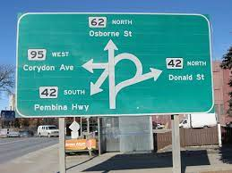

Slide 23
Follow up
Repeat bile acids and LFTs to ensure return to normal levels at least 4 weeks postpartum
No need to avoid OCPs
No need to avoid HT later in life
Risk in subsequent pregnancies is high
Notes:
If still abnormal question the diagnosis and refer for further work up

Slide 24
Pop Quiz: True or False
The guidelines say that Hepatitis C is a risk factor for ICP but we should not routinely test for it
The diagnosis is made based on a history of itching without rash and elevated bile acids
Ursodeoxycholic acid is the treatment of choice because it decreases itching and bile acid levels
Induction of labour decreases the risk of stillbirth

Slide 25
Summary
Diagnosis of exclusion
Refer to OBGYN
Measure bile acids and ALT
Other testing as needed
Monitor bile acids and other tests as indicated
Treat with ursodeoxycholic acid
Fetal surveillance unhelpful but usually done
Induce between 36 and 39 weeks (maybe earlier)

Slide 27
References:
Almas, L.T. “Intrahepatic Cholestasis of Pregnancy” J Obstet Gynaecol Can 1995;17:343-51
Girling, J., Knight, C.L., Chappell L., “Intrahepatic cholestasis of pregnancy” Green-top Guideline No. 43 June 2022
Grand’Maison, S. Durand, M, Mahone, M. “The Effects of Ursodeoxycholic Acid Treatment for Intrahepatic Cholestasis of Pregnancy on Maternal and Fetal Outcomes: A Meta-Analysis Including Non-Randomized Studies” J Obstet Gynaecol Can 2014;36(7):632–641
Lee, R. H., Greenberg, M., Metz, T.D., Pettker, C.M., “Society for Maternal-Fetal Medicine Consult Series #53: Intrahepatic cholestasis of pregnancy” Society for Maternal Fetal Medicine February 2021
Ovadia C, Seed PT, Sklavounos A, Geenes V, Di Ilio C, Chambers J, et al. Association of adverse perinatal outcomes of intrahepatic cholestasis of pregnancy with biochemical markers: results of aggregate and individual patient data meta-analyses. Lancet. 2019;393(10174):899–909.
Pillarisetty LS, Sharma A. Pregnancy Intrahepatic Cholestasis. [Updated 2022 Jun 12]. In: StatPearls [Internet]. Treasure Island (FL): StatPearls Publishing; 2022 Jan-. Available from: https://www.ncbi.nlm.nih.gov/books/NBK551503/

Slide 28
Questions and Discussion
Thank you for your time today!

Slide 29
Session Evaluation and Reflection These short forms are important to your learning process and our planning process!
For speakers: Your responses help them understand their strengths and weaknesses, participant learning needs, and teaching outcomes
For the CEPD office:
To plan future programs
For quality assurance and improvement
To demonstrate compliance with national accreditation requirements
For YOU: Reflecting on what you’ve learned and how you plan to apply it can help you enact change as you return to your professional duties
Please take 3-5 minutes to fill the evaluation form out. Thank you!
Use your phone camera to access the evaluation via the QR Code.

