Slide 1
Leveraging Policy to Address Hawaiʻi’s Health Workforce Shortages
2022 Hawaiʻi Health Workforce Summit
September 24, 2022
Aimee Malia Grace, MD, MPH, FAAP
Director, Office of Strategic Health Initiatives
(Lead, UHealthy Hawaiʻi Initiative and UH System Federal Relations)
University of Hawaiʻi System
Notes:
Interactive

Slide 2
Disclosures
No relevant disclosures.

Slide 3
My Career Path

Slide 4
Agenda
Discuss policy as a mechanism to improve Hawaiʻi’s health workforce shortages through the following approaches:
UHealthy Hawaiʻi Initiative
Rural Health Research and Policy Center
Other federal initiatives

Slide 5
Established in 2018
Initiative to improve health and health care in Hawaiʻi and the Pacific by leveraging the UH System’s health sciences programs and forging meaningful collaborative partnerships.

Slide 6
Four Key Priority Areas
Ensure a Robust Statewide Health Workforce
Discover & Innovate to Improve & Extend Lives
Promote Healthier Families & Communities
Advance Health in All Policies

Slide 7
Four Key Priority Areas
Ensure a Robust Statewide Health Workforce
Discover & Innovate to Improve & Extend Lives
Promote Healthier Families & Communities
Advance Health in All Policies

Slide 8
Ensure a Robust Statewide Health Workforce
Leverage the UH System—with its strong health sciences programs as well as faculty, staff, graduates, and students that provide health care services to the people of Hawaiʻi and the Pacific—to address the state’s health care workforce and service needs to include a diverse workforce that reflects the ethnic makeup of our state.

Slide 9
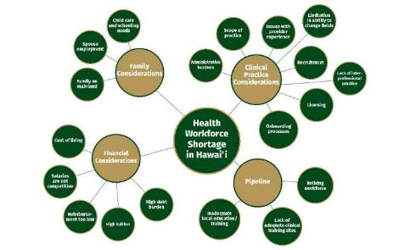
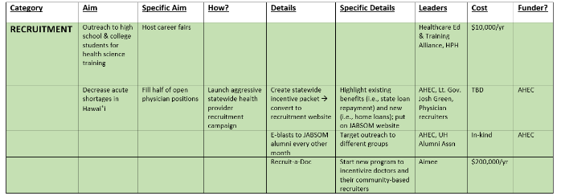
Strategic Planning & Sharing
Developed a matrix representing a menu of strategies to optimize Hawaiʻi’s health workforce.
Coordinated the “Hawaiʻi’s Health Workforce Development for the 21st Century” legislative informational briefing, led by Senator Rosalyn Baker and Representative John Mizuno, on August 21, 2019.

Slide 10
HCF Grant – Health Workforce
2020-2021 Hawaiʻi Community Foundation (HCF) grant to improve Hawaiʻi’s health workforce ($30k)
Four key areas of focus:
Supporting work to address Hawaiʻi’s clinical site training shortages;
Advancing working groups on innovative care delivery models (i.e., telehealth, role of pharmacists in primary care); federal/state reimbursement policies; and interprofessional care;
Expanding the state’s telehealth workforce (in partnership with the Pacific Basin Telehealth Resource Center) by improving provider recruitment, training, and retention; and
Creating a handbook for Hawaiʻi State Department of Education (DOE) principals to incorporate health coursework leading to certification for students in their schools.

Slide 11
Physician Recruitment Activities
http://hawaiihealthcareers.com/
https://www.ahec.hawaii.edu/rural-rotations/uh-homestay-aloha/

Slide 12
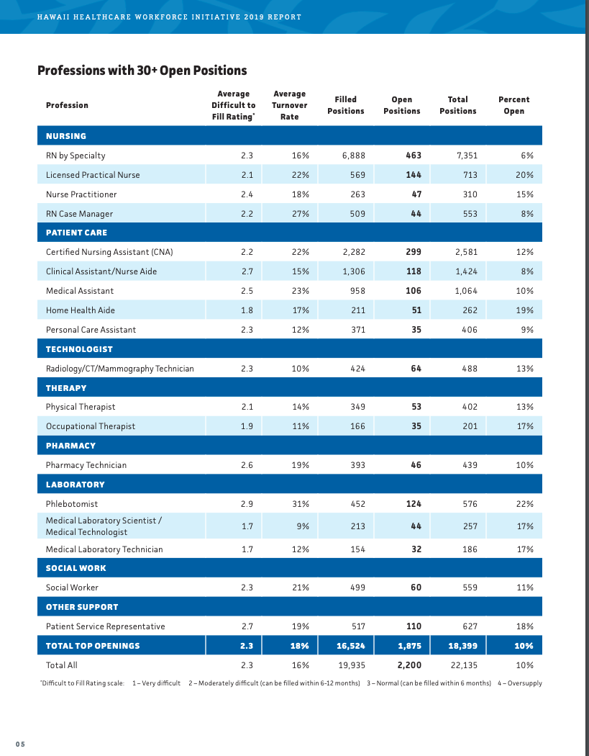
Aligning with Health Industry
Served on the steering committee for the Oʻahu Healthcare Sector Partnership’s Health Workforce Initiative (led by Healthcare Association of Hawaiʻi).
Catalyzed planning for a new Doctor of Physical Therapy (DPT) program at UH Mānoa.
Meetings to align DOH needs with UH Public Health offerings.
Supporting JABSOM legislative requests for expansion to neighbor islands.
UH System convenings, partner meetings, and strategizing for future legislative/budgetary priorities.

Slide 13
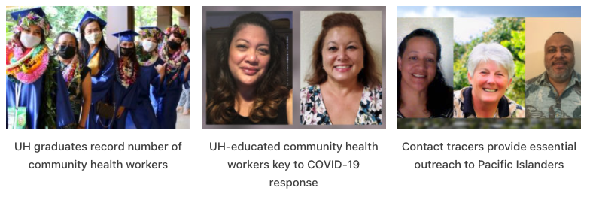
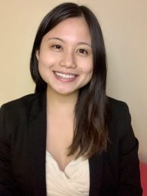
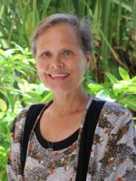
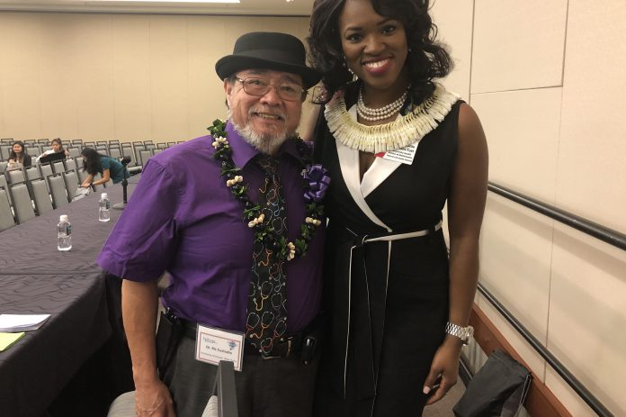
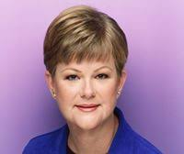
DOH-UH Contact Tracing Training Program
$2.5M grant developed in close partnership with DOH
Contact Tracing Training
Track 1 (clinical backgrounds)
Track 2 (non-clinical backgrounds)
508 contact tracers trained
Augmented Community Health Worker (CHW) Training
~130 CHWs trained through KCC
Statewide; online
Free of tuition
Pivots as needed
Evaluation ongoing

Slide 14
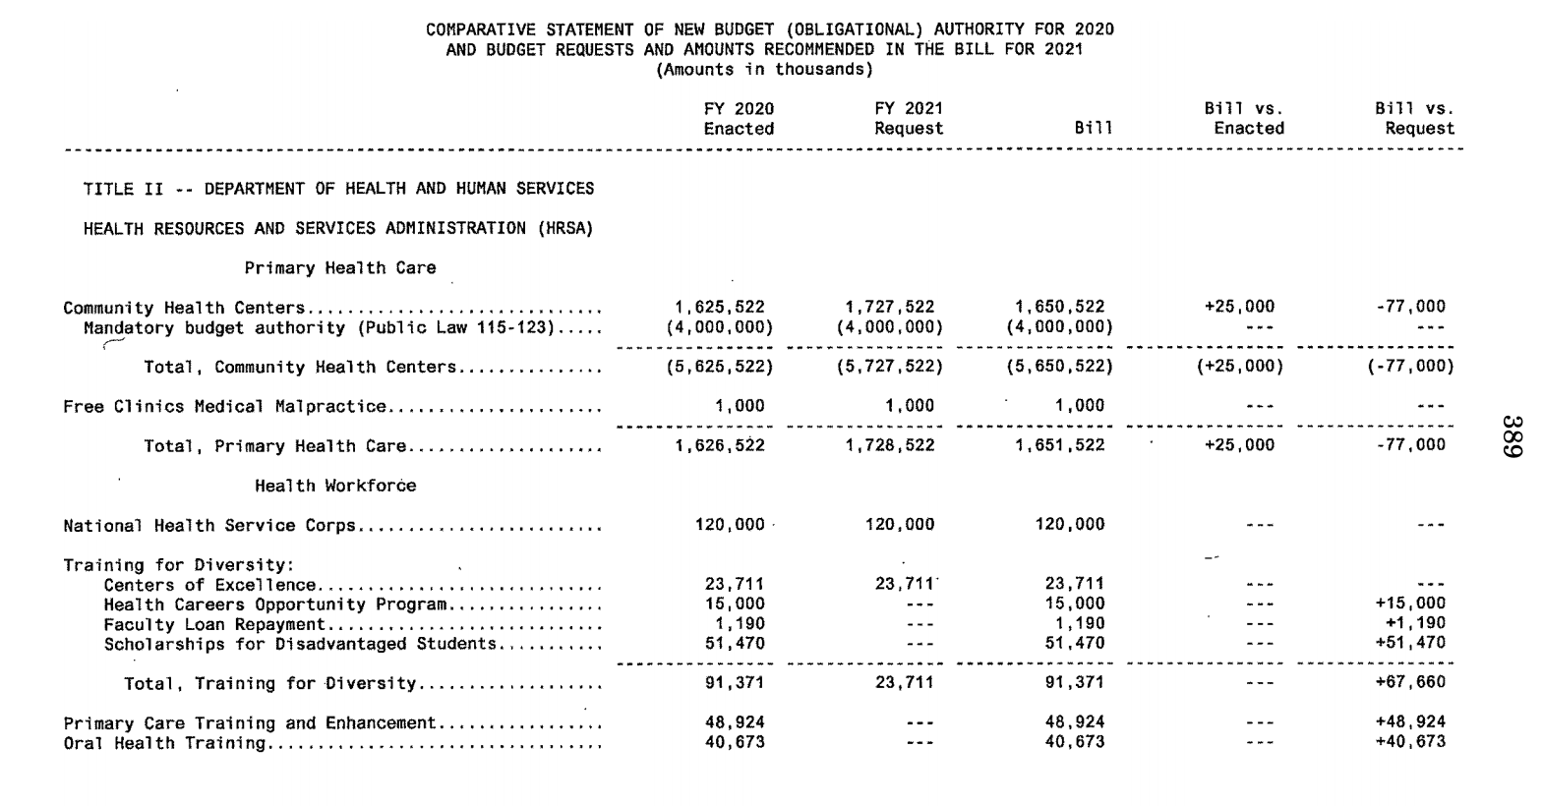
Advocating for Appropriations
Title VII (Health Professions Education) programs
Centers of Excellence (UH Native Hawaiian COE)
Scholarships for Disadvantaged Students
Faculty Loan Repayment Program
Health Careers Opportunity Program (HCOP)
Area Health Education Centers (AHEC)
Title VIII (Nursing) programs
Nursing Workforce Diversity Grants
Advanced Nursing Education
Nurse Corps
Nurse Faculty Loan Program

Slide 15
UH Rural Health Research and Policy Center
Proposal funded at $1 million through the FY22 Community Project Funding (CPF)/Congressionally Directed Spending (CDS) or “earmark” process.
Goals:
Conduct high-quality and policy-relevant research to develop policy recommendations to improve rural health care in Hawaiʻi.
Focus on health workforce policy and health equity.
Produce Actionable, Evidence-based Policy Strategies!

Slide 16
UH Rural Health Research and Policy Center, cont.
Key partners:
Hawaiʻi/Pacific Basin Area Health Education Center (Dr. Kelley Withy, Co-Investigator)
State of Hawaiʻi Office of Primary Care and Rural Health
Hawaiʻi State Rural Health Association
Pacific Basin Telehealth Resource Center

Slide 17
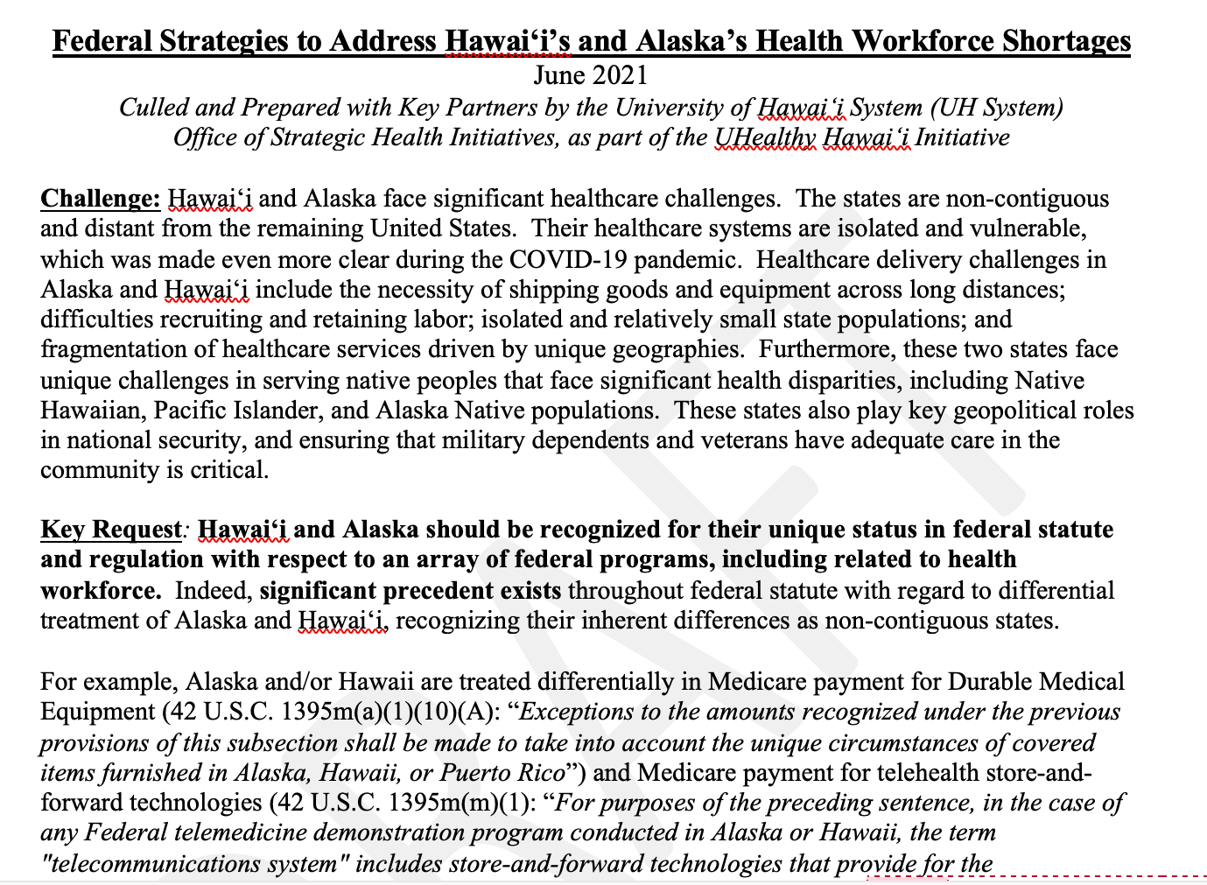
Potential Focus Areas
Providing the data to make the case for increased Medicare physician reimbursement.
Addressing issues with Health Professional Shortage Area (HPSA) designations in Hawaiʻi.
Advancing appropriations for health workforce programs that benefit Hawaiʻi.
Improving Medicare support for Graduate Medical Education (GME) positions in Hawaiʻi and other non-contiguous areas
On the state level, work with insurers in Hawaiʻi to improve access to care.
Other ideas??
Many focus areas based on collaborative “Federal Strategies” white paper produced in 2021

Slide 18
Other Federal Initiatives…

Slide 19
Proposed Non-Contiguous Areas Health Workforce Initiative
Non-contiguous areas such as Hawaiʻi, Alaska, Puerto Rico, and the US-Affiliated Pacific Islands face significant and unique challenges to health care and the health workforce.
Proposed $10 million initiative within HRSA to address critical health workforce shortages in non-contiguous areas, based on a similar program for the U.S. Delta region.
Potential areas of focus:
Education and training, especially of underserved populations.
Health workforce research.
Policy analysis and development.
Faculty investments, particularly for junior and diverse faculty.
Outreach and partnerships with health industry and other key stakeholders.

Slide 20
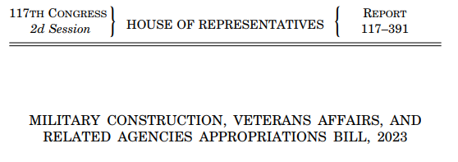
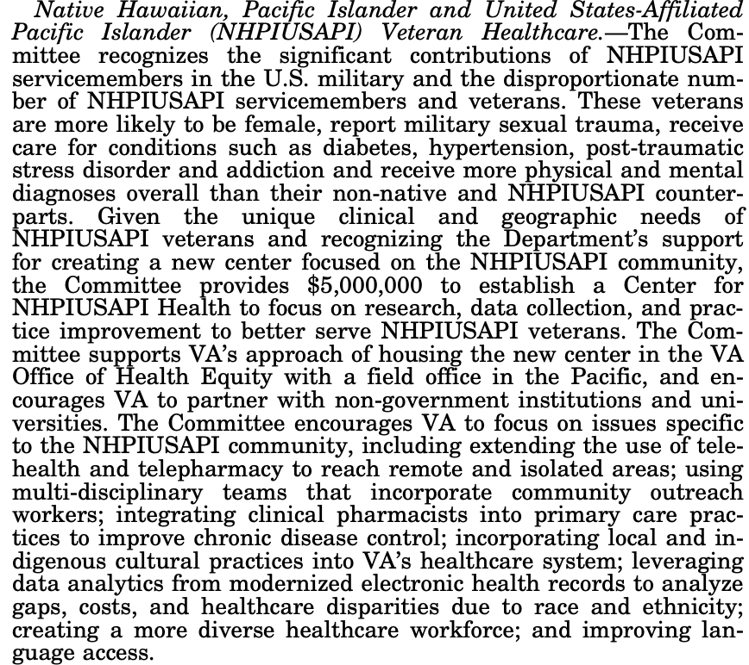
Hopefully - New VA Center for NH/PI/USAPI Health
Worked with Congress, VA, and Univ. of Arkansas for several years to advance proposal
Key Activities:
Research
Data collection
Practice Improvements within VA to better serve NH/PI/USAPI veterans
Focus Areas:
Health workforce
Telehealth/Telepharmacy
Indigenous cultural practices in VA health system
Analyzing modernized electronic health records for health disparities

Slide 21
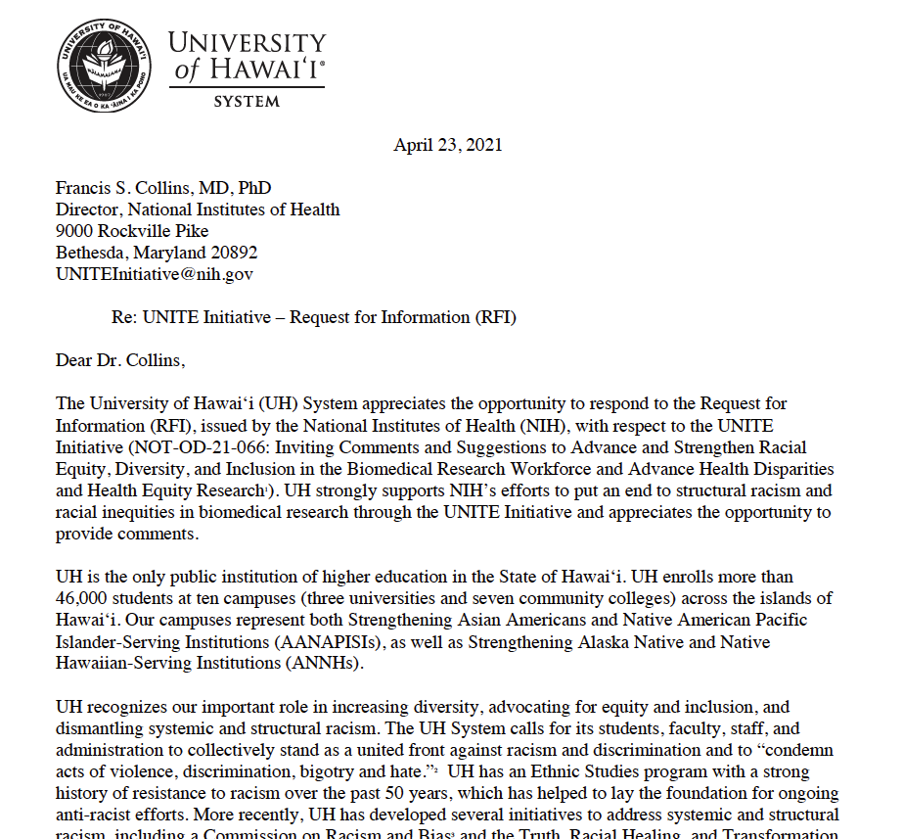
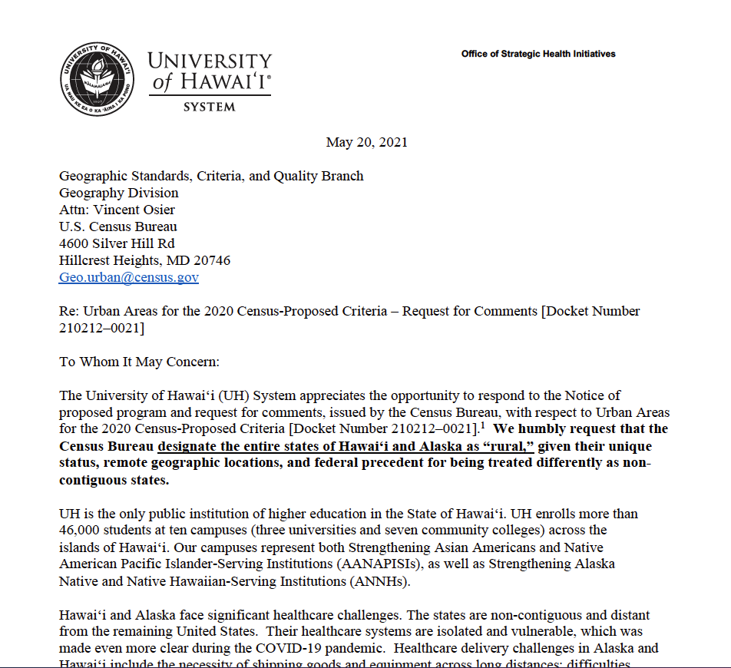
Responses to Federal RFIs
NIH UNITE Initiative to address structural racism and racial inequities in biomedical research
USDA RFI on advancing racial justice and equity and support for underserved communities at USDA
Census Bureau Request for Comments re: Urban Areas for the 2020 Census-Proposed Criteria

Slide 22
Other Ideas?
Would love to hear from you and partner with you!
amgrace@hawaii.edu
808-956-8069

Slide 23
UHealthy.hawaii.edu
Mahalo!
amgrace@hawaii.edu
808-956-8069

