Slide 2
Placeholder: goals/takeaways for today

Slide 5
Placeholder: brief history of COVID
Notes:
The first documented case of COVID-19 in Hawaiʻi was on March 6, 2020. The affected individual was a passenger on a cruise ship that had 21 confirmed cases of COVID-19, and became ill after returning home to Oʻahu. By March 19, 2020, the Hawaiʻi State Department of Health (“DOH”) reported 26 positive COVID-19 cases statewide, and county-level mandates to curb the spread of COVID-19 were implemented by March 20, 2020. This included the closure of indoor restaurants, parks, nightclubs, and nonessential businesses, the implementation of a nighttime curfew in some counties, and limits on group gatherings. These measures were followed up by subsequent travel restrictions, quarantine and testing protocols, and shelter-in-place and stay-at-home orders.
By March 31, 2020, Hawaiʻi saw its first COVID-19 death. Community partners quickly mobilized to leverage collective resources and connect Hawaiʻi families with support through these critical times. Of notable mention was the formation of the Kūpuna Food Security Coalition (“KFSC”), spearheaded by the EAD, AARP Hawaiʻi, Aloha United Way, and the Harry & Jeanette Weinberg Foundation, to connect kūpuna with food/meals and wraparound health and social services.

Slide 6
Placeholder: Brief history of vaccine roll out
Notes:
Finally, on December 11, 2020, Emergency Use Authorization (“EUA”) by the U.S. Food & Drug Administration was granted for the first COVID-19 vaccine (Pfizer BioNTech) for use by adults aged 18 and older. By this time, there were 18,951 cumulative COVID-19 cases across the state. Though availability of COVID-19 vaccines increased over time as manufacturing ramped up, additional vaccine brands gained EUA status, and more providers offered the vaccine in a number of settings, COVID-19 continued to devastate Hawaiʻi’s communities. Certain subgroups continued to carry a disproportionate burden of COVID-19 impact, including Native Hawaiians, Pacific Islanders, and Filipinos, and those with barriers preventing access to vaccination

Slide 7
Placholder: How kupuna were affected

Slide 8
Placeholder: Importance of community power

Slide 9
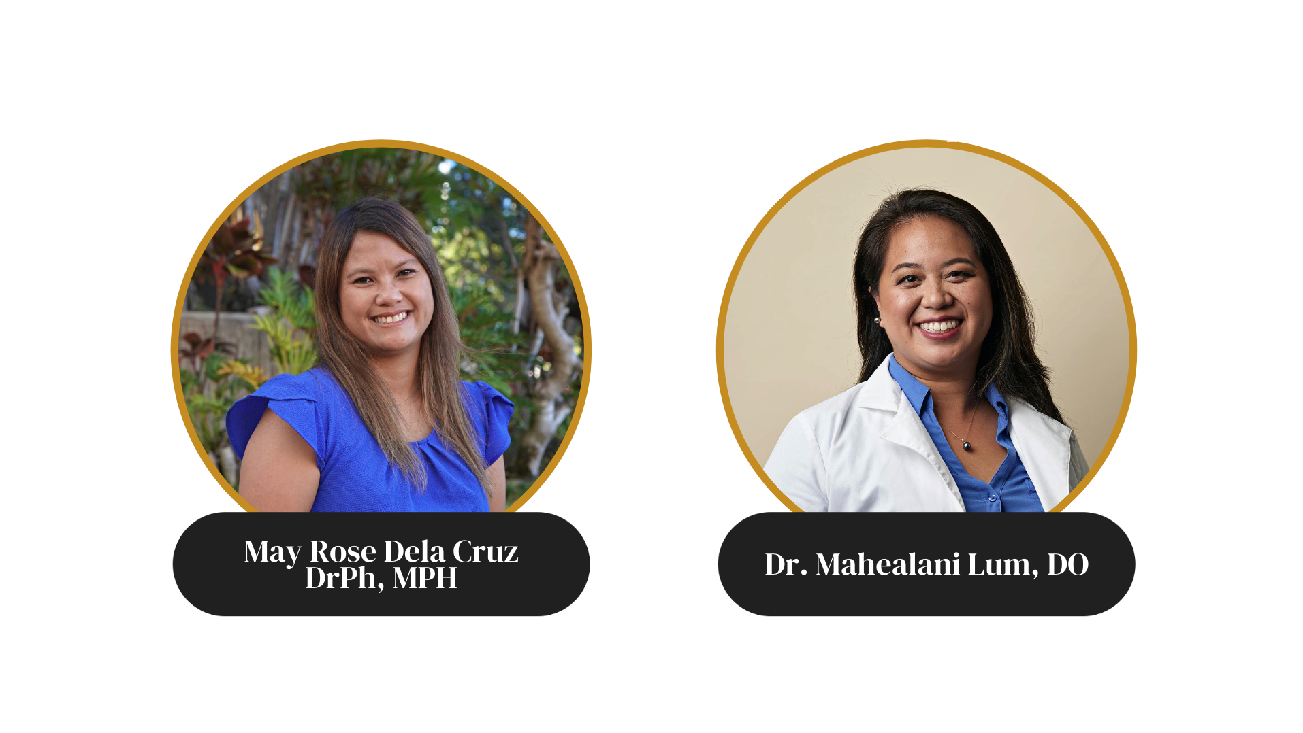
Notes:
Dr. Nicole Mahealani Lum, D.O. was raised in ʻAiea, Oʻahu, and practices primary care Family Medicine and Geriatrics at Ke Ola Mamo Native Hawaiian Health System. She is a scholar of Papa Ola Lokahi’s Native Hawaiian Health Scholarship Program, and serves on the board of directors for ʻAhahui o nā Kauka, the Association of Native Hawaiian Physicians. Dr. Lum provides community education and medical home visits to kūpuna in collaboration with Kula No Na Po'e Hawai'i o Papakōlea, Kewalo, Kalawahine. In her spare time, Dr. Lum enjoys studying hula and oli, making lei, learning lomi lomi, and helping her ʻohana lead ʻāina restoration efforts at Loko Iʻa Pāʻaiau fishpond and Ka Mahiʻai ‘Ihi o Wailea maile farm.

Slide 10
Lessons Learned:
How Community-Based Organizations & Coalitions Supported Our Kūpuna During the COVID-19 Pandemic
May Rose I. Dela Cruz, DrPH
Hawaiʻi Health Workforce Summit
September 24, 2022

Slide 11
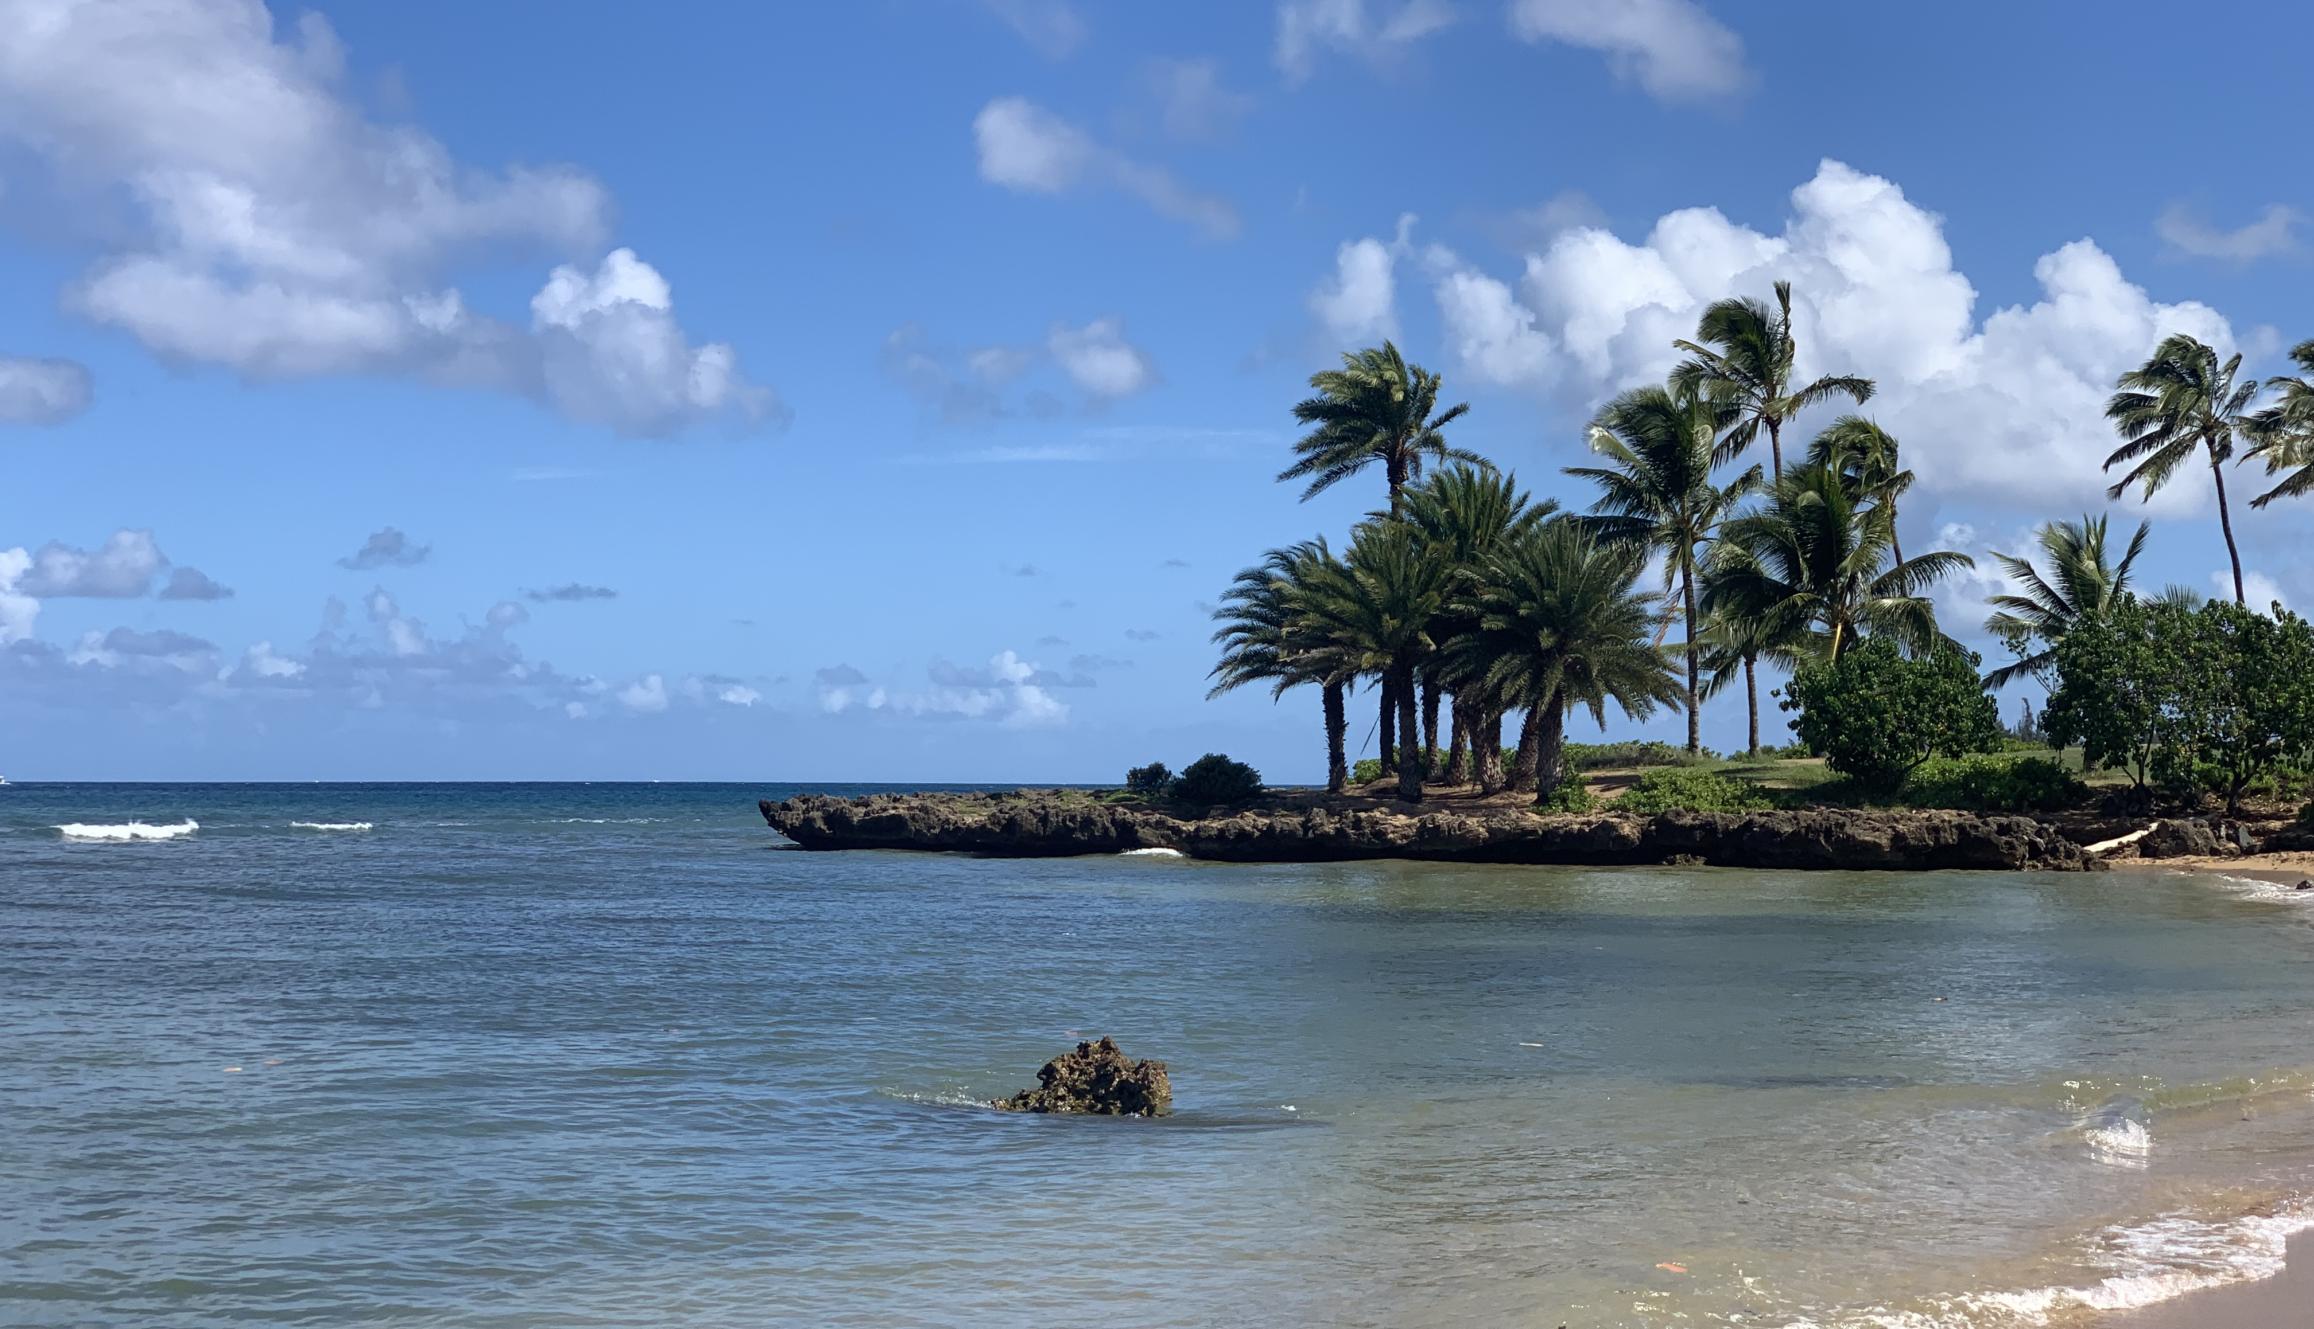
Land Acknowledgement
Kanaka Maoli (Hawaiʻi)

Slide 12
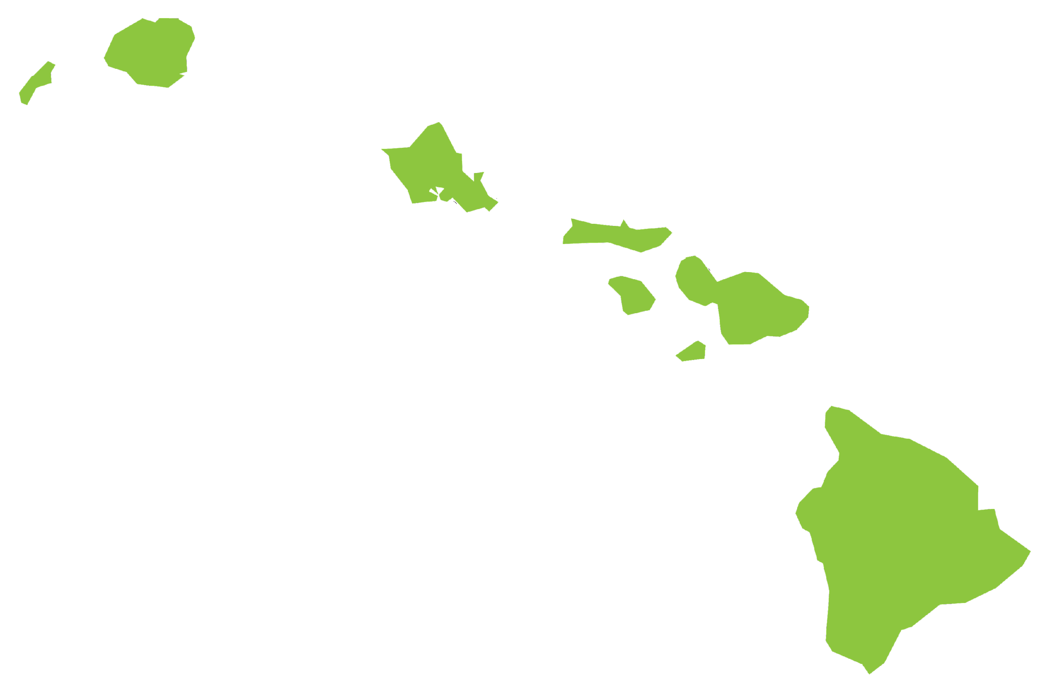
Hawaiʻi and COVID-19
Hawaiʻi’s Native Hawaiian, Pacific Islander and Filipino communities have been disproportionately affected by COVID-19
They have consistently had the highest rates of COVID-19 cases, mortality and hospitalizations

Slide 13
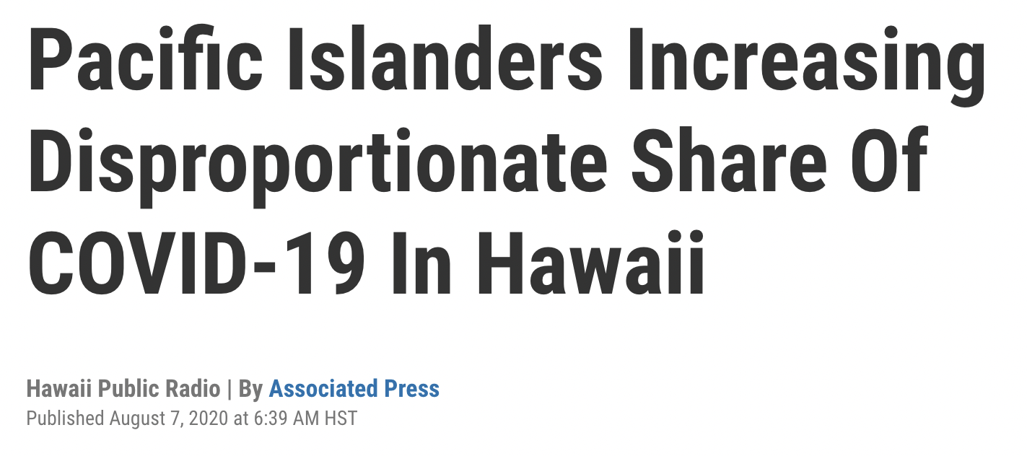
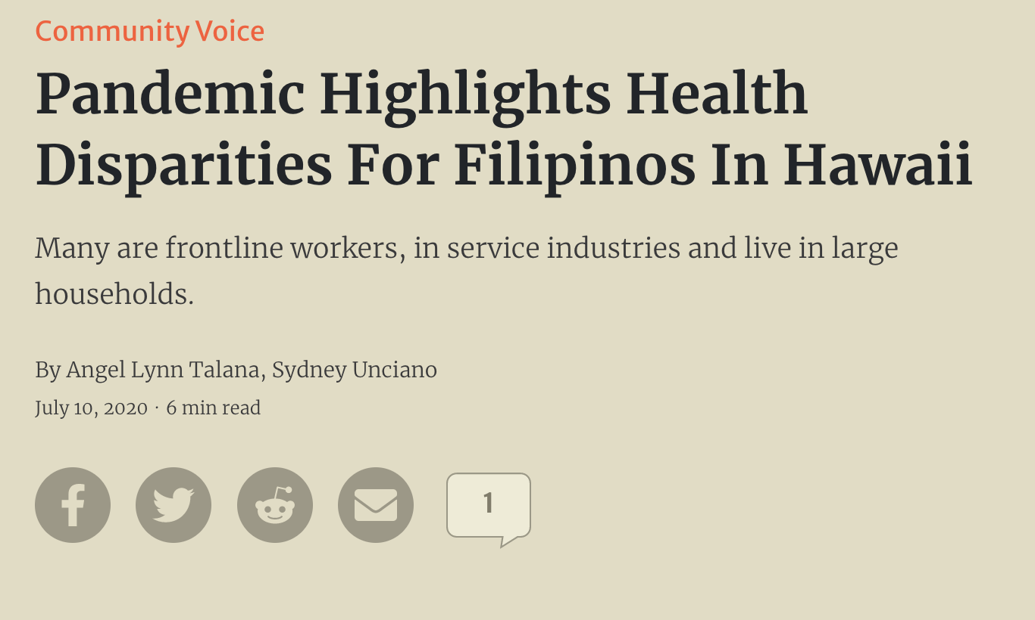

Slide 14
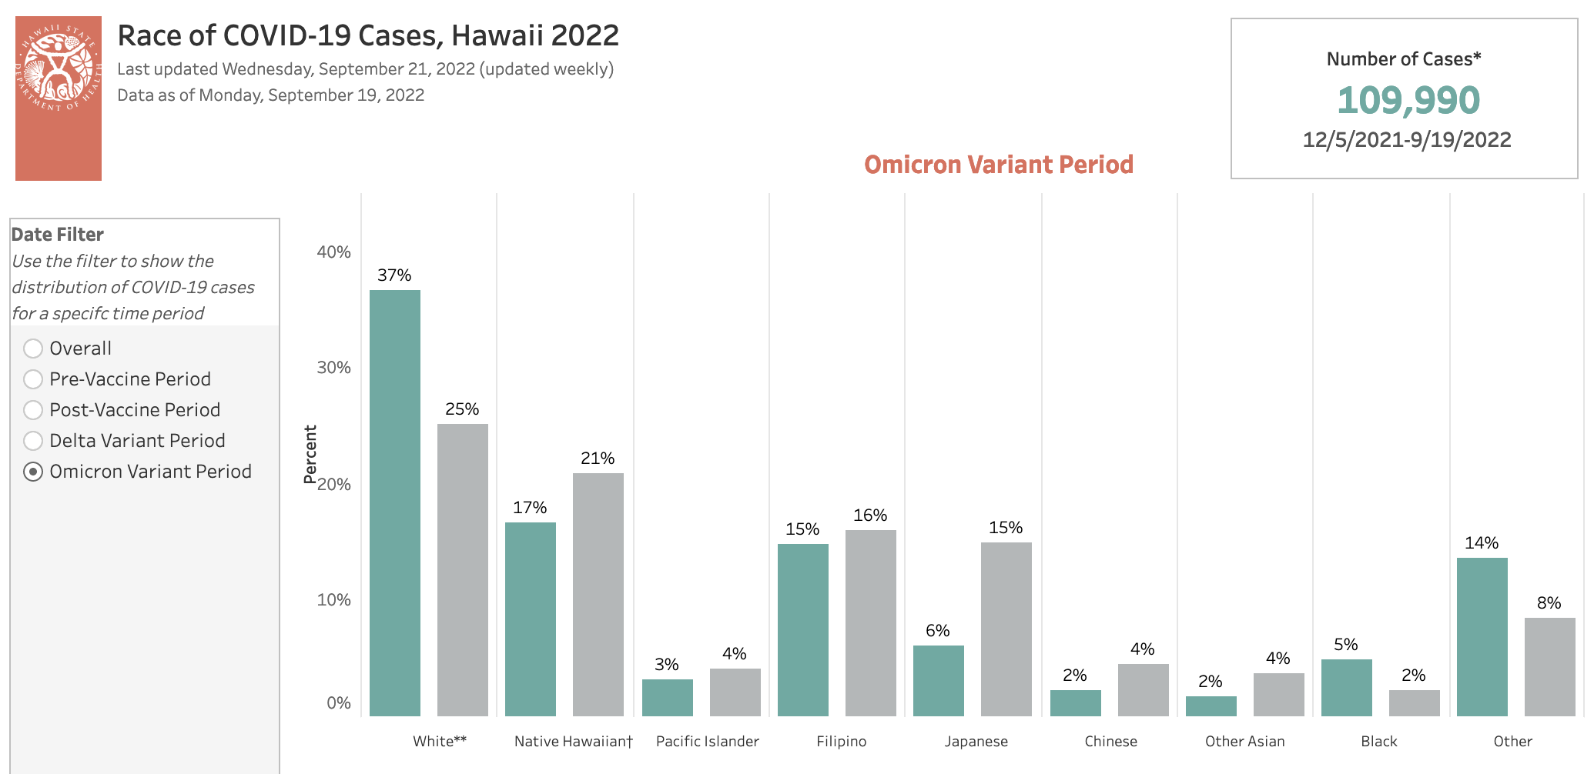
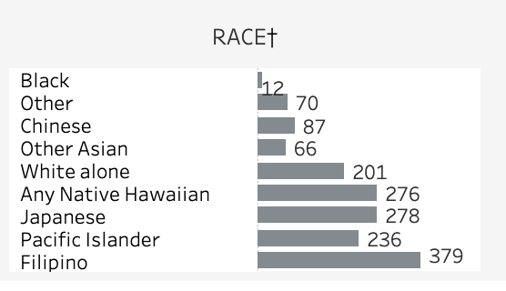
COVID-19 Cases and Mortality Data
Summary of COVID-19 Deaths, Hawaii
Source: Hawaiʻi Department of Health, 2022

Slide 15
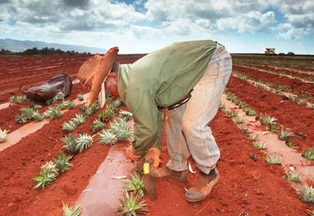
Pre-COVID Disparities of Filipinos
Live in environments that increase risk of COVID-19 (multi-generational homes, congregated dwellings, etc.)
Essential workers in tourism, retail, food, agriculture and hospitality industries
Nurses and care homes
High rates of severe obesity, hypertension, diabetes, respiratory illness, cardiovascular disease
Access to health care is limited
Financial hardship
Colonization and militarization
Non-English speakers

Slide 16
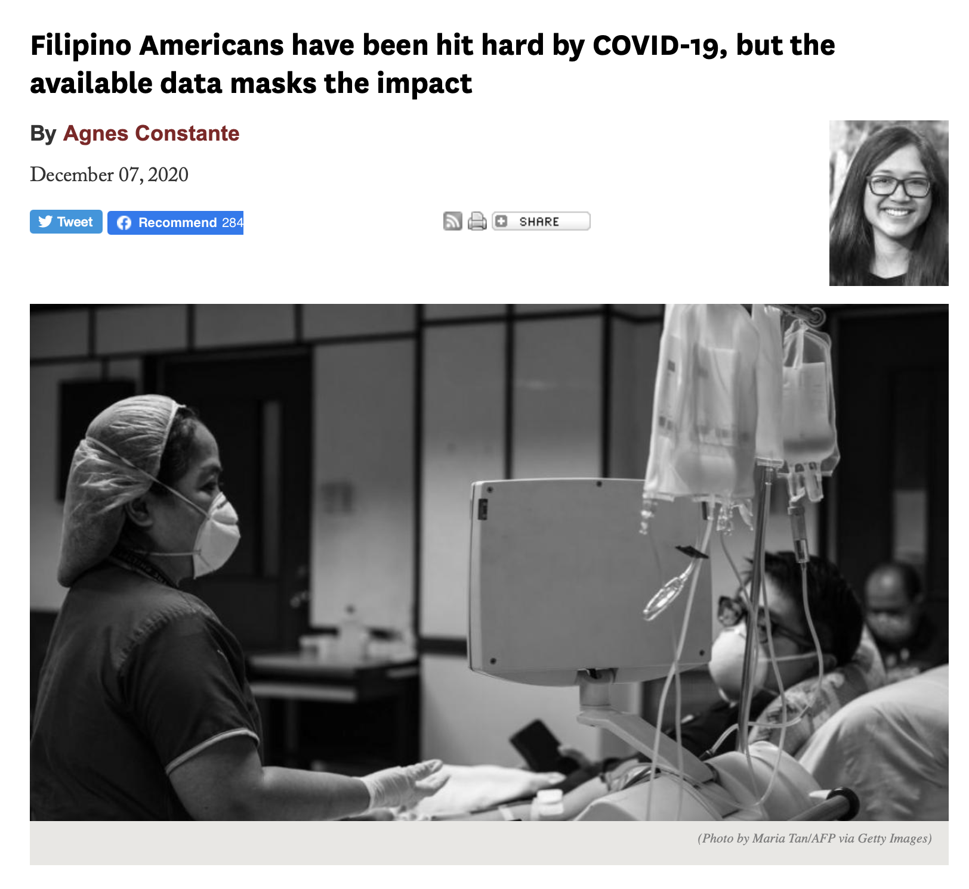
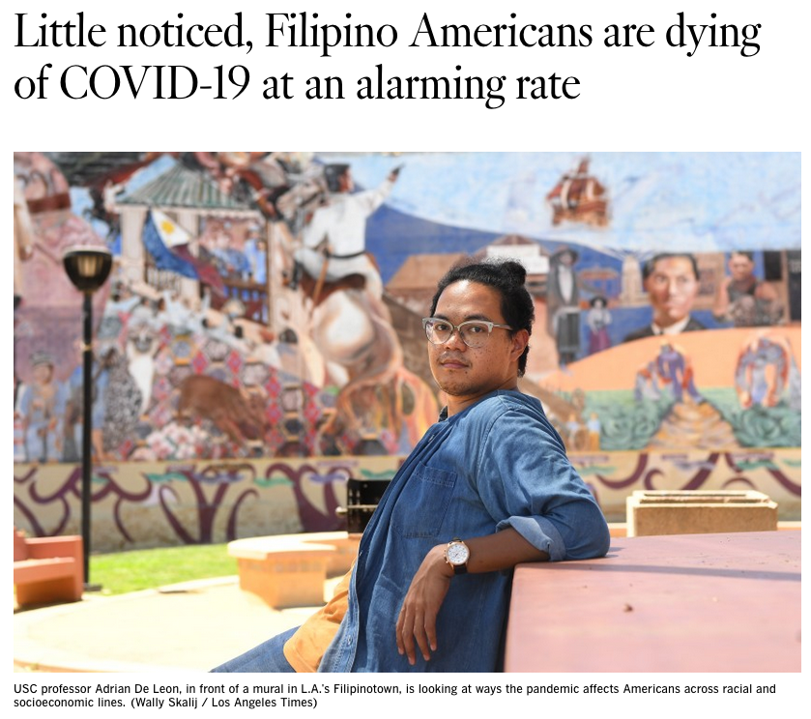
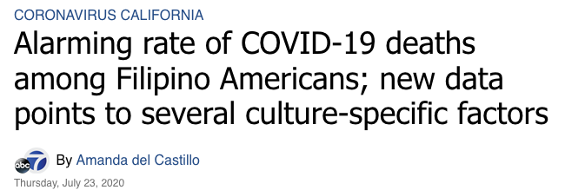
WHO WILL HELP US?

Slide 17
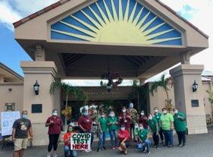
FilCom Cares Project
Born from the pandemic and founded by Filipino community members (Drs. Agbayani, Dela Cruz, Malate)
Filipino community response to the COVID-19 pandemic
Comprised of volunteers from 20 organizations
Catholic churches

Slide 18
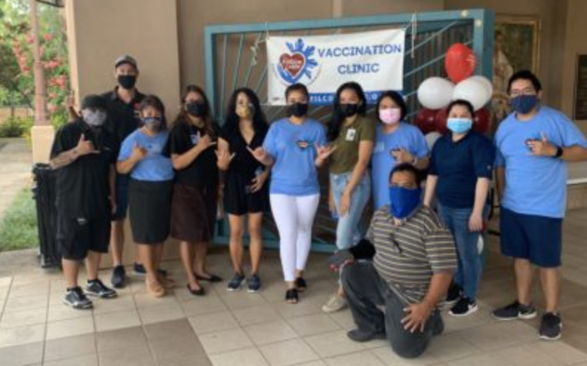
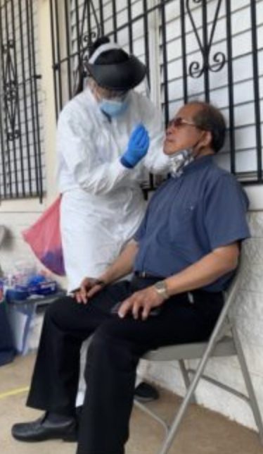
FilCom Cares Project (cont’d)
Leveraged 7 grants
100 vaccination clinics, 3,600 vaccinated, tested 300
4 radiothons
15 translated materials in Ilokano & Tagalog, over 3,000 distributed
Over 100 volunteers

Slide 19
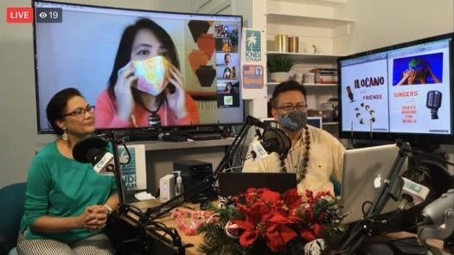
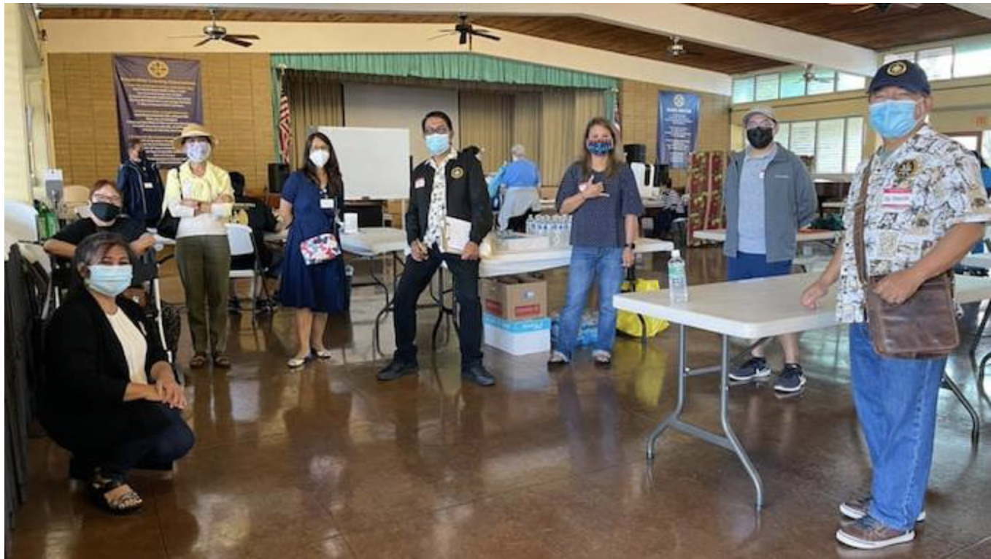
Announcements on the radio
COVID vaccination of elderly at Co-Cathedral St. Theresa
If you want to reach Filipinos,
you send Filipinos

Slide 20
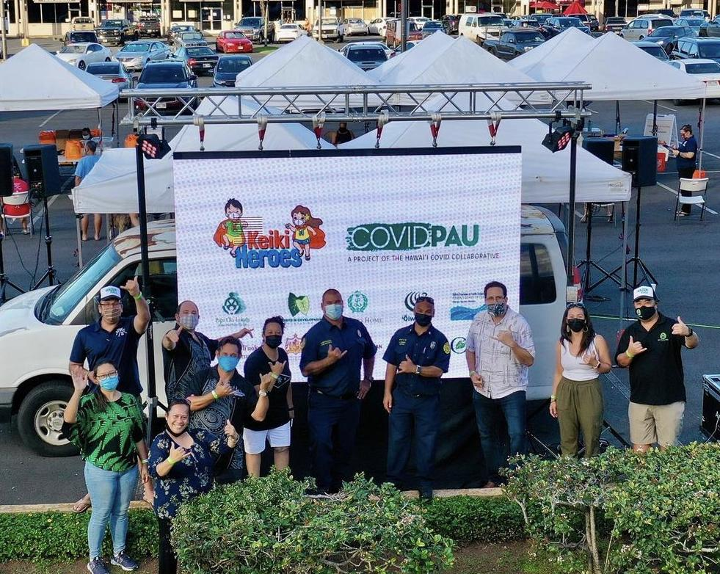
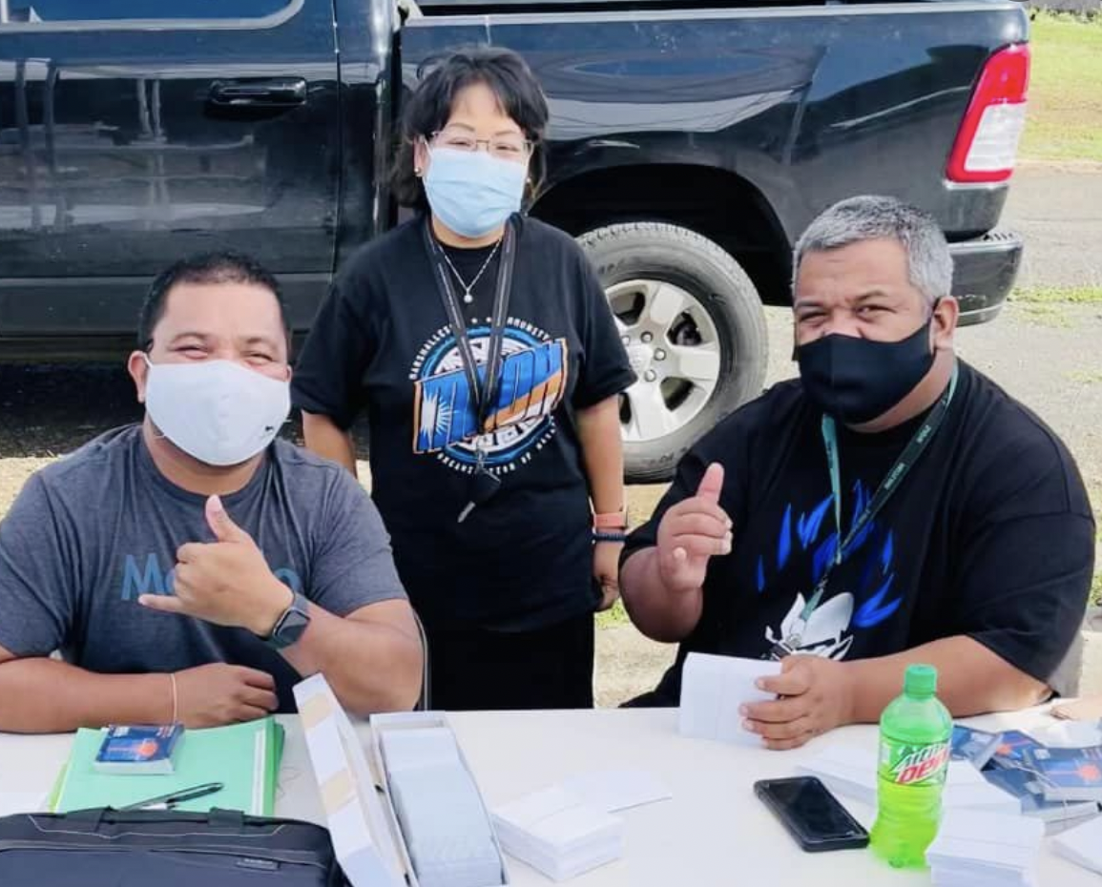
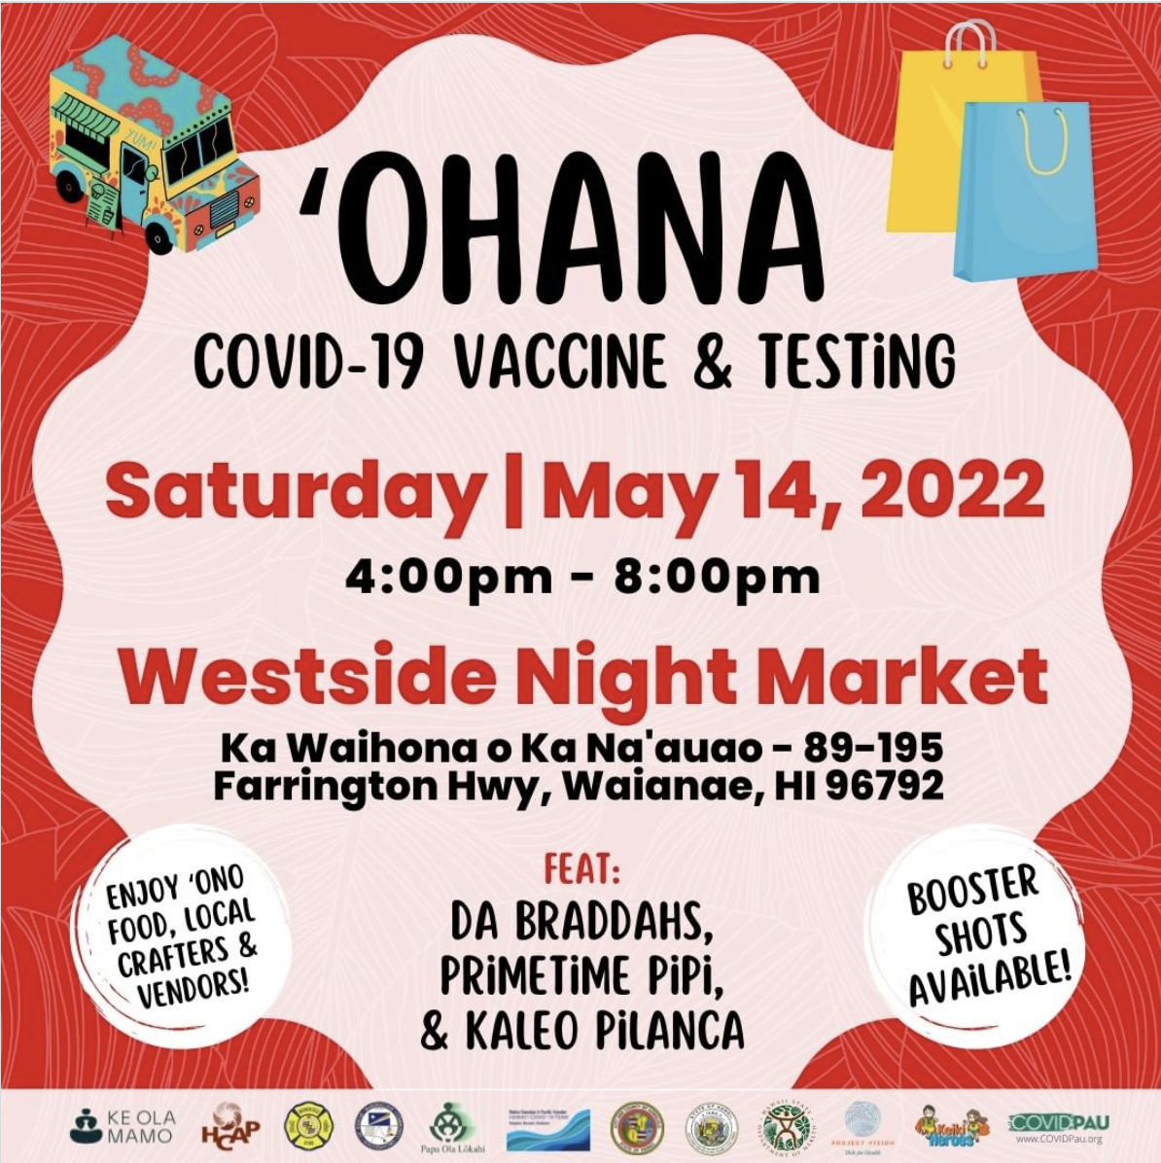
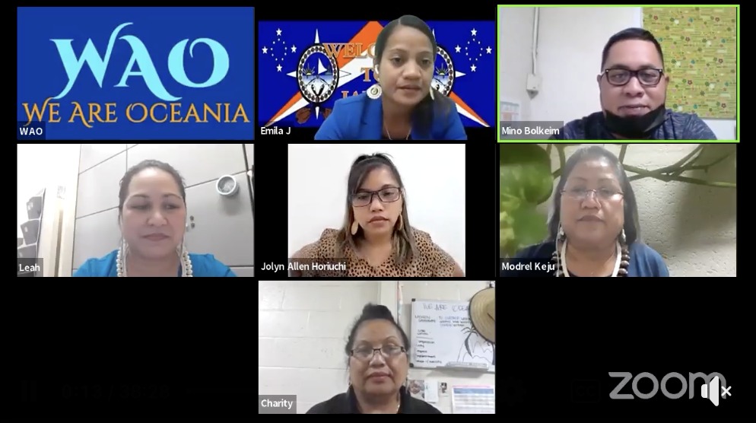
Community Outreach Mobilization
Sources: Marshallese Community Organization of Hawaiʻi; We Are Oceania; COVID Pau

Slide 21
“The COVID-19 problem just amplified the inequalities. The takeaway is that the government and private groups have a responsibility to work in partnership with these communities because these communities are here and deserve support.”
Dr. Amy Agbayani
President’s Advisory Commission on Asian Americans, Native Hawaiians, and Pacific Islanders

Slide 22
Community Engagement for Health Equity in COVID-19 Prevention & Mitigation Project (CBO Grant)

Slide 23
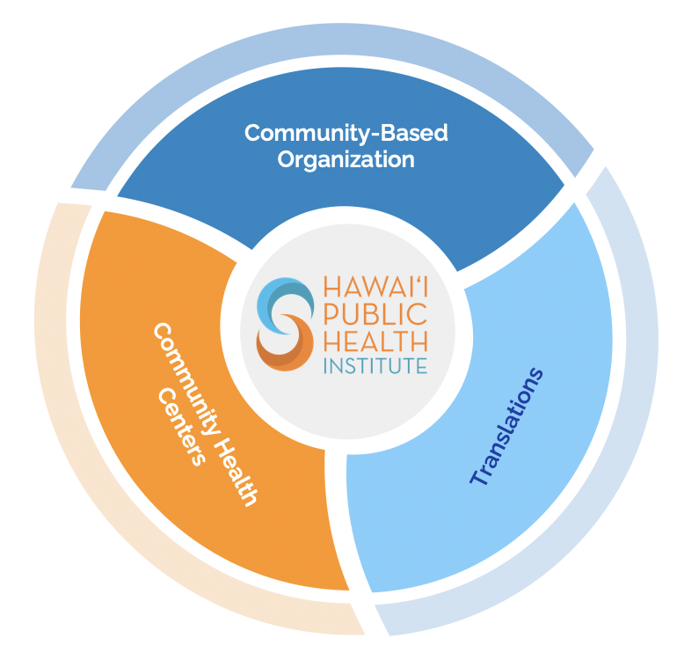
Community-Based Organization COVID-19 Prevention & Mitigation Project (“CBO Grant”)
Federal Grant: CDC
March 2022 – November 30, 2022
11 Community-Based Organizations (CBOs)
7 Federally Qualified Health Centers (FQHCs)
Statewide, counties

Slide 24
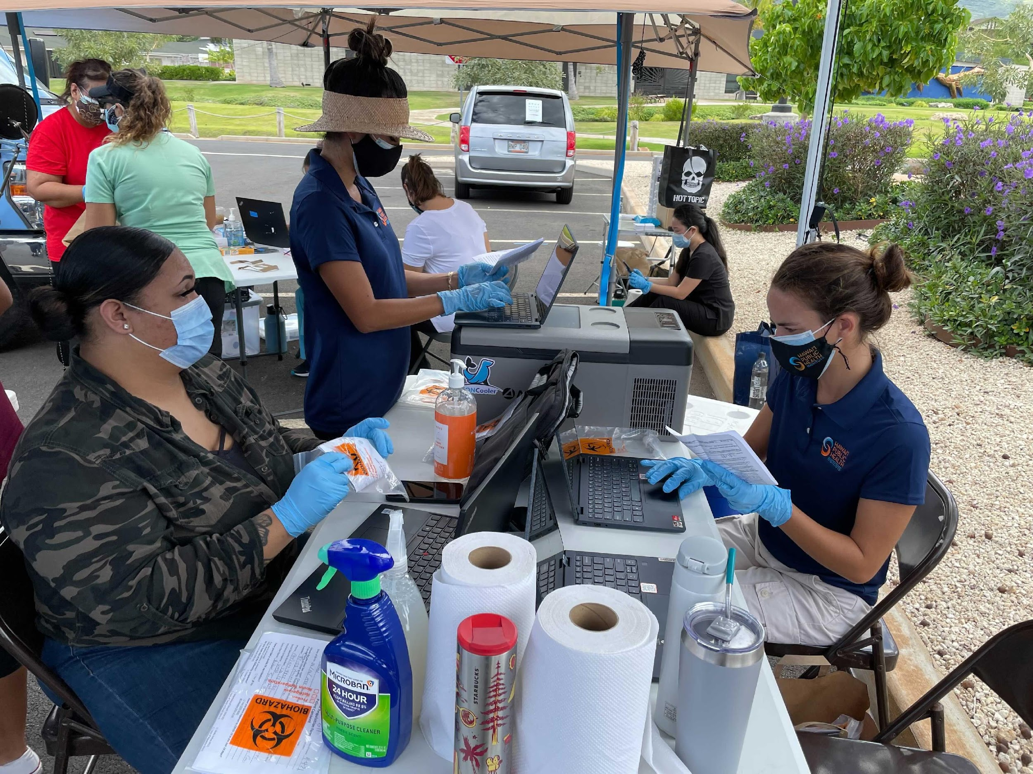
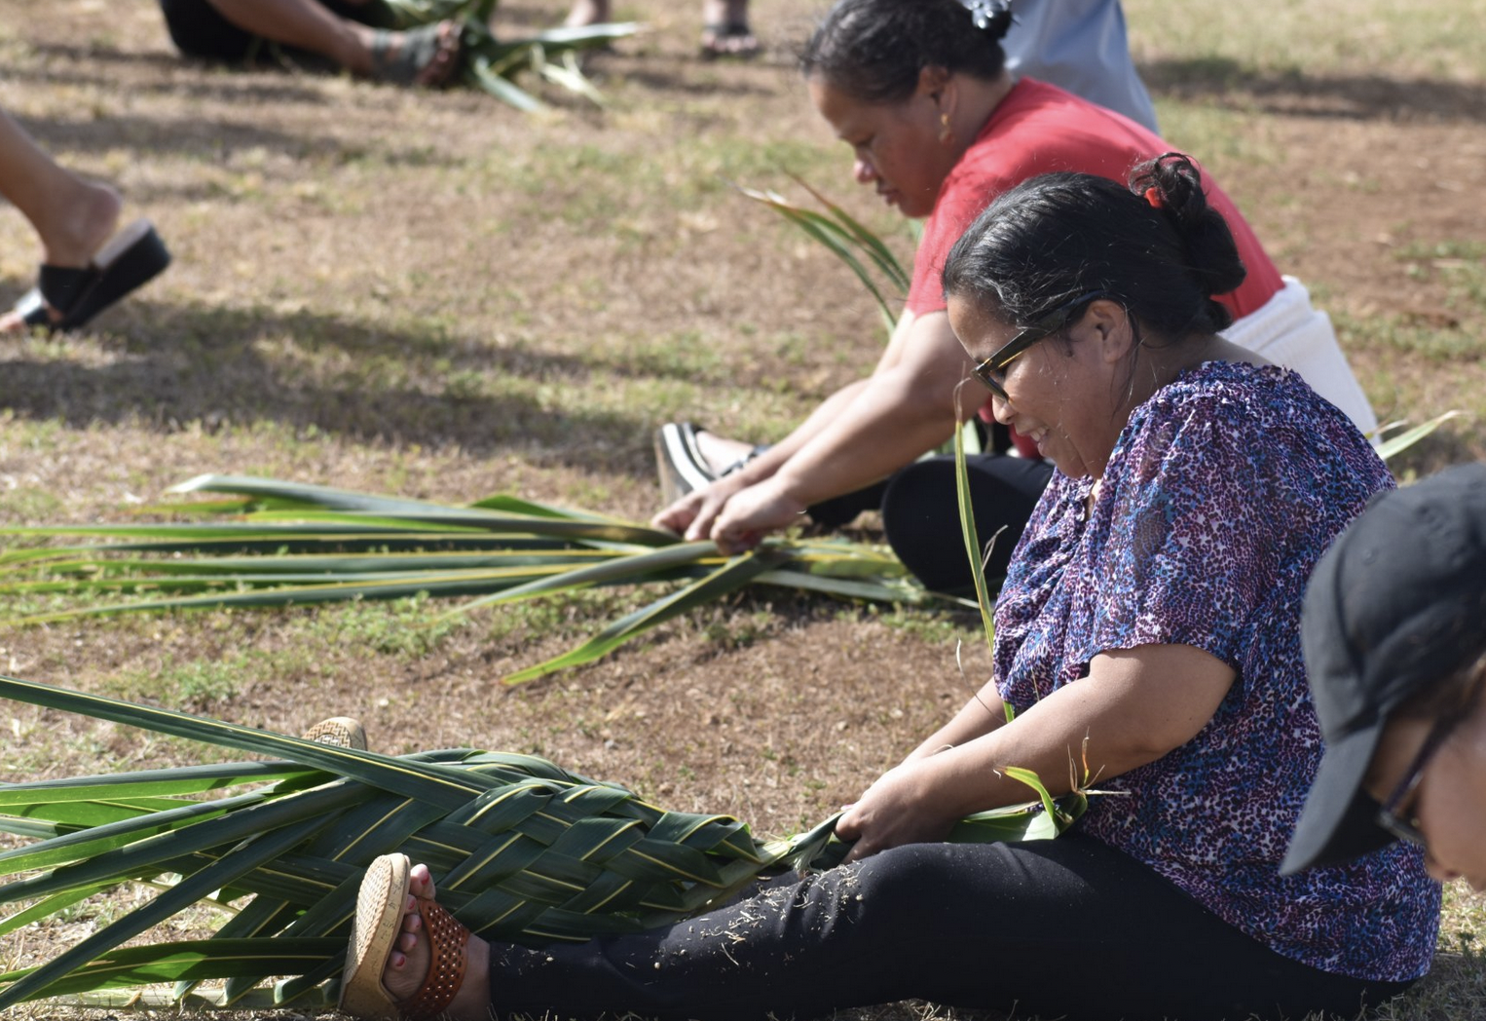
Funding for Community-Based Organizations’ outreach, vaccination clinics, COVID tests, communications, translation, infrastructure
Culturally appropriate services / venues:
Filipinos: radiothons, churches
Pacific Islanders: Sports activities, churches, Facebook
Native Hawaiians: Healing practices, medicinal plants, cultural activities (hula, massage, etc.)
Outreach to rural communities and unsheltered individuals
Translated materials in Ilokano, Tagalog, Chuukese, Marshallese, Hawaiian, etc.

Slide 25
Community-Based Organizations & Federally Qualified Health Centers
Type | Name | Community & Focus
CBO | All Him Productions | Statewide: Health Promotion & Outreach
CBO | East Hawaiʻi IPA (Doctors) | Hawaiʻi Island: Providers, vaccination, outreach, testing
CBO | FilCom Cares | Statewide: Filipinos, vaccination outreach, testing
CBO | Healthy Mothers, Healthy Babies | Oʻahu: Pregnant women & children
CBO | Kauai Economic Opportunity | Kauaʻi: NH/PI, Filipino, unsheltered, elderly
CBO | ‘Ōiwi TV | Statewide: Media, broadcasting, social media
CBO | Pear Suite | Maui & Oʻahu: Call Center & interpreters
CBO | Project Vision | Oʻahu: Mobile clinics, vaccination, outreach, testing

Slide 26
Community-Based Organizations & Federally Qualified Health Centers
Type | Name | Community & Focus
CBO | Partners in Development | Statewide: NH/PI, children, outreach, test distribution
CBO | We Are Oceania | Oʻahu: Pacific Islanders, NH, vaccination outreach, education
FQHC | Hāmākua-Kohala Health | Hawaiʻi Island: Website, outreach, education
FQHC | Kōkua Kalihi Valley | Oʻahu: Laʻau lapaʻau (medicinal plants), education
FQHC | Koʻolauloa Health Center | Oʻahu: Outreach & education
FQHC | Lanaʻi Community Health Center | Lanaʻi: Outreach & education
FQHC | Wahiawā Health | Oahu: Outreach & education
FQHC | Waimānalo Health Center | Oahu: Laʻau lapaʻau, education
FQHC | West Hawaiʻi Community Health Center | Hawaiʻi Island: Outreach & education

Slide 27
11 CBOs & 7 FQHCs
Statewide:

Slide 28
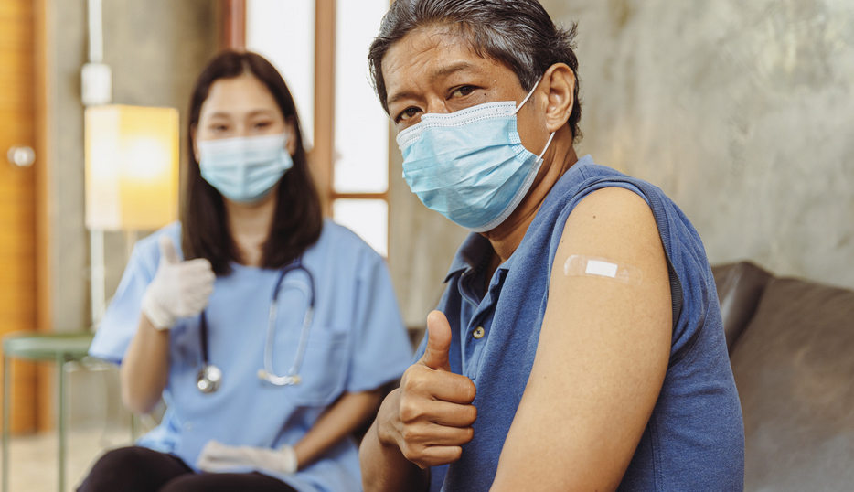
Desired Outcomes
Wide COVID-19 vaccination and testing, especially our kūpuna
Increased collaborations between CBOs, FQHCs, and DOH
Funding utilized by and for communities
Unconventional partnerships (CBOs receiving federal funding)
Sustainability of outreach activities
Supporting infrastructure
Recognition of traditional practices
Normalizing translational services
Data disaggregation and empowerment

Slide 29
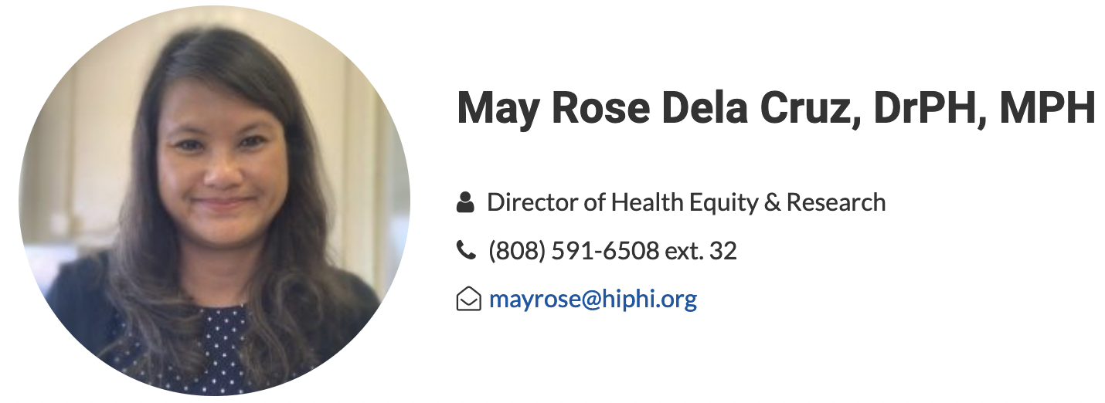
Thank you
Mahalo
Salamat

Slide 30
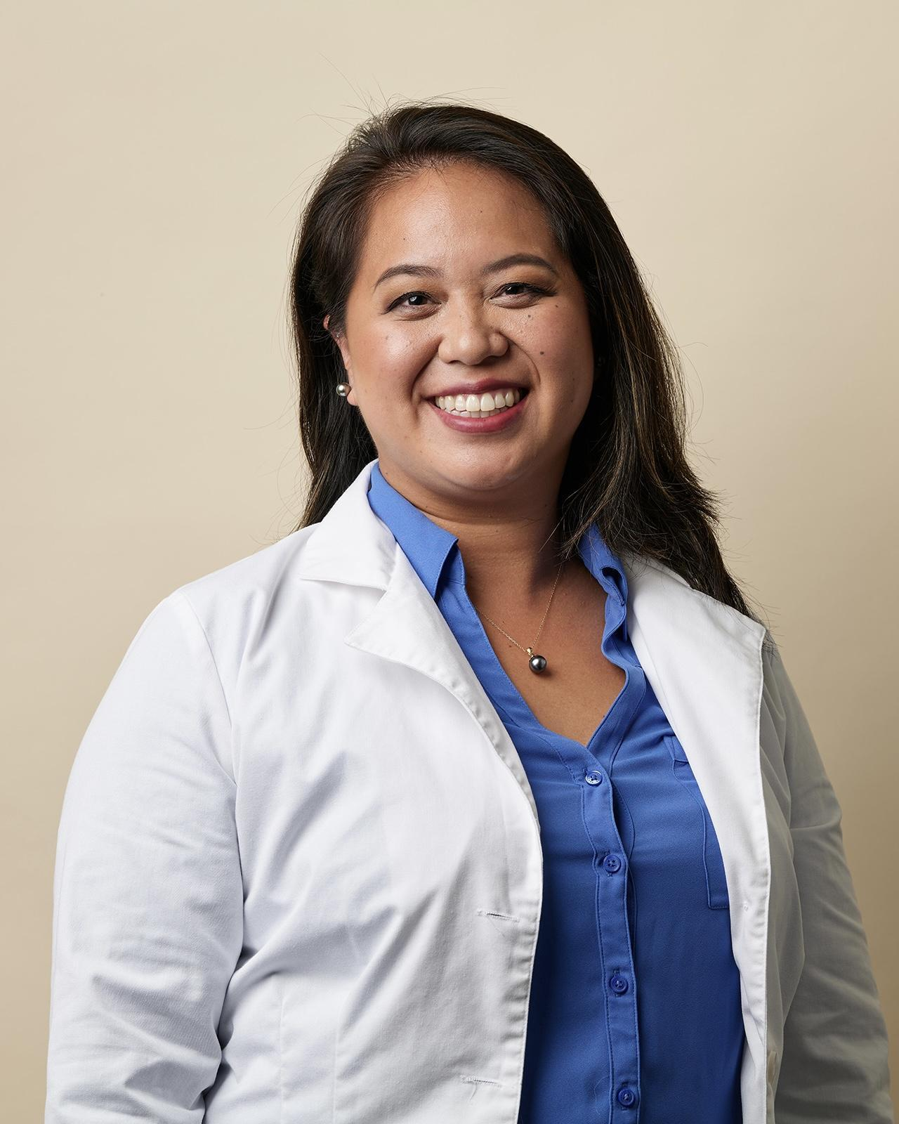
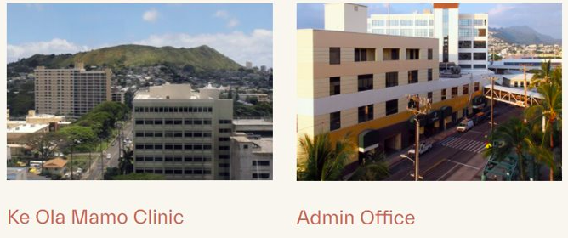
Dr. Nicole Mahealani Lum, D.O.
Family Medicine & Geriatrics
Notes:
Ke Ola Mamo mission: Empower, educate, and promote the health and well-being of our Native Hawaiian community.

Slide 31
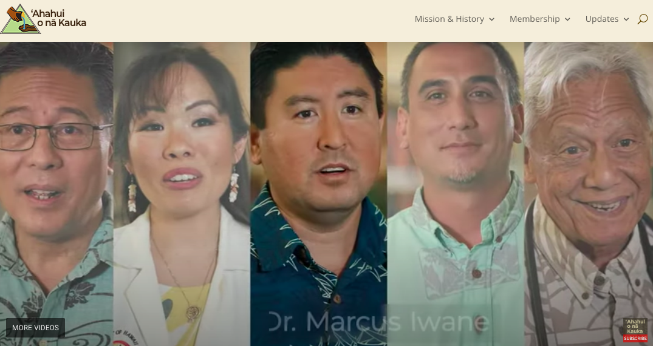
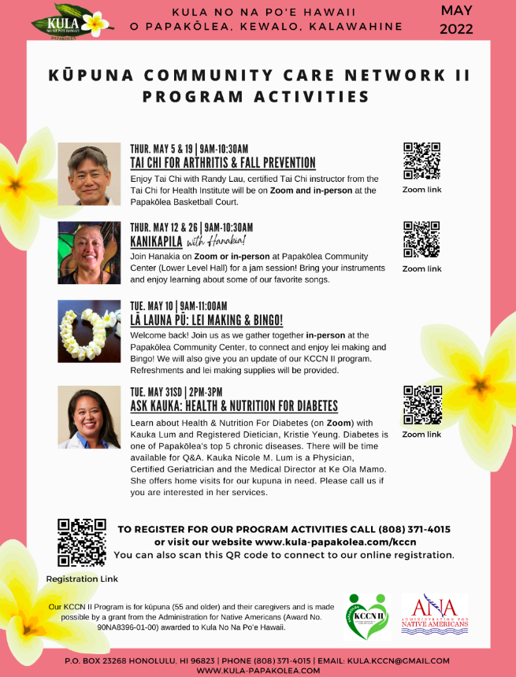
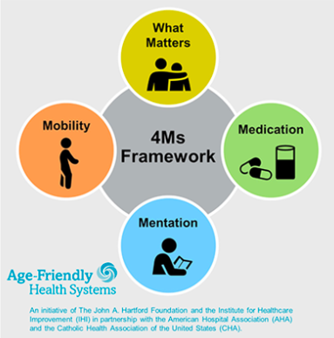
Education & Awareness
COVID-19
Chronic disease management
Mental health
Screening and prevention
Collaboration:
Provider
Organization
Community
Notes:
COVID-19: basics/101, CDC recommendations, layered prevention, infection precautions, vaccinations, severe COVID
Chronic disease management: Papakolea top 10, Geriatric syndromes
Mental health: Depression, anxiety, substance use
Screening and prevention: USPSTF, other vaccinations, screenings for cancer and chronic disease, advance care planning, aging in place, healthy nutrition and physical activity
Provider: patient encounters, Ask Kauka workshops, vaccine pods, PSAs (radio 102.7 Da Bomb / 94.7 KUMU / 105.9 The Wave / HI93)
Organization: COVID response team, protocols to serve our clients safely and protect our employees, CHW and ARP community outreach, posters/handouts, social media
Community: KCCN II, POL Ask Kauka, growing/developing the workforce for Geriatrics (JABSOM fellows, residents, med studs, pre-med, allied professional health)

Slide 32
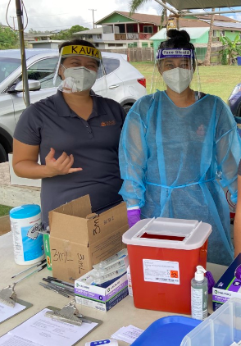
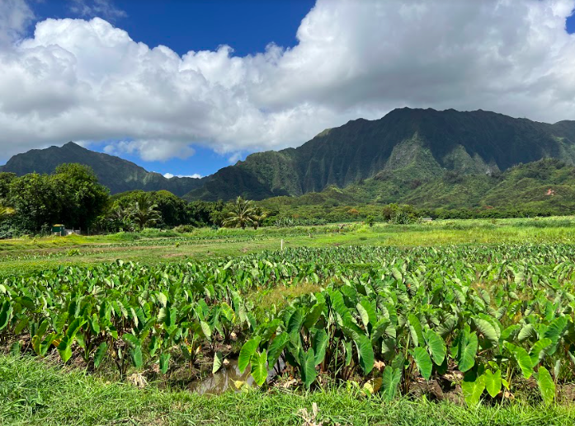
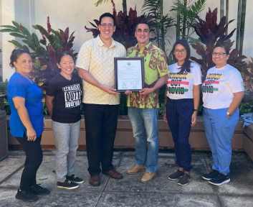
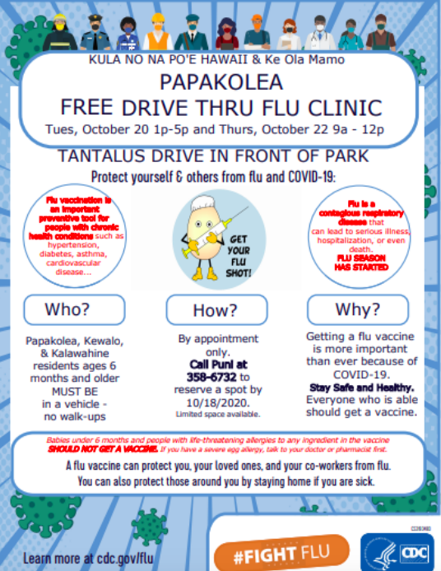
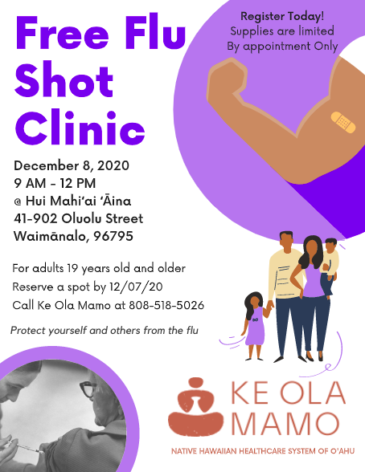
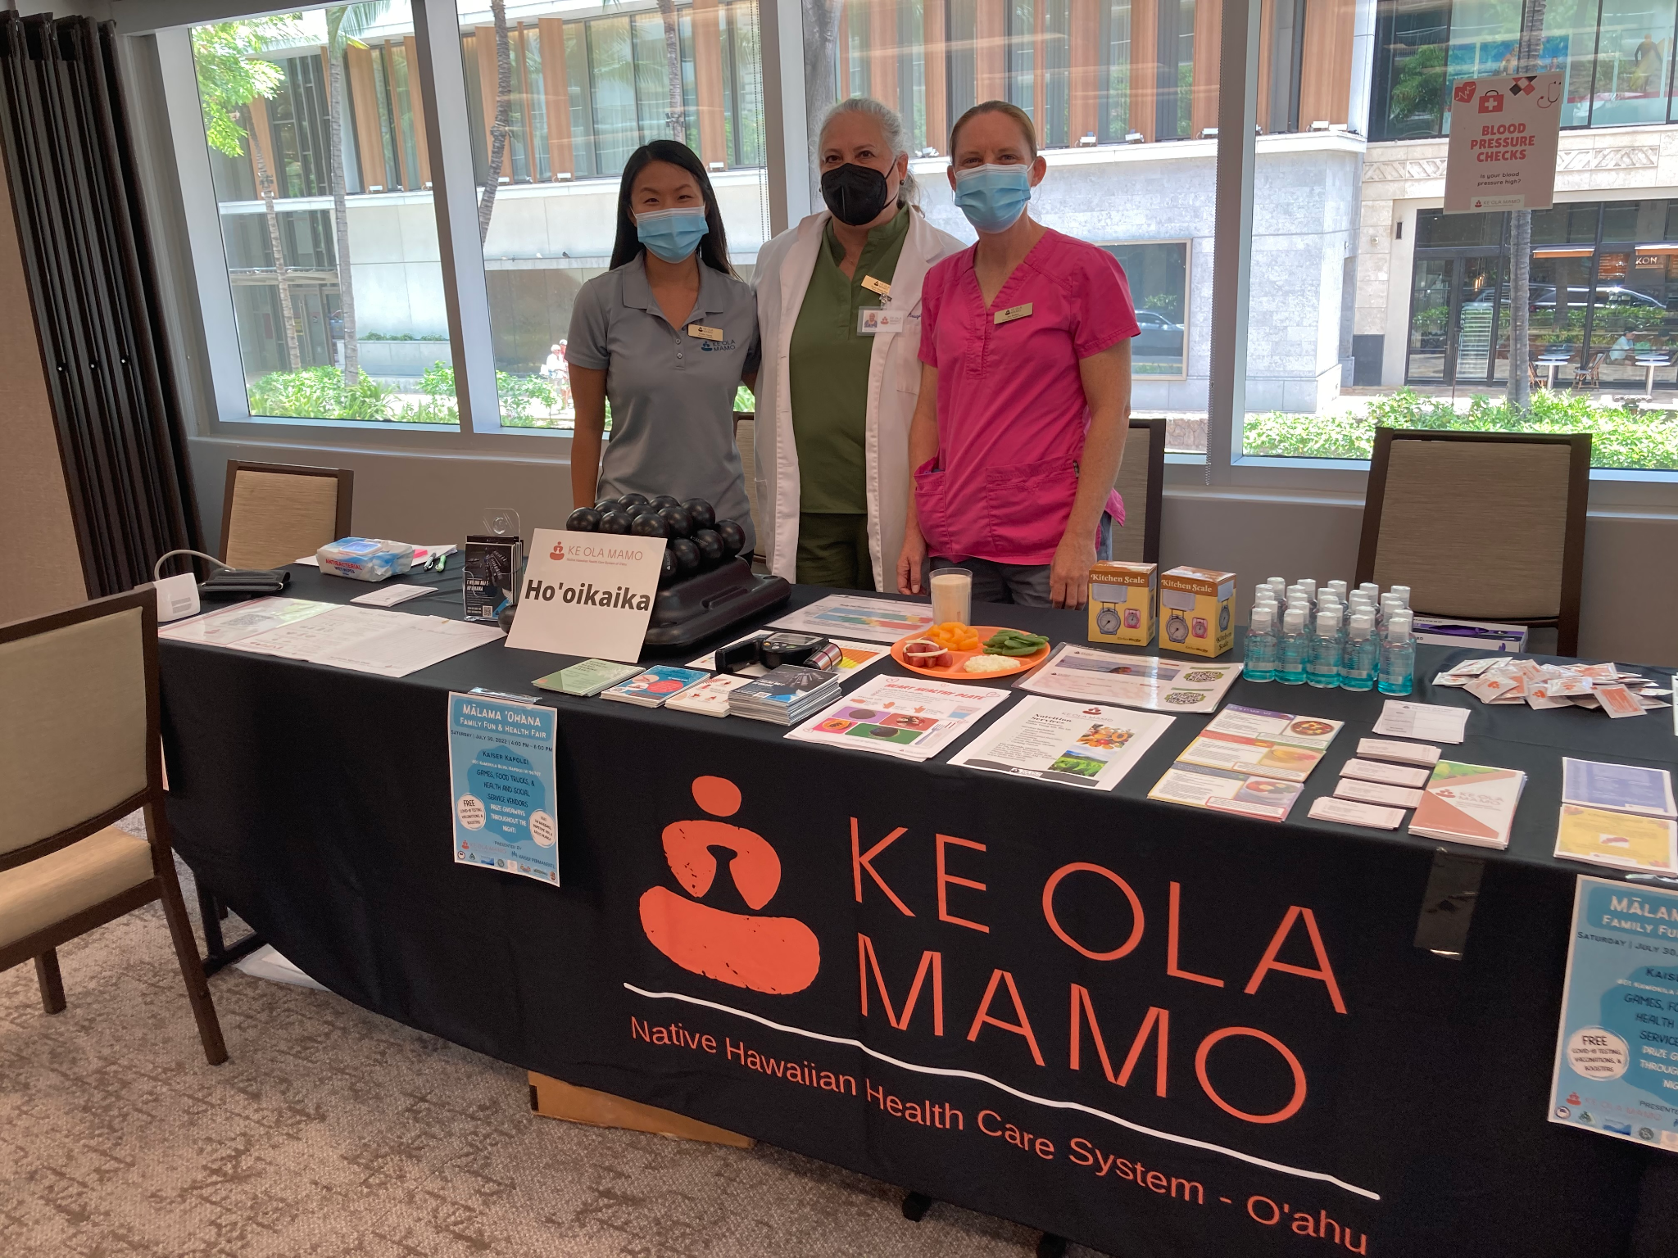
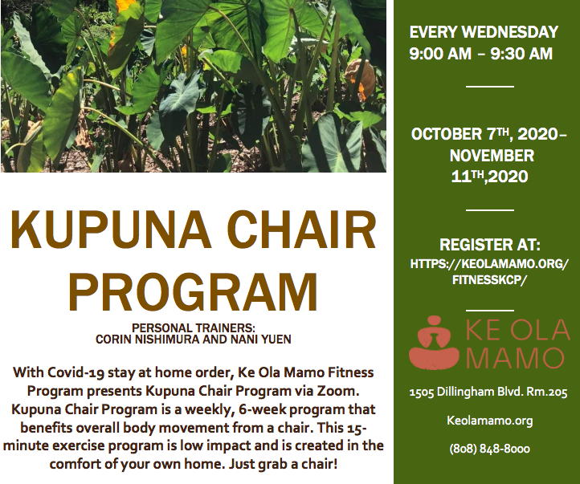
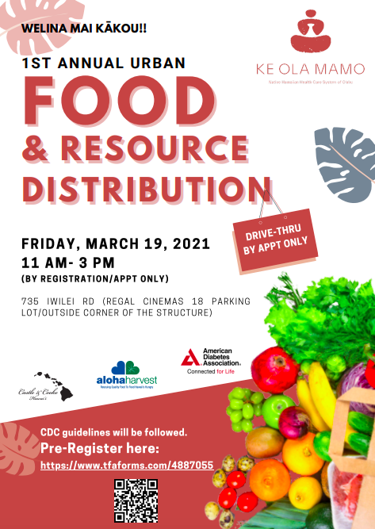
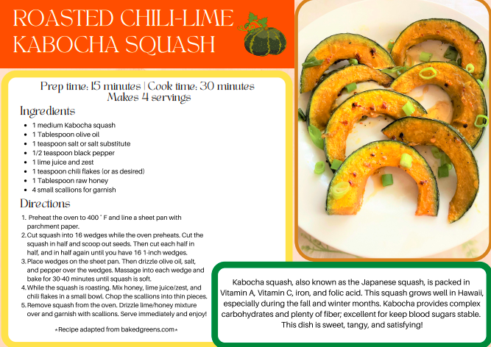
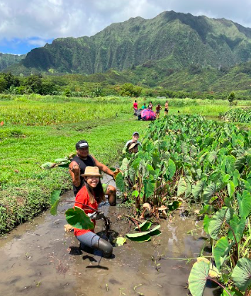
Services & Support
COVID-19
Medical care
Preventive care
Non-clinical services
Collaboration:
Provider
Organization
Community
Notes:
COVID-19: vaccine & testing pods (DOH, QMC, HPH, Waianae), PPE distribution, ARP community outreach
Medical care: telehealth, home visits, primary care, geriatric care, chronic disease management, acute care, end-of-life, psychiatry
Preventive care: BP screening events (Na Aliʻi kupuna convention, Kapolei health fair), other immunizations (flu shots Papakolea, Waimanalo), dental, nutrition & physical activity programs (Alu Like, Waimanalo)
Non-clinical services: food & resource distribution (Urban, Kapolei, Koʻolauloa, Hui Mahiʻai ʻĀina), housing/employment assistance, medical insurance eligibility, connection to services/resources, FCC cell phones
Provider: during medical visits, community/outreach events
Organization
Community: Kula No Na Poʻe Hawaiʻi, Kaiser, Aloha Harvest, Kākoʻo ʻŌiwi, ʻAhahui o nā Kauka

Slide 33
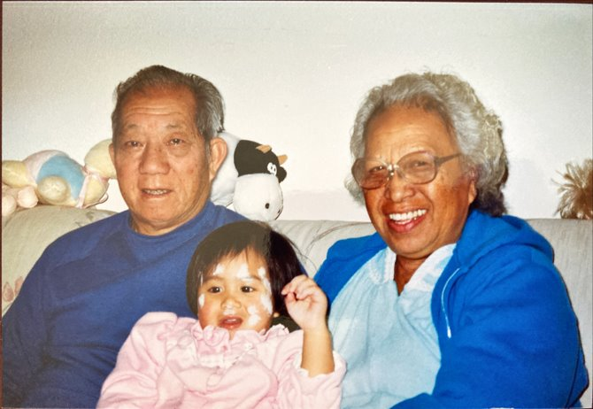
Mahalo!

